Slide 1

Thesis Progress Defense
Towards Developing a limited Magnitude Error Correction Methodology
Supervised By:
Dr. Muhammad Sheikh Sadi
Professor
Department of Computer Science and Engineering
Khulna University of Engineering & Technology(KUET)
Presented By:
Mahmudur Rahman Limon (1607049 )

Slide 2
Outline of The Presentation
Objectives
Introduction
Methodology
Experimental Analysis
Conclusions
References

Slide 3
Objectives
To propose for magnitude error and correction method for multilevel cell memories .
Optimizing the thesis for more bits and reduces the distance between levels.
Perform the error correction code (ECC) properly.

Slide 4
Introduction
MLC (Multilevel cell memory) perform increasing density at low cost for next generation memories & need to Find the error of MLC.
Finding the error through ECC(Error correction code).
ECC protects the memories from error and ensure that the store data is not corrupted.
Interleaved Parity (IP) bits and Single Error Correction and Double Adjacent Error Correction (SEC-DAEC) codes are utilized. The xor of any two adjacent columns is different and also different from all the columns of the matrix.

Slide 5
Methodology
The Scheme is divided into two parts:
Encoder
Decoder
Through the encoder and decoder could found the error.

Slide 6
Encoder
Input the data into encoder
Calculate IP bits
Calculate SEC-DAEC parity bits

Slide 7
Decoder
Found Codeword from memory and given to the decoder.
Generate IP syndrome bits.
Generate SEC-DAEC syndrome bits.
Checking the syndrome bits for getting the error and correct the error.

Slide 8
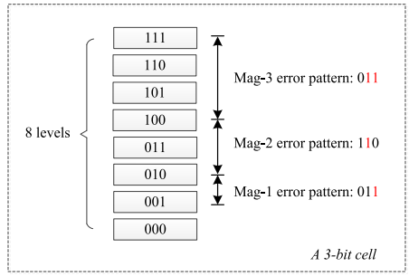
Error Variation
Here Magnitude are 3 types. They are:
Magnitude -1: only for single bit error which
attack lowest bit.
Magnitude -2 : the second lowest bit are changed
through the error.
Magnitude -3 : Both attack the lowest and second
lowest bit.

Slide 9
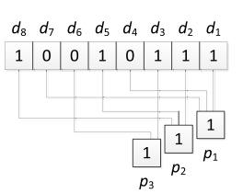
IP(Interleaved Parity)
IP used in binary memories to detect errors that affect adjacent bits.
t bit adjacent errors on k bit data. Here , t = 3 ; k = 8.
pi = di ⊕ di+t ⊕ di+2t ⊕ . . . ⊕ di+j·t
Pi′′ = di ⊕ di′+ t ⊕ di′ + 2t ⊕ . . . ⊕ di′+ j
Si = pi′ ⊕ pi′′
Figure of an IP bits.

Slide 10
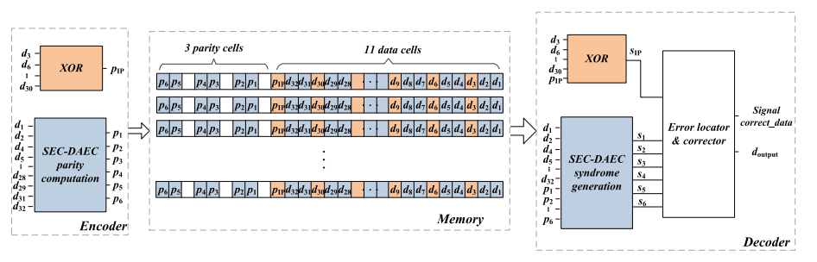
Scheme to project on MLC memory
Figure of Implementation of the proposed scheme.

Slide 11
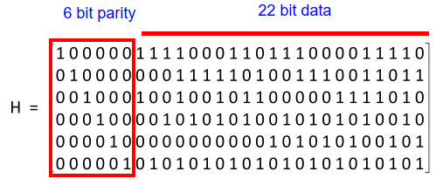
SEC-DEC Code Through the H Matrix
The (28, 22) SEC-DAEC code of [18] with
the H matrix .(P1-P6) are found from here:
IP parity Pip = d30⊕……..⊕d9⊕d6⊕d3 = 1
P1 = d32 ⊕ d31 ⊕……..⊕ d5 ⊕ d4 ⊕ d2 = 1
P2 = d28 ⊕ d26 ⊕……..⊕ d5 ⊕ d2 ⊕ d1 = 1
P3 = d32 ⊕ d28 ⊕……..⊕ d7 ⊕ d5⊕ d2 = 0
P4 = d28 ⊕ d26 ⊕……..⊕ d10 ⊕ d7 ⊕ d2 = 1
P5 = d17 ⊕ d14 ⊕……..⊕ d8 ⊕ d4 ⊕ d1 = 0
P6 = d31 ⊕ d28 ⊕……..⊕ d7 ⊕ d4 ⊕ d1 = 1
Figure of H Matrix

Slide 12
Future Plan of the Thesis
Solving The IP and SEC-DAEC Syndrome and the error up to 64 bits.
Try to solve Increasing density at low cost.
Finding and solving the errors through ECC(Error Correction Code).

Slide 13
Conclusions
The main contribution of this paper is find out IP and SEC-DAEC Syndrome. Checking the syndrome we can be found errors and solve it.
This proposed method requires MLC memory and solve the problems with the ECC code.
The IP Parity and SEC-DAEC Parity are calculated properly.

Slide 14
References:
[1] Codes for Limited Magnitude Error Correction in Multilevel Cell Memories Shanshan Liu , Member, IEEE, Pedro Reviriego , Senior Member, IEEE, and Fabrizio Lombardi , Fellow, IEEE TRANSACTIONS ON CIRCUITS AND SYSTEMS–I: REGULAR PAPERS, VOL. 67, NO. 5, MAY 2020

Slide 15
Thanks to All !

