Slide 1

Thesis
Towards Developing a Limited Magnitude Error Correction Methodology
Supervised By:
Jakaria Rabbi
Assistant Professor
Department of Computer Science and Engineering
Khulna University of Engineering & Technology
(KUET)
Presented By:
Mahmudur Rahman Limon (1607049)

Slide 2
Outline of The Presentation
Objectives
Introduction
Methodology
Experimental Analysis
Conclusions
References

Slide 3
Objectives
To propose for magnitude error and correction method for multilevel cell memories .
Optimizing the thesis for more bits and reduces the distance between levels.
Perform the error correction code (ECC) properly.

Slide 4
Introduction
MLC (Multilevel cell memory) perform increasing density at low cost for next generation memories & need to Find the error of MLC.
Finding the error through ECC(Error correction code).
ECC protects the memories from error and ensure that the store data is not corrupted.
Interleaved Parity (IP) bits and Single Error Correction and Double Adjacent Error Correction (SEC-DAEC) codes are utilized. The xor of any two adjacent columns is different and also different from all the columns of the matrix

Slide 5
Error Detection
Error detection is the ability to detect the presence of errors caused by noise or other impairments during transmission from transmitter to the receiver.
A code word is transmitted one or more number of transmitted will be reversed due to transmission impairments.
Redundancy, a shorter group of bits may be appended to the end of each unit instead of repeating the entire data stream.

Slide 6
Error Detection
Extra data added to a message for the purposes of error detection.
All error detection codes transmit more bits than were in the original data.
The transmitter sends a fixed number of original data bits, followed by fixed number of check bits.
If the values do not match, an error has occurred at some point during the transmission.

Slide 7
Error Correction
Error correction is the detection of errors and reconstruction of the original, error-free data.
To detect and repair faults for successful communication, some error detection and correction methods are utilized.

Slide 8
Various Method for Error Correction
Hamming
BCH code
DMC code
MC codes
Spotty Codes
OLS scheme

Slide 9
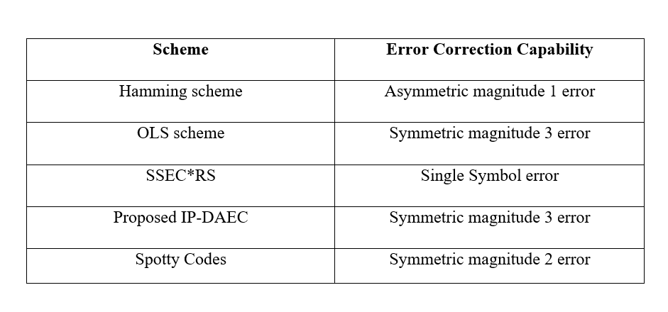
Error Corrections Capabilities in Different Schemes

Slide 10
Methodology
The Scheme is divided into two parts:
Encoder
Decoder
Through the encoder and decoder could found the error.

Slide 11
Encoder
Input the data into encoder
Calculate IP bits
Calculate SEC-DAEC parity bits

Slide 12
Decoder
Found Codeword from memory and given to the decoder.
Generate IP syndrome bits.
Generate SEC-DAEC syndrome bits.
Checking the syndrome bits for getting the error and correct the error.

Slide 13
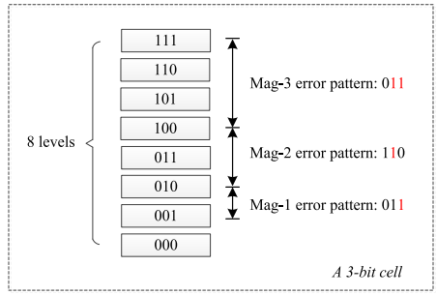
Error Variation
Here Magnitude are 3 types. They are:
Magnitude -1: only for single bit error which
attack lowest bit.
Magnitude -2 : the second lowest bit are changed
through the error.
Magnitude -3 : Both attack the lowest and second
lowest bit.

Slide 14
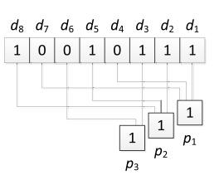
IP(Interleaved Parity)
IP used in binary memories to detect errors that affect adjacent bits.
t bit adjacent errors on k bit data. Here , t = 3 ; k = 8.
pi = di ⊕ di+t ⊕ di+2t ⊕ . . . ⊕ di+j·t
Pi′′ = di ⊕ di′+ t ⊕ di′ + 2t ⊕ . . . ⊕ di′+ j
Si = pi′ ⊕ pi′′
Figure of an IP bits.

Slide 15
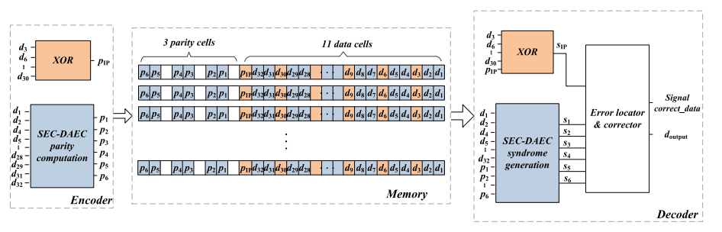
Scheme to Project on MLC Memory
Figure of Implementation of the proposed scheme.

Slide 16
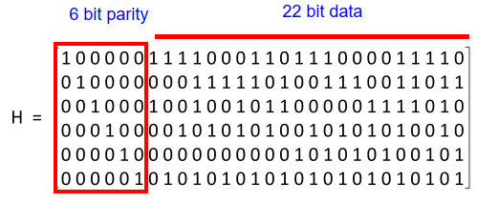
SEC-DEC Code Through the H Matrix
The (28, 22) SEC-DAEC code of [18] with the H matrix .(P1-P6) are found from here:
P1 = d32 ⊕ d31 ⊕……..⊕ d5 ⊕ d4 ⊕ d2 = 1
P2 = d28 ⊕ d26 ⊕……..⊕ d5 ⊕ d2 ⊕ d1 = 1
P3 = d32 ⊕ d28 ⊕……..⊕ d7 ⊕ d5⊕ d2 = 0
P4 = d28 ⊕ d26 ⊕……..⊕ d10 ⊕ d7 ⊕ d2 = 1
P5 = d17 ⊕ d14 ⊕……..⊕ d8 ⊕ d4 ⊕ d1 = 0
P6 = d31 ⊕ d28 ⊕……..⊕ d7 ⊕ d4 ⊕ d1 = 1
Figure of H Matrix

Slide 17
Future Plan of the Thesis
Solving The IP and SEC-DAEC Syndrome and the error up to 64 bits.
Try to solve Increasing density at low cost.
Finding and solving the errors through ECC(Error Correction Code).

Slide 18
Conclusions
The main contribution of this paper is find out IP and SEC-DAEC Syndrome. Checking the syndrome we can be found errors and solve it.
This proposed method requires MLC memory and solve the problems with the ECC code.
The IP Parity and SEC-DAEC Parity are calculated properly.

Slide 19
References:
[1] W. A. Bhat, “Is a data-capacity gap inevitable in big data storage?” Computer, vol. 51, no. 9, pp. 54–62, Sep. 2018.
[2] G. Atwood, S.-I. Chae, and S. S. Y. Shim, “Next-generation memory,” Computer, vol. 46,no. 8, pp. 21–22, Aug. 2013.
[3] N. Papandreou et al., “Multilevel phase-change memory,” in Proc. IEEE Int. Conf. Electron. Circuits Syst., Dec. 2010, pp. 1017–1020.
[4] G. S. Sandhu, “Emerging memories technology landscape,” in Proc. 13th Non-Volatile Memory Technol. Symp., Jul. 2014, pp. 1–5.

Slide 20
References:
[5] X. P. Wang, Z. Y. Wang, and Y. Shen, “A high reliable design of memristor-based multilevel memory,” in Proc. IEEE 34th Chin. Control Conf., Sep. 2015, pp. 5615–5618.
[6] (Nov. 2019). Intel Optane Memory. [Online]. Available: https://www. intel.com/content/www/us/en/support/products/99745/memory-andstorage/intel-optane-memory.html
[7] J. Li, B. Luan, and C. Lam, “Resistance drift in phase change memory,” in Proc. IEEE Int. Rel. Phys. Symp. (IRPS), Apr. 2012, p. 6C-1.

Slide 21
Thanks to All !

