Slide 1
Computing Vision
Business Proposal
November 2022.

Slide 2
Agenda
1
Overview and Business Understanding
2
Data Understanding and Analysis
3
Recommendation
4
Next Steps

Slide 3
Overview & Business Understanding

Slide 4




Overview
Computer vision proposal
Evaluate business needs
Determine our key questions
Computer Vision wants to create original video content in their newly formed movie studio.
What type of films would be best?
Conduct data exploration
Data cleaning
Useful Insights
Create data driven recommendations
Statistic Analysis
Data Visualizations

Slide 5
As a new movie , what are the business needs?
NEW MOVIE STUDIO

Slide 6
What does a successful movie means?
SUCCESSFUL
Notes:
Tags: statement, quote, callout

Slide 7
How much should be spend for a higher return of investm ?
RETURN OF INVESTMENT
Notes:
Tags: statement, quote, callout

Slide 8
Data Understanding & Analysis

Slide 9
Data Understanding & Analysis
Multiple Sources of Data
Findings
Box Office
IMDB
Rotten Tomatoes
Movie DB
The Numbers
Six datasets (.csv) with more than 26 thousand movies.
Information about genres, budgets, release dates, directors, ratings, reviews, etc…
Data Cleaning & Exploration
Categorization of budgets
Relation between budget and ROI
Average ROI by budget
Choosing of budget dataset with 5,782 entries and 6 columns.
Cleaning, rename and formatting.
Descriptive analysis and statistics.
Hypothesis Testing

Slide 10
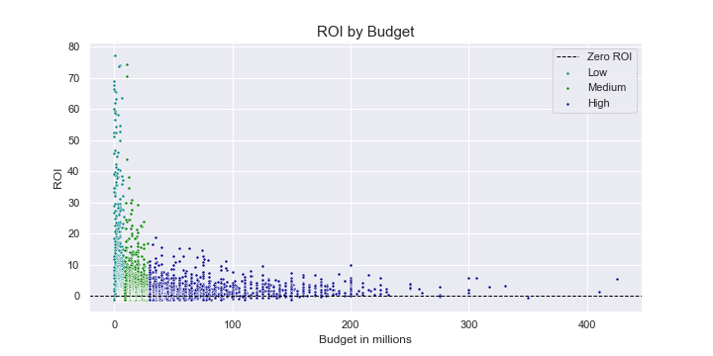
The Findings
Data Exploration
Production budgets can go high.
Budgets can go from just a couple of thousand dollars to hundred of millions!
Percent of Movies with Revenues
Key Takeaways
75%
Successful Rate
+ $30 million budget
Low Budget
< $8 million
Low Budget
- $8 million
Medium Budget
< $29 million
$10.17
Increase in Per Capita Spend (Team Games)
High Budget
> $30 million
(Yes, there are some points below 0)
*Based on The Numbers dataset of production budget and worldwide gross.
Notes:
Explain how you divide the data

Slide 11
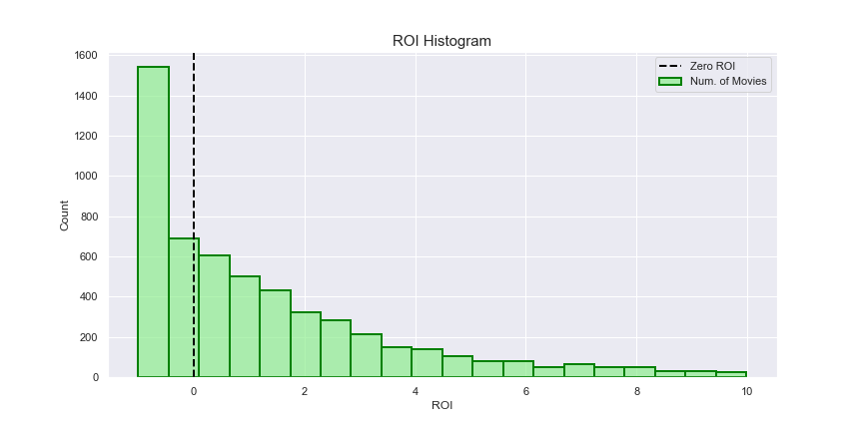
The Findings
Data Exploration
Not all movies have profits.
High density of movies doesn’t get any amount of ROI.
Percent of Movies with Revenues
Key Takeaways
75%
Successful Rate
+ $30 million budget
There is a significant number of movies that are not profitable.
$10.17
Increase in Per Capita Spend (Team Games)
36%
*Based on The Numbers dataset of production budget and worldwide gross.
It keeps going!

Slide 12
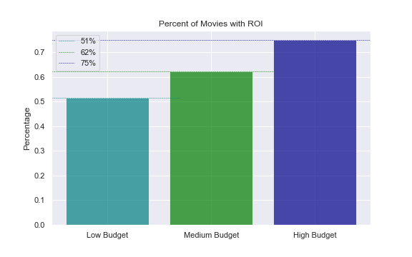
The Findings
Data Exploration
But high budget movies tends to have a higher successful rate.
From a dataset of almost 6,000 movies, we found that 75% of movies with a high budget ( + $30 million budget) had an actual profit, vs 51% of low budget movies (- $8 million budget)
Percent of Movies with Profits
Key Takeaways
75%
Successful Rate
+ $30 million budget
62%
Successful Rate
+ $8 million & - $30 million
51%
Successful Rate
- $8 million budget
*Based on The Numbers dataset of production budget and worldwide gross.

Slide 13
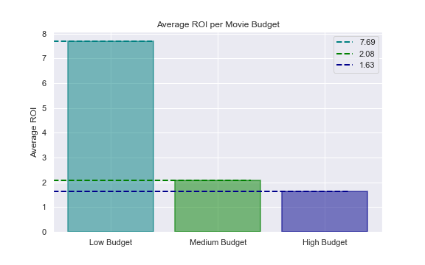
The Findings
Data Exploration
The ROI is significantly higher for low budget movies.
Even though low budget movies have a successful rate of 51%, the average ROI is much higher than the rest of the movies.
Average ROI
Key Takeaways
7.69
ROI
Low Budget Movies
2.08
ROI
Medium Budget Movies
1.63
ROI
High Budget Movies
*Based on The Numbers dataset of production budget and worldwide gross.

Slide 14
The Recommendation

Slide 15
The recommendation
Diversify!
Notes:
More direct recommendation!

Slide 16





The higher the risk, the higher the return.
The recommendation
HIGH BUDGET MOVIES
LOW BUDGET MOVIES
Of the movies have a return of their investment.
75%
51%
Of the movies have a return of their investment.
A + $30 million production budget will give you a lower risk of failure but also a lower return of the investment.
A - $8 million production budget will be a higher risk of failure but also a much higher return of the investment.
1.63
7.69
Average ROI
Average ROI
Notes:
More direct recommendation!

Slide 17
Next Steps

Slide 18
Now what?
Next steps
WHY DO SOME MOVIES FAIL?
WHICH ARE THE MOST PROFITABLE MOVIES?
PROFITABLE MOVIES ARE RELATED WITH POPULARITY?
PROFITABLE GENRES
WHICH AUDIENCE?

Slide 19
Thank You! Any questions?
Dámaris Flores Albores: dfloresalbores@deloitte.com

