Slide 1
TI-ARDI
Reactor Pattern

Slide 2
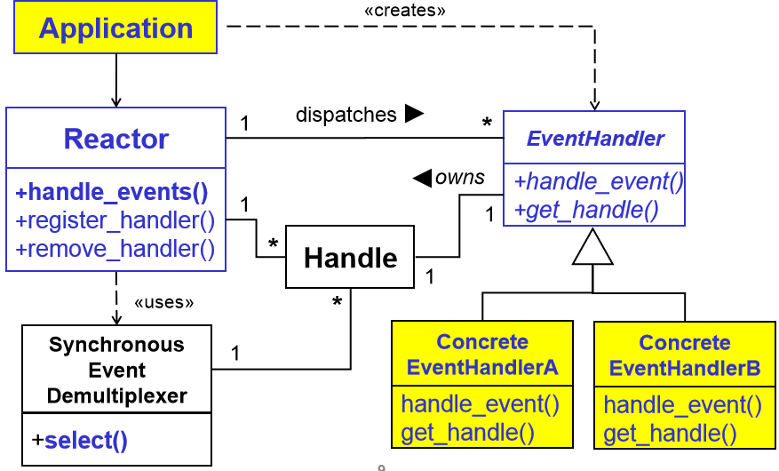

Slide 3
