Slide 1
TI-ARDI
Paradigms for Distributed Communication

Slide 2
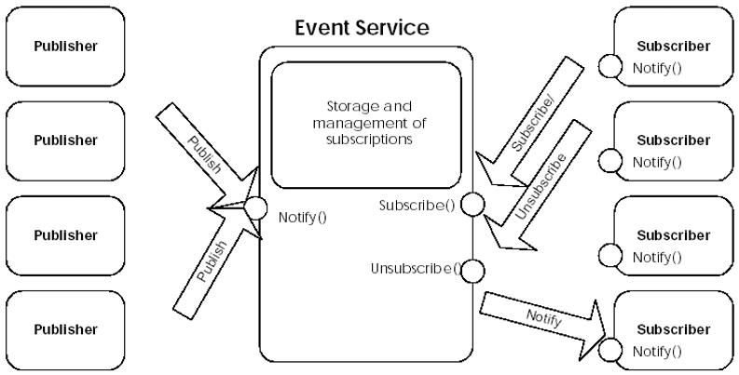

Slide 3
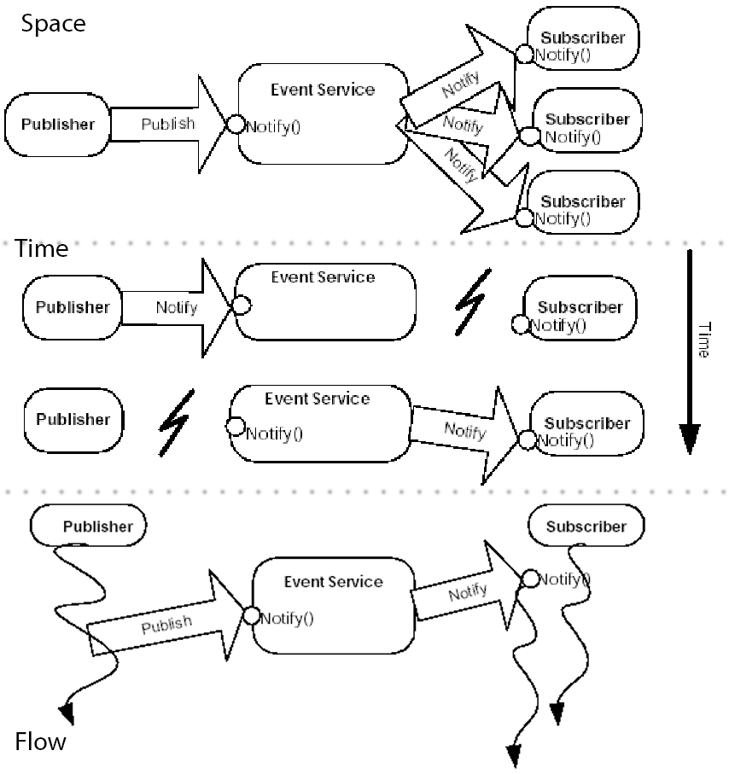

Slide 4
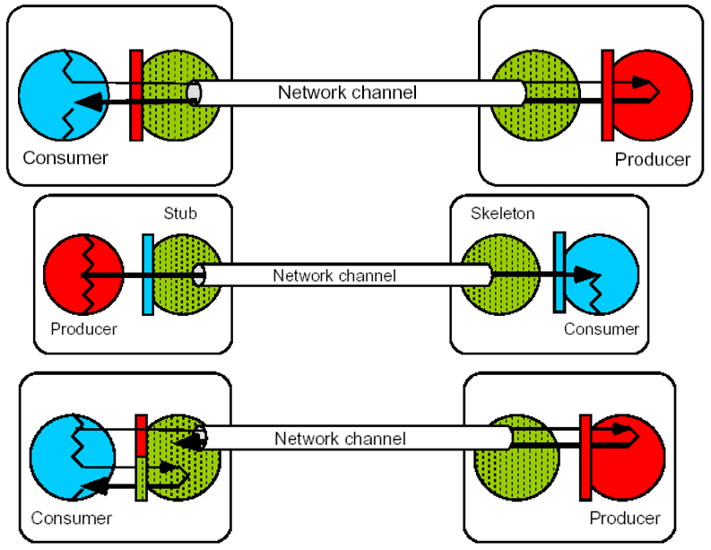

Slide 5
