Slide 1
TI-ARDI
Acceptor/Connector Pattern

Slide 2
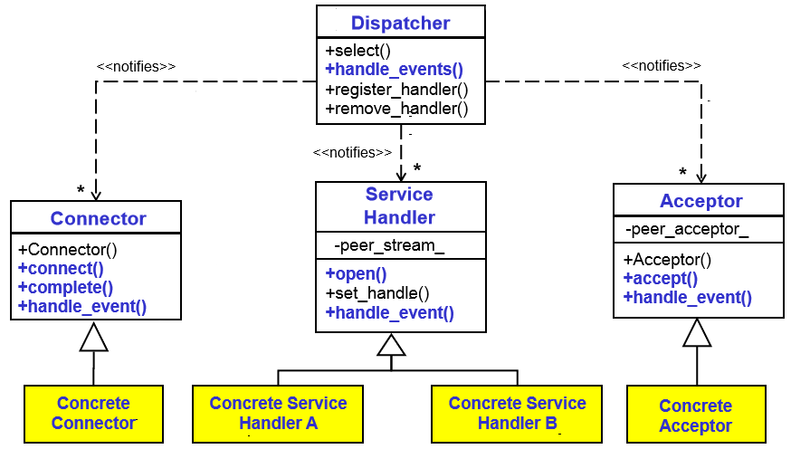

Slide 3
