Slide 1
TI-ARDI
Proactor and ACT Patterns

Slide 2
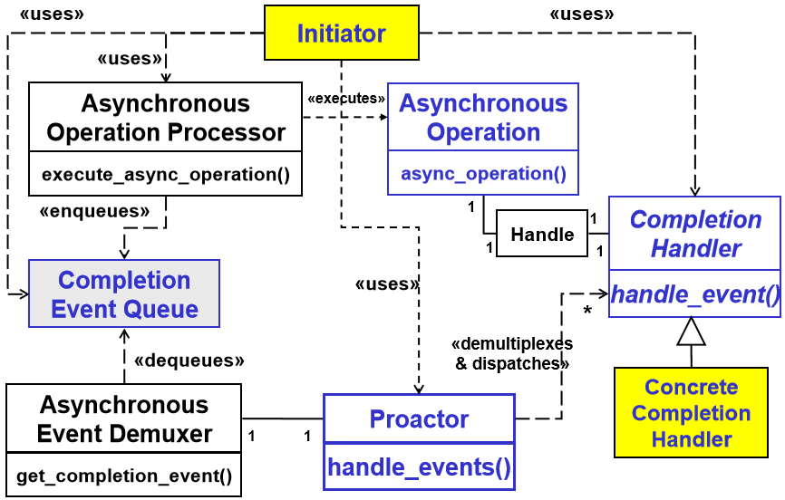

Slide 3
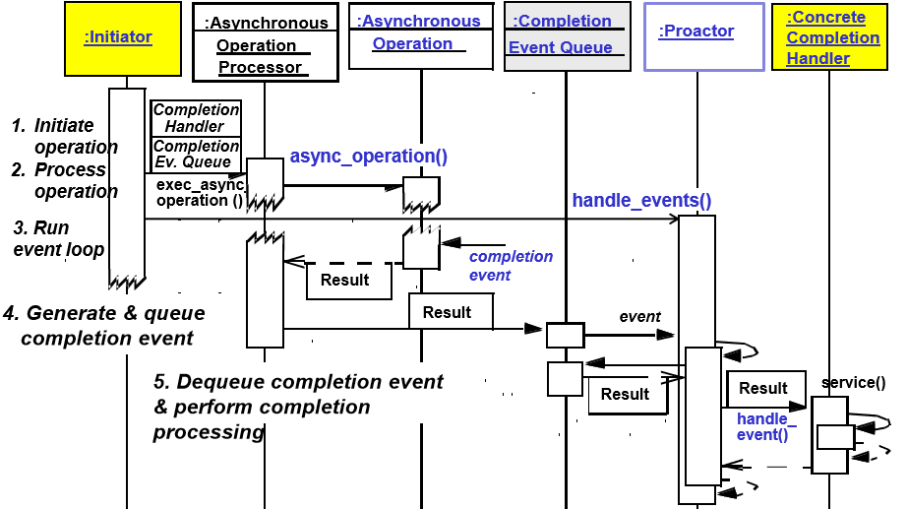

Slide 4
