Slide 1
TI-ARDI
Architecture Trade Off Analysis Method (ATAM) and Architecture Documentation

Slide 2
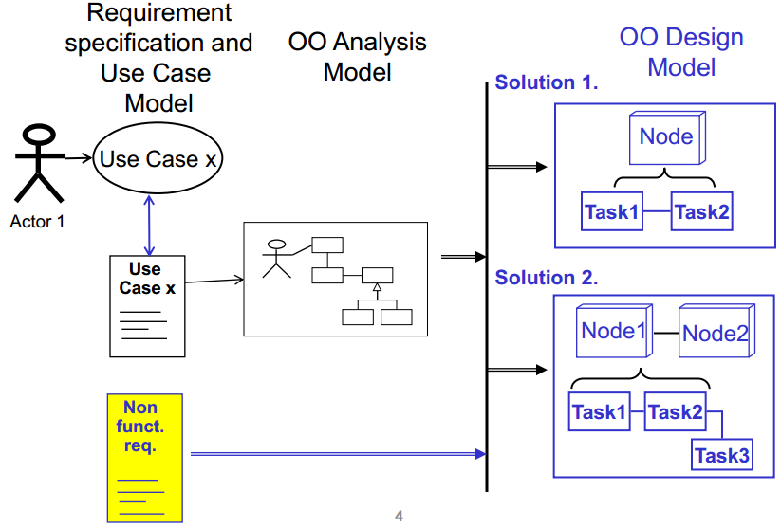

Slide 3
