Slide 1
TI-ARDI
Leader/Followers Pattern and Half sync/half async Pattern

Slide 2
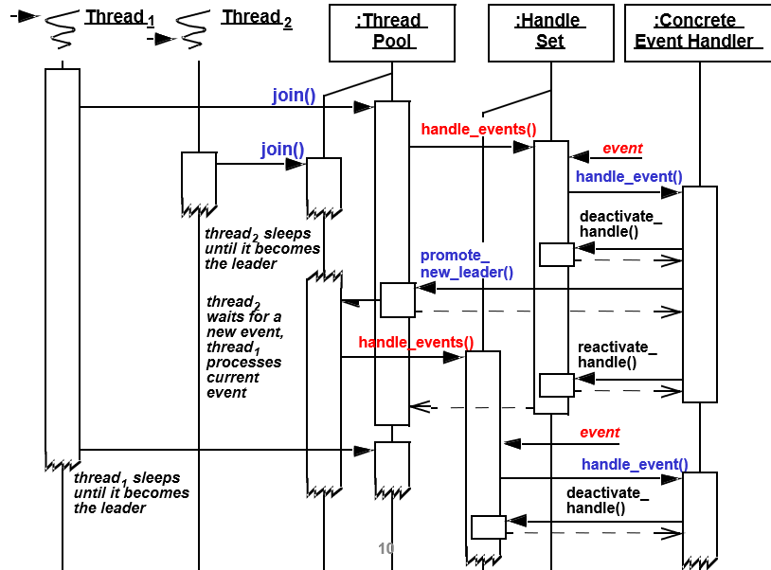

Slide 3
