Slide 1
TI-ARDI
Interceptor Pattern

Slide 2
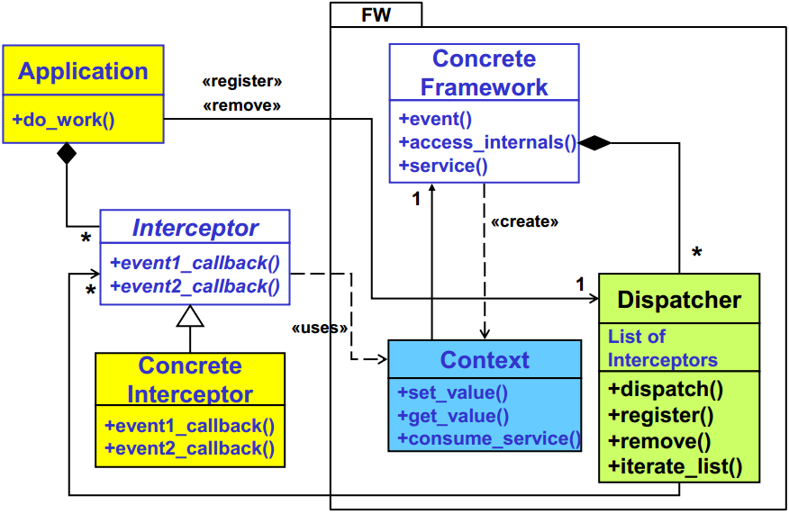

Slide 3
