Slide 1
TI-ARDI
Component Configurator Pattern

Slide 2
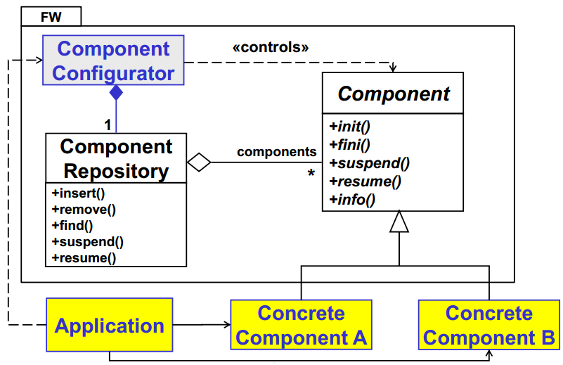

Slide 3
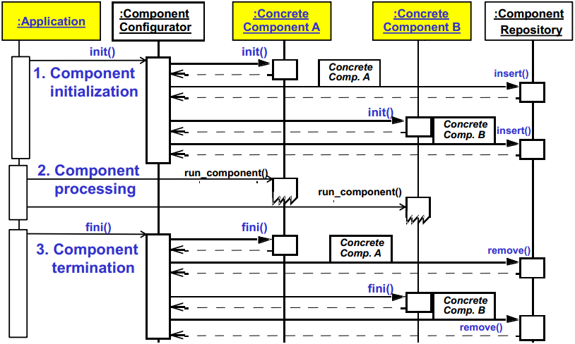

Slide 4
