Slide 1
ADVANCED PERVASIVE COMPUTING
Lecture 2: Distributed Context Awareness
Stefan Wagner
sw@eng.au.dk

Slide 2
AGENDA
Context
Context Awareness
Context Modelling & Reasoning
Distributed Context Awareness
EnablingTechnologies
PAN technologies
LAN/WAN technologies
Frameworks for Distributed Context Awareness:
  The Context Toolkit
  The Java Context Awareness Framework (JCAF)

Slide 3
CONTEXT
Context is derived from the Latin word: contextus
from con- “together” and texere “to weave”.
Context is fundamental to human cognition, which is the act or process of
knowing, including perceiving, recognizing, conceiving, and reasoning.
Words, sentences, images, and experiences can be fundamentally
differently interpreted when served to the user in a different context
McCracken & Wolfe (2004)
Context is the circumstances that form the setting for an event, statement,
or idea, and in terms of which it can be fully understood
Oxford Dictionay (2012)

Slide 4
CONTEXT
Plenty of definitions of context exists in pervasive computing:
1. A context describes a situation and the environment a device or user is in.
2. A context is identified by a unique name
3. For each context a set of features is relevant.
4. For each relevant feature a range of values is determined (implicit or explicit) by the context.
Schmidt (1999)
A set of environmental states and settings that either determines an application’s
behavior or in which an application event occurs and is interesting to the user
Chen & Kotz (2000)
Any information that can be used to characterize the situation of an entity. An entity
is a person, place, or object that is considered relevant to the interaction between a
user and an application, including the user and the applications them-selves
Dey (2010)
The five W’s (Who, What, Where, When, Why) is the minimum information that is
necessary to understand context.
Abowd and Mynatt (2010)

Slide 5
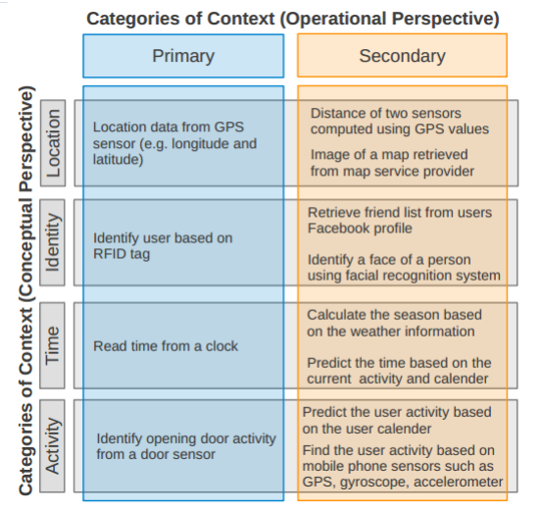
CONTEXT

Slide 6
CONTEXT AWARENESS
Again, several definitions exists:
Context-aware computing is the ability of a mobile user's applications to
discover and react to changes in the environment they are situated in.
In our system mobile users run software that is constantly monitoring, or
subscribing to information about the world around them.
Schilit & Thiemer (1994)
A system is context-aware if it uses context to provide relevant information
and/or services to the user, where relevancy depends on the user’s task.
Dey (2010)

Slide 7
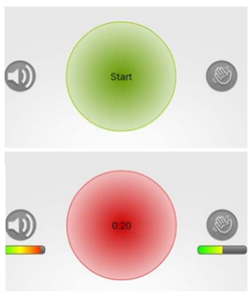
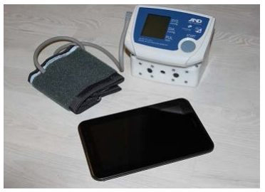
CONTEXT AWARENESS
Three features that context-aware applications may support:
    1) Presentation of information and services to a user
    2) Automatic execution of a service
    3) Tagging of context to information for later retrieval
Abowd et al. (1999)

Slide 8
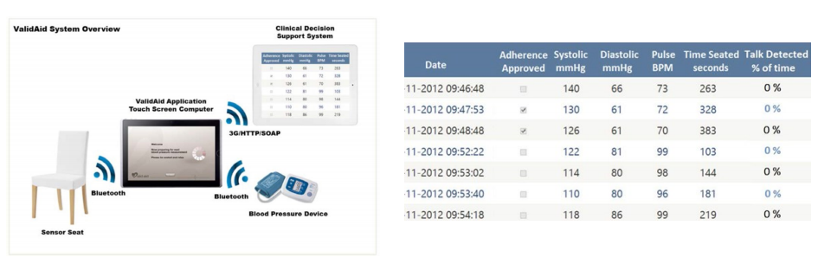
CONTEXT AWARENESS
Two main categories of context awareness:
  1) Infrastructure-based context awareness
  2) Self-contained context awareness
Varshney (2009)

Slide 9
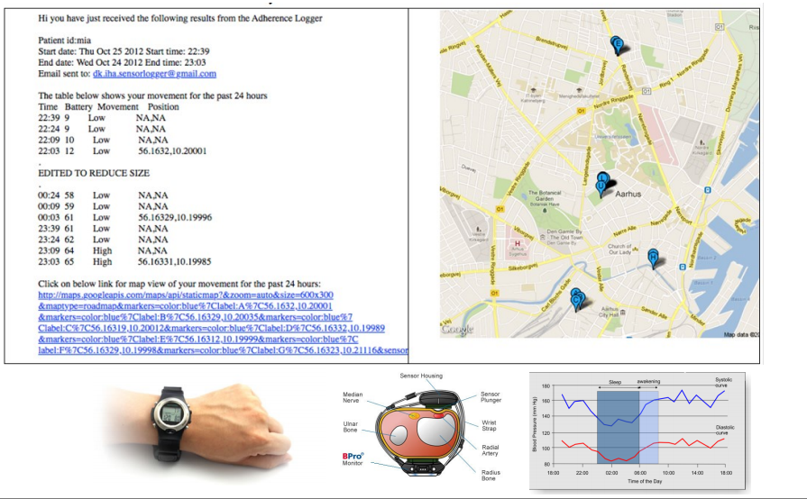
CONTEXT TAGGING

Slide 10
CONTEXT MODELS
A context model identifies a concrete subset of the context that is
realistically attainable from sensors, applications and users and able to be
exploited in the execution of the task. The context model that is employed
by a given context-aware application is usually explicitly specified by the
application developer, but may evolve over time.
A context attribute is an element of the context model describing the
context. A context attribute has an identifier, a type and a value, and
optionally a collection of properties describing specific characteristics
Henricksen (2003)

Slide 11
CONTEXT MODELS
Key-Value models
      These models represent the simplest data structure for context modeling. They are frequently used in various service frameworks, where the key-value pairs are used to describe the capabilities of a service. Service discovery is then applied by using matching algorithms which use these key-value pairs.
Markup scheme models
      All markup based models use a hierarchical data structure consisting of markup tags with attributes and content.
Object oriented models
      Modeling context by using object-oriented techniques offers to use the full power of object orientation (e.g., encapsulation, reusability, inheritance). Existing approaches use various objects to represent different context types (such as temperature, location, etc.), and encapsulate the details of context processing and representation.

Slide 12
CONTEXT MODELS
Logic based models
      Logic-based models have a high degree of formality. Typically, facts, expressions and rules are used to define a context model. A logic based system is then used to manage the aforementioned terms and allows to add, update or remove new facts. The inference (also called reasoning) process can be used to derive new facts based on existing rules in the systems. The contextual information needs to be represented in a formal way as fact.
Ontology based models
      Ontologies represent a description of the concepts and relationships. Therefore, ontologies are a very promising instrument for modeling contextual information due to their high and formal expressiveness and the possibilities for applying ontology reasoning techniques. Various context-aware frameworks use ontologies as underlying context models

Slide 13
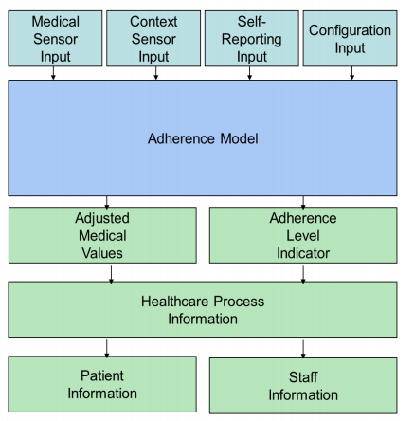
CONTEXT MODELS
Adherence Strategy Engineering Toolkit (ASET)

Slide 14
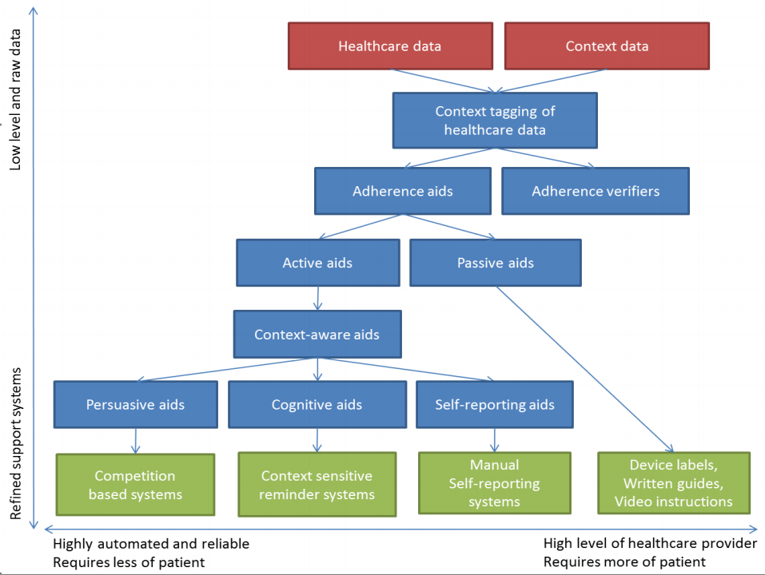


Slide 15
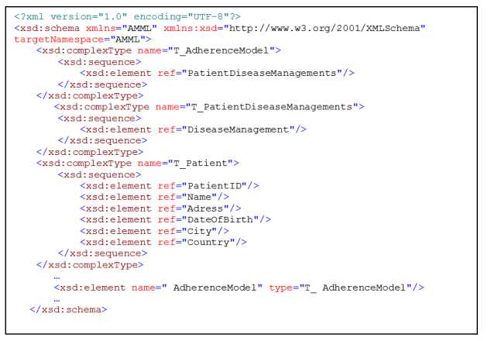
CONTEXT MODELS
Adherence Model Markup Language (AMML)

Slide 16
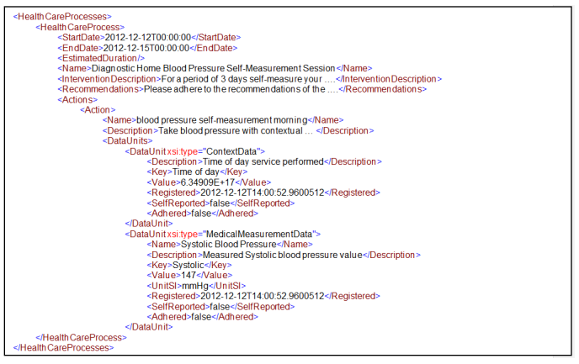
CONTEXT MODELS
AMML sample document

Slide 17
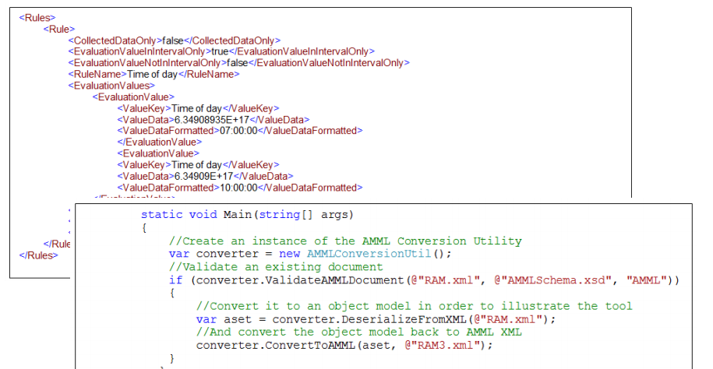
CONTEXT MODELS
Using AMML with ASET

Slide 18
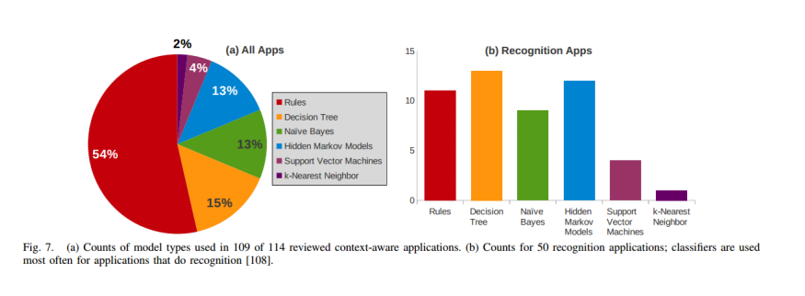
CONTEXT REASONING
Context Reasoning and Interpretation
      Raw context data is often too noisy and too vague to provide the true context state of an entity
      By combining current context event data with historic events from one or mulitple context sensors, this will allow us to determine a ”hidden state” based on the sensor fusion of one or more ”visible states”
      Various approaches possible: Rule based logic, Hidden Markov Models, Bayesian Networks, Artificial Neural Networks, Support Vector Machines, Ontology based, Fuzzy reasoning, k-nearest neighbor

Slide 19
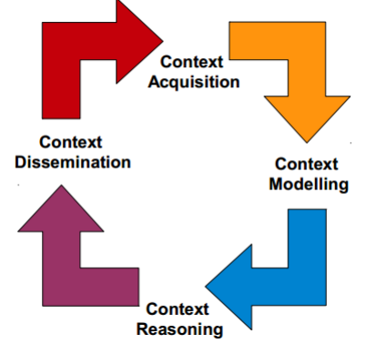
CONTEXT LIFECYCLE

Slide 20
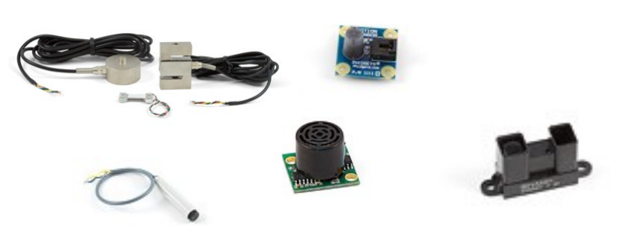
ENABLING TECHNOLOGIES
Sensors
    Movement, proximity, distance, sound, temperature, light, gas, pressure, acceleration, gyroscope, magnetometer, altimeter

Slide 21
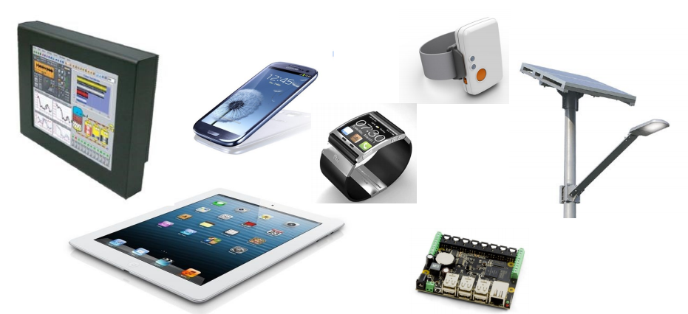
ENABLING TECHNOLOGIES
Sensor Platforms
    Personal computer, smart phone, tablet, smart watch, mobile sensor node, smart space computer (car, room, street-light)

Slide 22
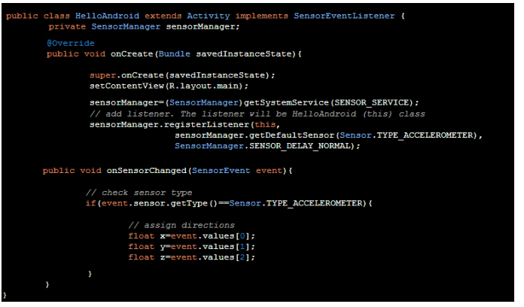
ENABLING TECHNOLOGIES
Programming API’s
    Easy access to tablet/smart phone/smart watch sensors
    Easy access to computer based prototyping with context sensors

Slide 23
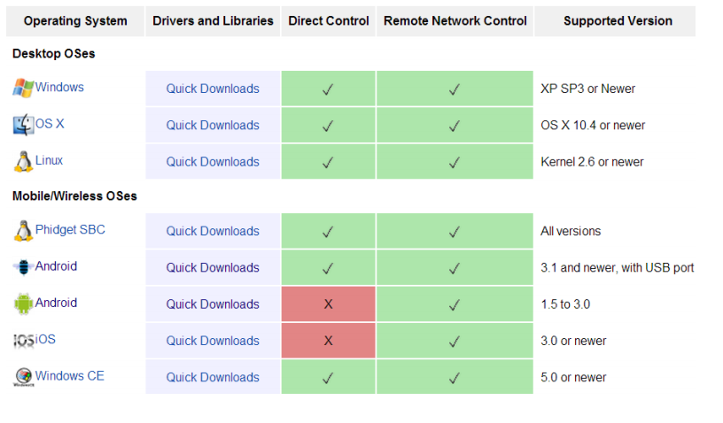
PHIDGETS OS SUPPORT

Slide 24
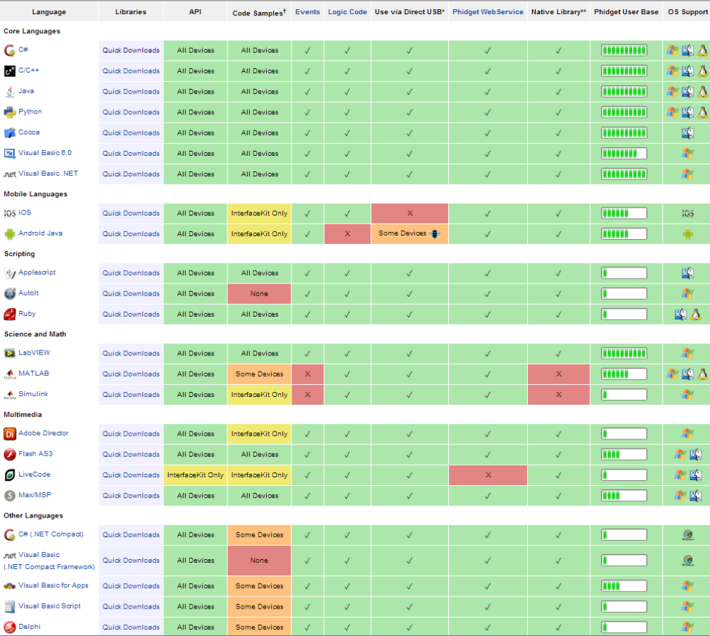

Slide 25
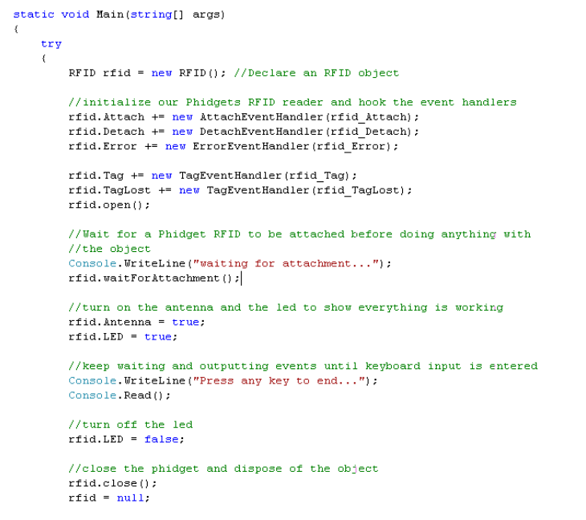
PHIDGETS PROGRAMMING

Slide 26
DISTRIBUTED CONTEXT AWARENESS
Self-contained context awareness is limited
    - using context-aware sensors on a local device can only update part of the model
    - often only simple causality updates – when person present -> do task
    › - hard to make elaborate and accurate models – e.g. of activitites of daily living
Infrastructure-based context awareness
    - enables sensor fusion of multiple context sensor types
    - environment based, body worn, virtual,
    - requires support for distribution of sensor data

Slide 27
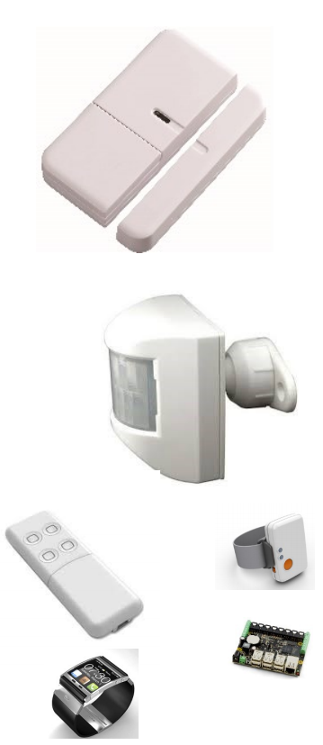
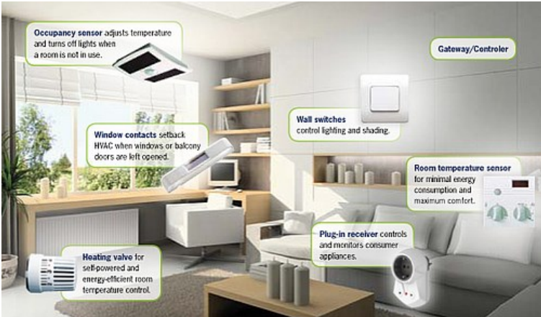
ENABLING TECHNOLOGIES
PAN Technologies
  Z-Wave, ZigBee, Bluetooth, ENOCEAN
LAN/WAN Technologies
    TCP/IP, HTTP/SOAP/WS/Web services, CORBA, Java RMI, ICE, DDS, Thrift

Slide 28
WEB SERVICES
Provides a simple and heterogenous distribution model
    1. Standard HTTP/SOAP based Web services (WS-*) o
    2. HTTP/JSON/XML Web services (REST)
Wide spread support
    › - Language and platform access transparency through open standards
    › - Location transparency through HTTP prototocol
    › - Built-in firewall traversal through HTTP
    › - Security, scalability, and reliability services with WS-*
    › Easy to design a distributed context aware service infrastructure
    › Alternative to existing distributed context awareness frameworks

Slide 29
DISTRIBUTION MIDDLEWARES
Alternatives to Web services:
      1. Basic socket (UDP/TCP/IP/HTTP): extremely high heterogenity, but error-prone and no built-in services. Scalability/security/reliability very problematic.
        2. Java Remote Method Invocation (Java RMI): tight coupling with Java, Java Standard Edition only, fast but requires router access for WAN communications. Limited features and only one vendor. Security problematic.
        3. Common Object Request Broker Architecture (CORBA): heterogenity high, large number of vendors, impressive number of services and features available, steep learning curve, large differences in products.
        4. Internet Communication Engine (ICE): comparable to CORBA but faster and simpler, license can be an issue, and only one version.
        5. Data Distribution Service (DDS): comparable to CORBA but event based and with quality of service parameters. Limited open source availability.
  Exercise:
        Make a matrix of the technologies above (use google) in order to identify which distribution technology is best suited in your opinion

Slide 30
CONTEXT FRAMEWORKS
1. Context Toolkit, Dey et al. (2001)
2. Gaia project (Roman et al., 2002)
3. Context Managing Framework, Korpipää et al. (2003)
4. Context Broker Architecture (CoBrA) Chen et al. (2003)
5. Service-Oriented Context-Aware Middleware (SOCAM), Gu et al. (2004)
6. Context-Awareness Sub-Structure (CASS), Fahy & Clarke (2004)
7. Java Context Aware Toolkit (JCAF), Bardram (2006)
8. Hydra, Badii et al. (2009)
9. MidSen Patel et al. (2009)
10. COPAL, Li et al. (2010)
11. ComiHOC, Wibisono et al. (2010)
12. Octopus, Firner et al. (2011)
› In the following we will discuss 1 and 7 in detail

Slide 31
COMMON FRAMEWORK CHALLENGES
Most available context awareness frameworks and middleware's face a range of challenges:
    1. Available in Java only or supported on a single platform only
    2. Overly complex and not ”real world operational”
    3. Limited flexibility in the design
    4. Limited security/scalability/reliability transparency
    5. Limited context sensor support
    6. Limited documentation and tutorials
    7. Firewall transversal limited or not possible
    8. Dependent on a centralized server architecture
In conclusion: are they really worth the hassle?
Consider starting from scratch, or using a very basic low level framework
Context frameworks may act as “best practice” guides

Slide 32
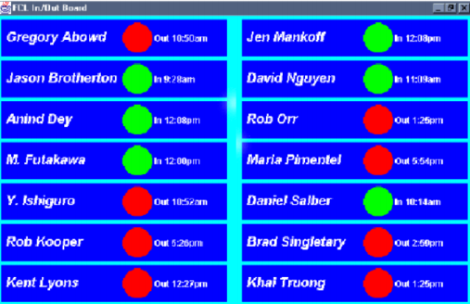
CONTEXT TOOLKIT
Toolkit for distributed context-aware apps
    - framework for acquiring and handling context
    - Standard components
Three key abstractions
    – Widgets, Interpreters, and Aggregators

Slide 33
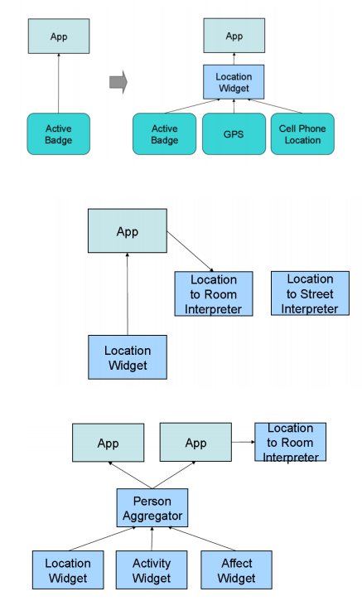
CONTEXT TOOLKIT
Context Widget
      Is a software component that:
      - provides application access to context information
      - encapsulates context acquisition
Context Interpreters
      Converts context to higher level information
Context Aggregators
      Collects context relevant to particular entities
Context Services
      Component for executing services (actuators)
Context Discoverers
      Registry of capabilities in the framework

Slide 34
CONTEXT TOOLKIT
Technical design:
    Written in Java
    Custom HTTP protocol
    Basic port to C#, VB, Flash
    No security/reliability/scalability features
    No ”out of the box” sensors supported
    http://contexttoolkit.sourceforge.net/

Slide 35
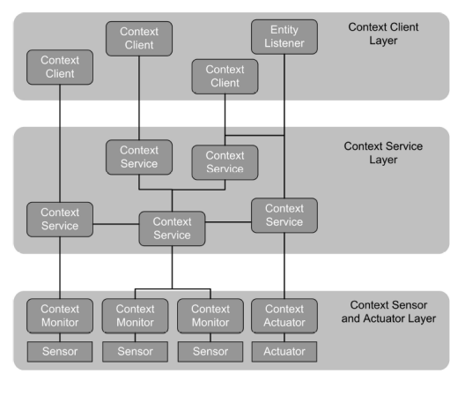
JAVA CONTEXT-AWARENESS FRAMEWORK
JCAF Runtime Infrastructure

Slide 36
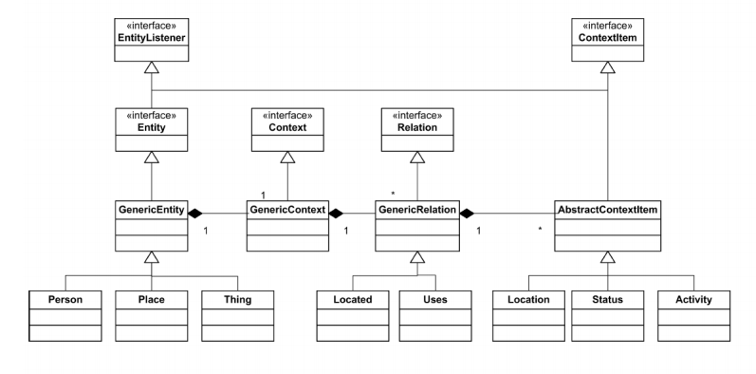
JAVA CONTEXT-AWARENESS FRAMEWORK
JCAF Context Model

Slide 37
JAVA CONTEXT-AWARENESS FRAMEWORK
Technical Design:
  Developed in Java
  Requires
      - Java RMI for distribution model
      - JAAS for security
  Limited heterogeneity (only Java Standard Edition)
  Firewall issues
  No ”out of the box” sensors supported
  http://sourceforge.net/projects/jcaf/

Slide 38
EXERCISE AND HAND-IN
Exercise 2:
      Learn how to contact a distributed fixed sensor via a Web service and acquire its data for use in a context aware system.
      Learn how to contact a mobile wireless sensor via Bluetooth and acquire its data for use in a context-aware system.
Hand-in 2:
      Make a UML Deployment diagram of a pervasive system consisting of a bed sensor, and four movement sensors (in the four rooms of a sample home), where all five sensors sends a context event to a central computer (gateway). Also, describe in ½ a page of text: 1) which specific technologies can be used to implement this (hardware nodes, network, middleware), and 2) how these sensors may be used to detect serious incidents - such as serious falls, and detecting dementia patients suffering from insomnia
      Must be solved in groups of 3-4. Must be handed in on Campusnet. 3) consider how a wearable sensor node (such as the Shimmer) can be used to supplement the ambient infrastructure based sensors.

