Slide 1
ADVANCED PERVASIVE COMPUTING
Lecture 4: Intelligent Environments
and Activity Classification
Stefan Wagner
sw@iha.dk
Presentation :
A Basic Introduction to Pervasive Computing

Slide 2
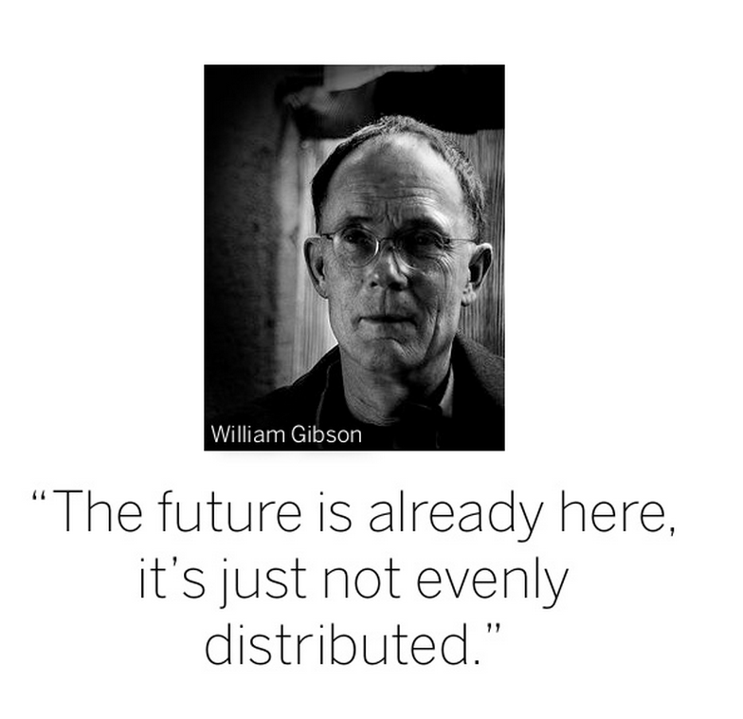
AGENDA
Intelligent Environments
Smart Cities
Smart Homes
Smart Spaces
User interfaces
AAL Smart Homes
ADL
IE Challenges
Focus for Exam

Slide 3
INTELLIGENT ENVIRONMENTS
Intelligent environments are spaces in which computation is seamlessly used to enhance ordinary activity (Steventon &Wright 2006)
One of the driving forces behind the emerging interest in highly interactive environments is to make computers not only genuine user-friendly but also essentially invisible to the user (Steventon &Wright 2006)

Slide 4
SMART HOMES
A smart home is an application of pervasive computing in a specific environment – a home.
Several synonyms are used for smart home technology:
smart house, home automation, domotique, intelligent home,
adaptive home, aware house, aware home
The smart home concept is the integration
of different services within a home by using a common
communication system. It assures an economic, secure, and
comfortable operation of the home and includes a high degree
of intelligent functionality and flexibility (Lutolf 1992)
A home or working environment, which includes the technology to allow the devices and systems to be controlled automatically, may be termed a smart home (Berlo et al. 1999)

Slide 5
SMART HOME
“A smart home is a residential setting equipped with a set of advanced electronics, sensors and automated devices specifically designed for care delivery, remote monitoring, early detection of problems or emergency cases and promotion of residential safety and quality of life. Information and Communication Technologies (ICTs) are utilized to allow individuals to live independently in their preferred environment. Thus, systems are patient-centered rather than institution-centered as they are designed to address the needs of individuals, their families and caregivers rather than those of health care facilities.” (International Medical Informatics Association, Working Group on Smart Homes and Ambient Assisted Living 2011)
This definition limits smart home technologies to one user group

Slide 6

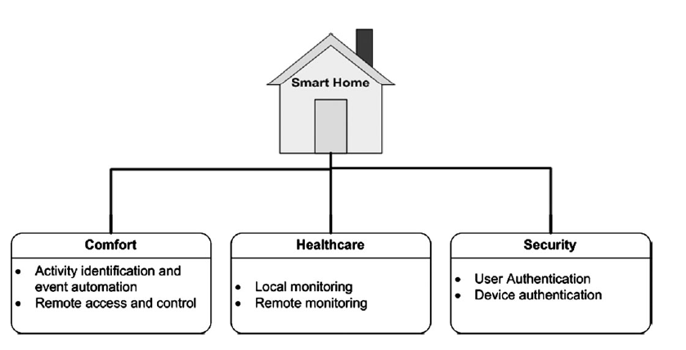
SMART HOME TAXONOMY
(Alam et al. 2012)

Slide 7
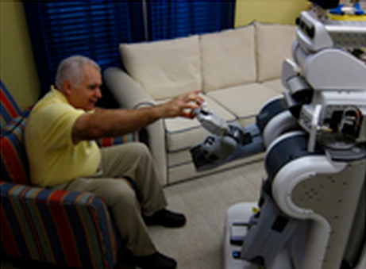
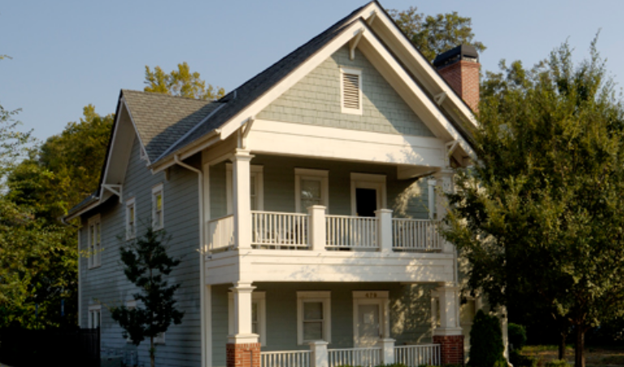
SMART HOME OBJECTIVES
Improving the user experience
      efficiency
      comfort
      healthcare
      safety
      security
      energy conservation

Slide 8
FOCUSING COURSE EFFORTS
Intelligent Environments
Smart Cities
Smart Homes
Smart Spaces
AAL
ADL

Slide 9
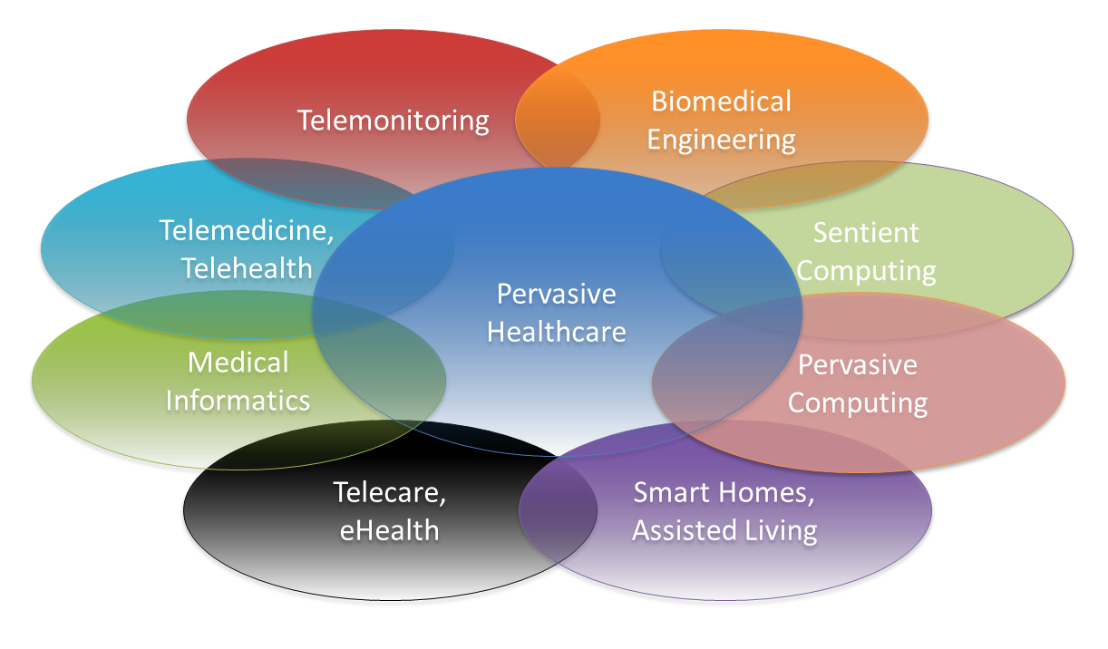
AMBIENT ASSISTED LIVING
Several uses for smart home technology
    Example: Ambient assisted living
        - Safety (fall detection/prevention), self-care (dressing, bathing, cooking, medication), telehealth

Slide 10
ACTIVITIES OF DAILY LIVING
Activities of Daily Living (ADL), as
deﬁned by the medical community, are:
“the things we normally do in daily living including any daily activity we perform for self-care (such as feeding ourselves, bathing, dressing, grooming), work, homemaking, and leisure” (Fleury et al. 2010)
    The ability to self care can be modeled using an ADL scale as a standardized measure of a persons ability to self care as compared to the “normal” range
    The ability to correctly self-measure, self-medicate, and self-exercise can be modeled using AMML, which is related to self care
    Other relevant modeling could include safety hazards, energy consumption, artifact tracking and discovery, and more

Slide 11
ADL SCALE (KATZ & AKPOM 1976)
Bathing (sponge bath, tub bath, or shower),
      receives either no assistance or assistance in bathing only one part of the body
Dressing,
      ﬁnds clothes and dresses without any assistance except for tying shoes.
Toilet use,
      goes to the toilet, uses toilet, dresses, and returns without any assistance (may use cane or walker for support and may use bedpan/urinal at night)
Transferring
      moves in and out of bed and chair without assistance (may use cane or walker).
Continence,
      full control of bowel and bladder.
Feeding,
      feeds without assistance (except for help with cutting meat or buttering bread).
Depending on the answer yes or no to each of these questions, geriatricians compute the ADL score of the elderly person. This scale is internationally recognized as one of the references.

Slide 12
ADL MONITORING
Can be achieved by using distributed context sensor technology
Sensors
      Infrastructure-based, wearable, stand-alone, collaborating
Network infrastructure
      Cabled, wireless (WiFi, Zwave, ZigBee), web services, CORBA, DDS, ICE
Context model
      Context toolkit, JCAF, own implementation, other
Context reasoning engine
      First order logic, Bayesian networks, HMM, SVM, Decision tree
  Actuators
      User interfaces, external communication, service robots, automatic ventilation
Software frameworks for rapid prototyping important for domain comprehension

Slide 13
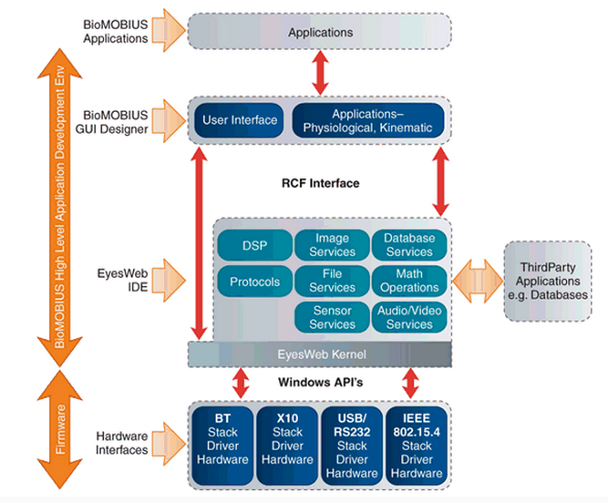
FRAMEWORKS
Activity Classification Rapid Prototyping Toolkits
    OpenCare RELEI
    SPINE
    BioMOBIUS
    Shimmer3 Prototyping Tools

Slide 14
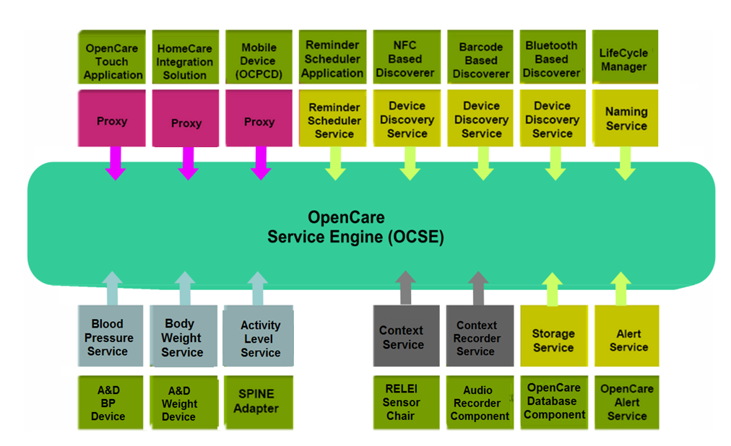

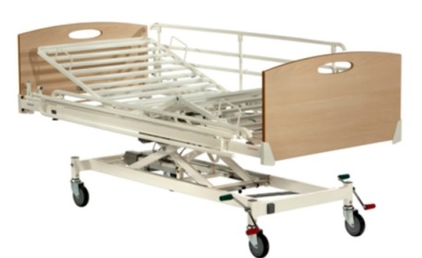
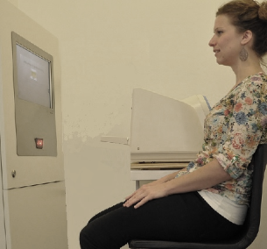
OPEN CARE SERVICE ENGINE
  Middleware (MAF/WS/ICE) based communication infrastructure broker
… or combine your own components

Slide 15
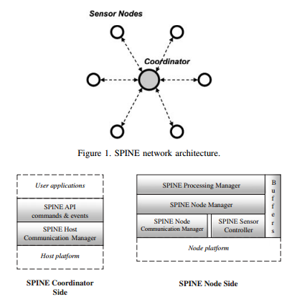
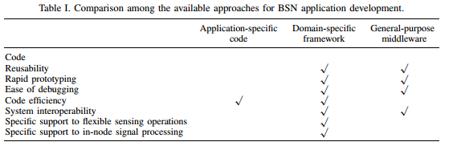
SPINE
SPINE (Signal Processing in Node Environment) is a software Framework for the design and fast prototyping of Wireless Body Sensor Network (BSN) applications. SPINE enables efficient implementations of signal processing algorithms for analysis and classification of sensor data through libraries of processing functionalities. It also embeds an application-level communication protocol.
(Bellifemine et al. 2010)

Slide 16
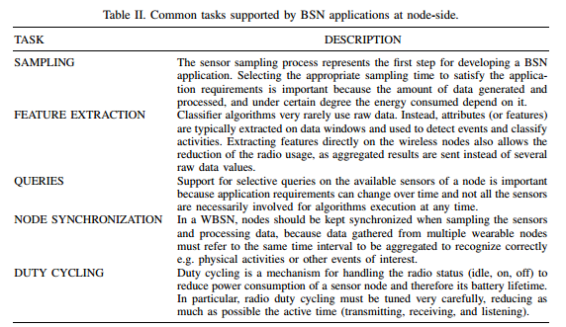
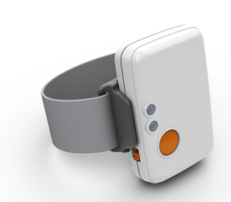
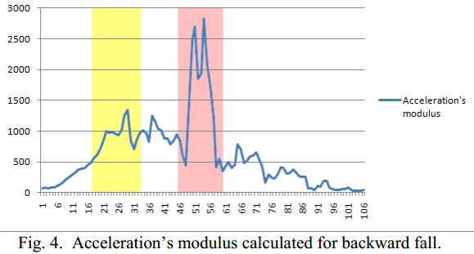
SPINE

Slide 17
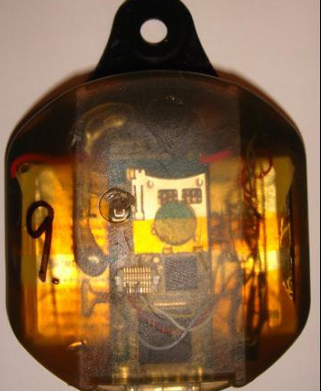
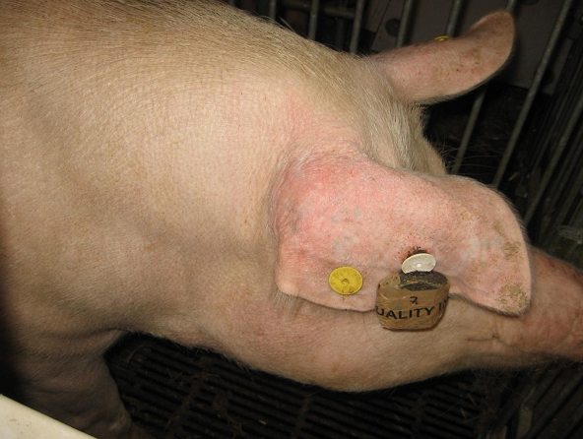
SPINE USAGE
Activity tracking of humans
Fall detection
Farrowing behavior of pigs

Slide 18
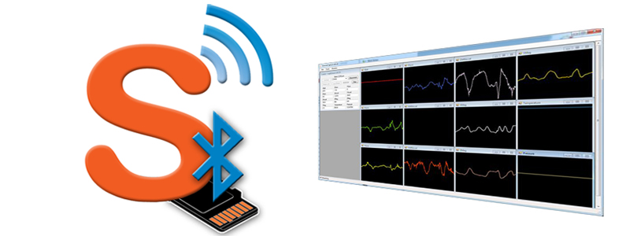
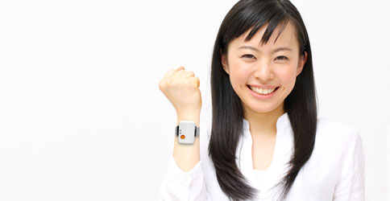
SHIMMER3
X | Y | Z | X2 + Y2 + Z2 | SQRT(D)
-0,1992188 | 1,021484 | 0,1601563 | 1,108767733 | 1,052980405
-0,3476563 | 0,9580078 | 0,06445313 | 1,042798054 | 1,02117484
-0,2226563 | 0,9580078 | 0,04882813 | 0,969738959 | 0,984753248
-0,2636719 | 0,9609375 | 0,04882813 | 0,995307936 | 0,99765121
-0,2607422 | 0,9609375 | 0,04394531 | 0,993318564 | 0,996653683
-0,2529297 | 0,9589844 | 0,04296875 | 0,985470826 | 0,992708832
-0,2509766 | 0,9423828 | 0,02636719 | 0,951769824 | 0,975586913
-0,2988281 | 0,9433594 | 0,04492188 | 0,981243166 | 0,990577188
-0,2539063 | 0,9560547 | 0,03125 | 0,979485561 | 0,989689629
-0,2646484 | 0,9501953 | 0,02636719 | 0,973605112 | 0,986714301
-0,2587891 | 0,9570313 | 0,03710938 | 0,984257814 | 0,992097683
-0,2587891 | 0,9599609 | 0,03613281 | 0,989802308 | 0,994888088
-0,2646484 | 0,9521484 | 0,03515625 | 0,977861313 | 0,988868704
-0,265625 | 0,9541016 | 0,02148438 | 0,981328082 | 0,990620049
-0,2685547 | 0,9521484 | 0,04785156 | 0,980997974 | 0,990453419
-0,2626953 | 0,9550781 | 0,04589844 | 0,983289665 | 0,991609633
-0,2626953 | 0,9599609 | 0,04785156 | 0,992823522 | 0,9964053
-0,2519531 | 0,9589844 | 0,03710938 | 0,98450855 | 0,992224042
-0,2519531 | 0,9589844 | 0,04394531 | 0,985062634 | 0,992503216
-0,2744141 | 0,9521484 | 0,04199219 | 0,983653018 | 0,99179283
-0,2548828 | 0,9550781 | 0,02929688 | 0,977997726 | 0,988937675
-0,2822266 | 0,9521484 | 0,0390625 | 0,987764308 | 0,993863325
-0,2666016 | 0,9570313 | 0,04101563 | 0,988667604 | 0,994317658
-0,265625 | 0,9589844 | 0,03808594 | 0,991658259 | 0,995820395
-0,265625 | 0,9541016 | 0,04199219 | 0,982629848 | 0,991276877
-0,2714844 | 0,9492188 | 0,04296875 | 0,976566423 | 0,988213754
-0,2685547 | 0,9550781 | 0,04199219 | 0,986059148 | 0,99300511
-0,2763672 | 0,9501953 | 0,0390625 | 0,980775816 | 0,990341263
-0,2773438 | 0,9521484 | 0,05175781 | 0,98618503 | 0,993068492
 | Standing | Running | Lying | Walking
Mean | 1,00 | 1,51 | 1,00 | 1,09
Median | 0,99 | 1,57 | 1,00 | 1,01
Std Dev | 0,02 | 0,64 | 0,00 | 0,35
Sample Variance | 0,00 | 0,42 | 0,00 | 0,12
Minimum | 0,95 | 0,00 | 0,99 | 0,48
Maximum | 1,17 | 2,79 | 1,00 | 2,67
Count | 108 | 108 | 108 | 108

Slide 19
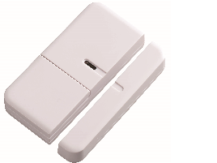
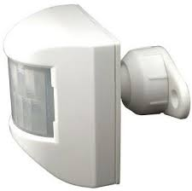

IE SENSOR CHALLENGES
  Sensors
        Which types are relevant for current activity recognition?
        How many?
        What cost?
        Problems with interference and network topology needed
        Autonomous or connected
        Power consumption
        Active vs. Passive
        Communication
        Time to interface
  Networking
        Wired vs. Wireless
        Protocol(s)
        Bandwidth
        Power consumption
        Range
        Topology

Slide 20
IE CONTEXT MODEL CHALLENGES
  Data storage
        Size
        Query rate
        Active vs. Passive
        Decision-making
        Communication
  Prediction and Decision-Making
        Dynamic/static, learning algorithms / temporal patterns
        Data relevance
        Sensor fusion
        Real-time
        Autonomy

Slide 21
IE SYSTEM CHALLENGES
  System architecture
      Agent-based vs. monolithic
      Hierarchical vs. flat
      Distributed vs. centralized control
      Open vs. closed
  Systems integration
      Plug-n-play
      Existing appliances
  Use frameworks
      (JCAF, SPINE,)
      Build your own framework
  Privacy and Security
        Unwanted surveillance
        “Break-ins”

Slide 22
CASE STUDY
Calm Ambient Medication Reminder System
  Use a PIR sensor for detecting user presence
  Use a medication box sensor for detecting medication taken
  Only remind the patient to take medication after “grace” period
  Ensure patient only takes his medication once per day
  Use calm reminders
  Use speech as an interface
  Consider how to reuse sensors for other purposes?

Slide 23
FOCUS FOR ORAL EXAM
Read about Intelligent Environments, Smart Spaces, and Smart Homes
Make sure to couple todays manuscripts to the ubiqutious computing, calm computing, and context toolkits and frameworks (especially JCAF and the Context Toolkit) literature
Make sure to read about ADL and how this can be quantified using distributed context sensor technology
Make sure to read about fall detection – and how this can be classified
Go back to the distributed context sensor lesson – and check for specific sensor technologies that may be used as “enabling technologies”
Make sure to read about types of ubicomp user interfaces for Intelligent Environments
Make sure to read about SPINE – and figure out whether it is a better approach than manual Shimmer3/TinyOS programming – e.g. for fall detection – or just using a SmartPhone
Do not focus on the SVM model – or other approaches to context reasoning or feature extraction. These topics will be covered by Christian (though not SVM) – and we will not ask you to pay close attention to SVM and other reasoning models from the current papers
Make sure to note most of the IE challenges and even elaborate on them if relevant

Slide 24
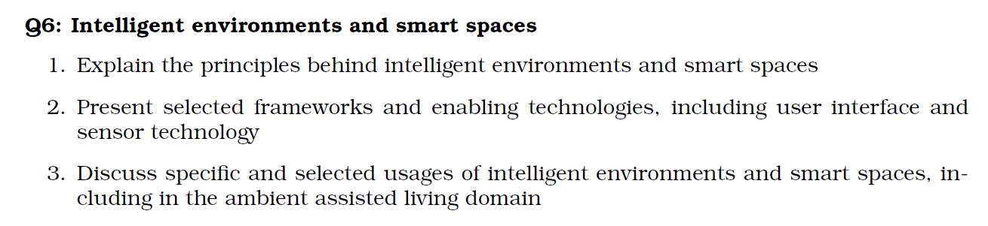
2013 EXAM QUESTION

