Slide 1
ADVANCED PERVASIVE COMPUTING
Lecture 5: Zero configuration and service discovery
Stefan Wagner
sw@eng.au.dk
Presentation :
A Basic Introduction to Pervasive Computing

Slide 2
AGENDA
Introduction
Addressing
Naming
Service Discovery
Bonjour Service Names
Publication Steps
Discovery Steps
Resolution Steps
Conclusion
References

Slide 3
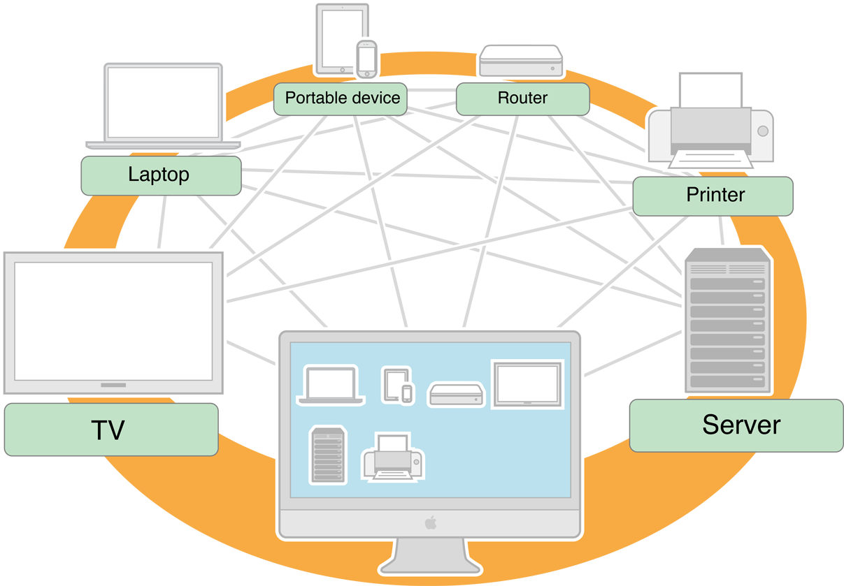

Slide 4
INTRODUCTION
Main objective:
    Automatic discovery of devices and network services without prior configuration
    End-users should not know about endpoints and naming servers
This implies:
    1) Allocate addresses without a DHCP server (IPv4 Link-Local Addressing)
    2) Translate names and IP addresses without a DNS server (Multicast DNS)
    3) Find services, like printers, without a directory server (DNS Service Discovery)
Solutions:
    AppleTalk (ethernet) 1985
    AirTalk (wifi) 1999
    Standardization efforts: Zeroconf Working Group 1999
    Bonjour (Apple)
    Avahi (Avahi)
    UPnP (UPnP forum)

Slide 5
STANDARDIZATION EFFORTS
IETF Zeroconf Working Group
  The Internet Engineering Task Force (IETF®)
  Established (September 1999)
Dynamic Configuration of IPv4 Link-Local (2005)
  Assign addresses without a DHCP (RFC 3927)
Zero Configuration DNS free name look-up (2013)
  Multicast DNS or mDNS (RFC 6752)
Service Discovery Protocols (2013)
  DNS Service Discovery or DNS-SD (RFC 6763)
Bonjour supports 3927, 6752, and 6763, UPnP only 3927
Bonjour version 1 (2005)
  Apples version of zero configuration
Bonjour version 2 (2010)
  Available on OSX, iOS, Windows, BSD and Linux
IPv4: 169.254.0.0/16
IPv6: prefix fe80::/10

Slide 6
IMPLEMENTATIONS
Bonjour, Apple
  Supports: OSX, iOS, Windows, Linux, BSD
UPnP, UPnP Forum
  Supports: (in theory – all supporting HTTP/XML)
Avahi, Avahi Project
  Supports: BSD, Linux

Slide 7
BONJOUR
Apple
  Bonjour Device Architecture (ISO/IEC 29341) 2008
Bonjour functionality:
  Adresssing: AutoIP implements IETF’s (RFC 3927)
  Discovery: mDNS with mDNSResponder
  Description: Service Record and Pointer Record
  Control: pure IP communications
  Event notification: none
  Presentation: none

Slide 8
UPNP
UPnP Forum
  UPnP Device Architecture (ISO/IEC 29341) 2008
UPnP functionality:
  Addressing: references IETF’s (RFC 3927)
  Discovery: Simple Service Discovery Protocol (SSDP)
  Description: XML description, vendor, serial number, service list, actions, variables, parameters
  Control: actions called using Simple Object Access Protocol (SOAP)
  Event notification: subscribe to events
  Presentation: a URL for presentation

Slide 9
BONJOUR
We shall focus on Bonjour
  Widespread support
  Fairly easy to program
  Comparably “small” footprint and “simple” stack
  Feasible to for embedded platform use

Slide 10
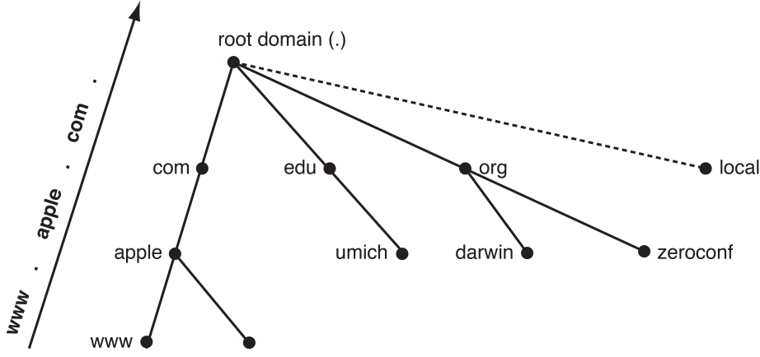
ADDRESSING
Bonjour uses self assigned link-local addressing
Addresses assigned
  - from range of reserved addresses
Random address assigned
  - from range if not in use

Slide 11
NAMING
mDNSResponder daemon
  for name-to-address translation
All devices must use the mDNSResponder
  to respond on their behalf to Multicast DNS Queries
Queries are made
  for service or devices names rather than IP address of the client application
Must have unique name on local network

Slide 12
SERVICE DISCOVERY
Bonjour client queries
  using service-centric approach to query for services
  Only one query needed
Query contains
  service type and domain

Slide 13
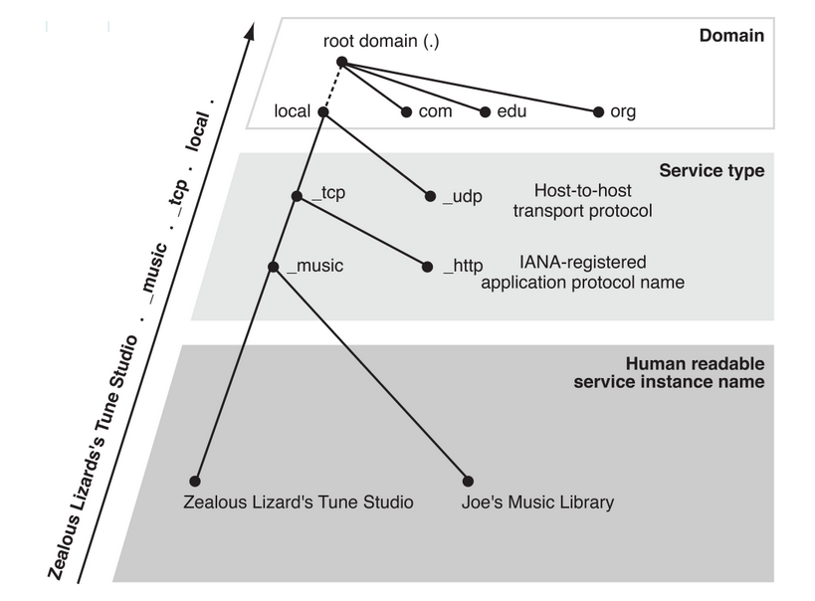
BONJOUR SERVICE NAMES
Bonjour service names use the following format:
  _ServiceType._TransportProtocolName.
  Example: Printer using TCP:
    _printer._tcp.
Service Instance names
  Are human readable
  Need not be unique
  Example:
      ”Zealous Lizard's Tune Studio”
      DNS SRV record name:
      Zealous Lizard's Tune Studio._music._tcp.local.

Slide 14
PUBLICATION STEPS
Service registers
  with the Multicast DNS Responder using the Bonjour API
After registering
  Service Record, pointer record, and text record are created
  Service Record – contains Hostname and port number
  Pointer Record – maps service type to a list of service instances
  Text record – used to provide additional information about the service, typically no more than 100-200 bytes

Slide 15
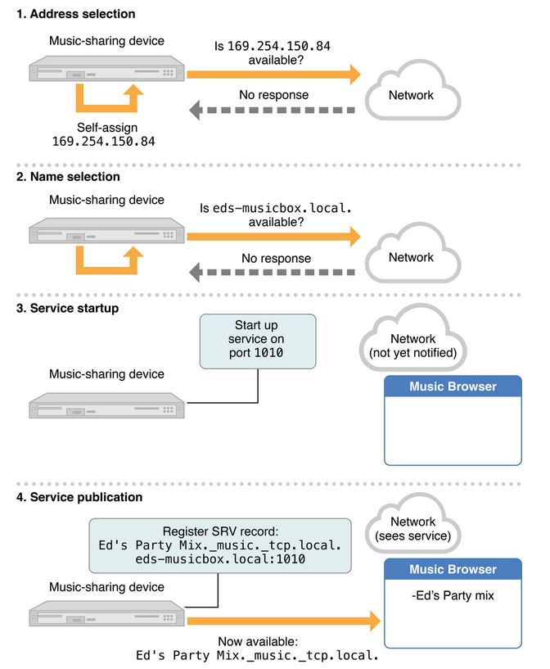
BONJOUR PUBLICATION EXAMPLE

Slide 16
DISCOVERY STEPS
Client queries for Pointer Records
  using the service type
  all Multicast DNS responders on the network are queried
DNS responders
  with registered services of the queried service type return a pointer record
  pointer record contains the service instance name

Slide 17
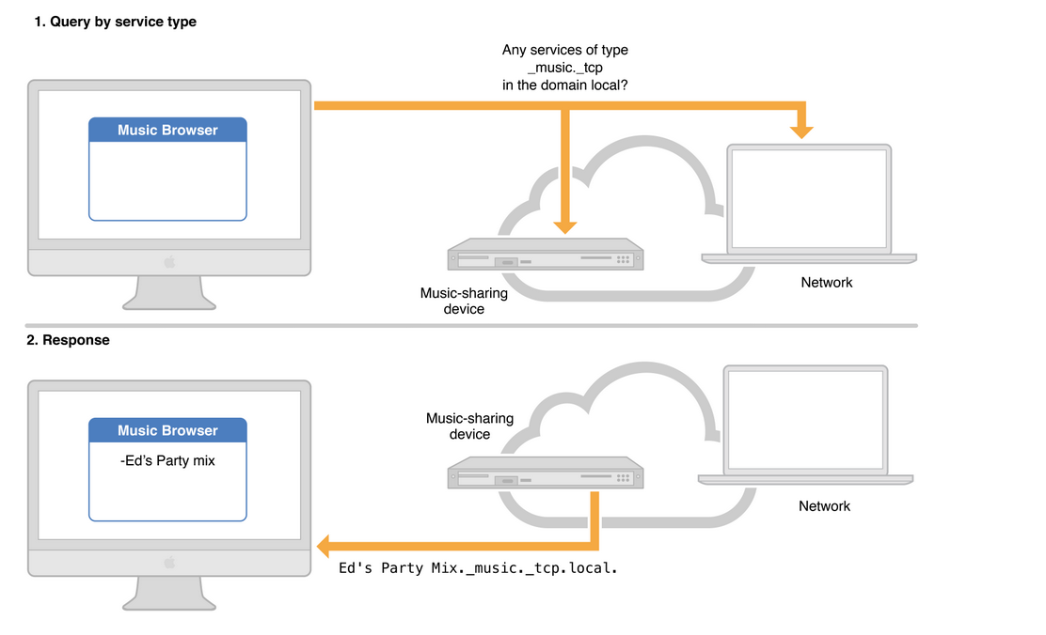
DISCOVERY EXAMPLE
mDNSResponder daemon
returns PTR record
The PTR record is stored at the client
From here the service instance can be extracted later as the stable service identifier

Slide 18
RESOLUTION STEPS
Client selects service instance
  that it wants to connect to
Client performs a DNS lookup
  for the service record using the instance name
Multicast DNS Responder returns the service record
  – containing hostname and port number
Client sends a multicast request
  using hostname for the IP address
Request is resolved to an IP address
  - to which the client can connect

Slide 19
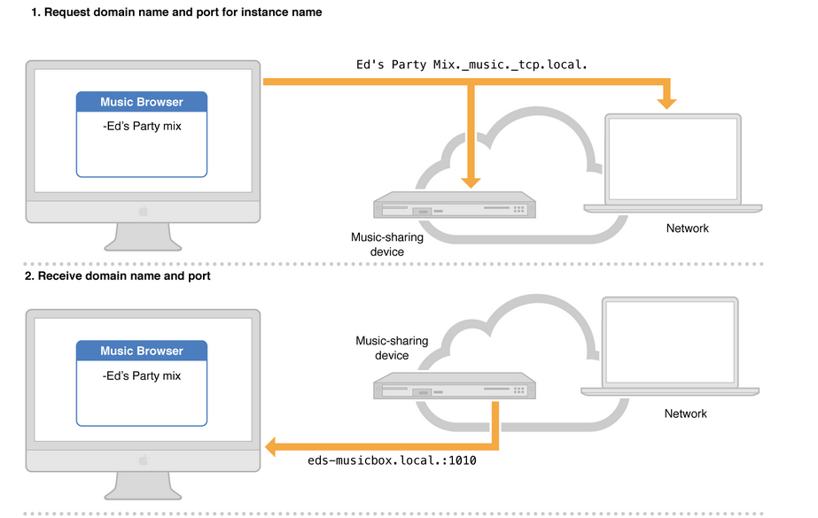
RESOLUTION EXAMPLE 1/2
mDNS query to the multicast address 224.0.0.251
asking for the Ed’s Party Mix._music._tcp.local
Returns SRV record

Slide 20
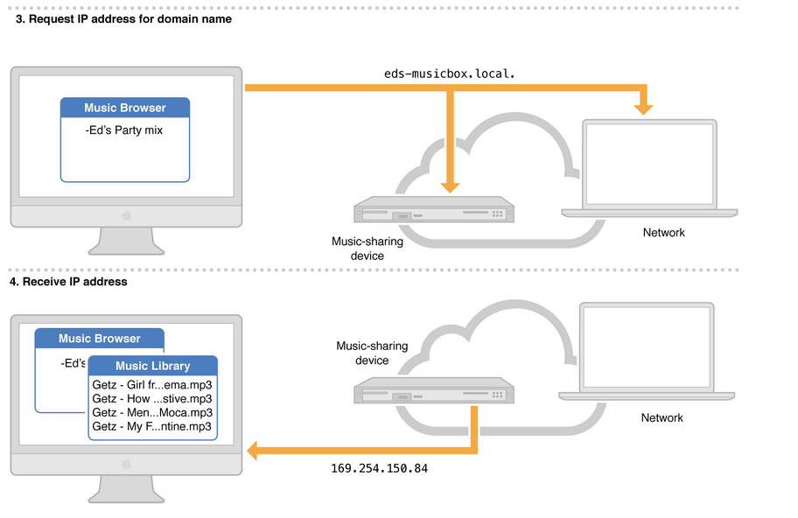
RESOULTION EXAMPLE 2/2
New mDNS request for IP adress of domain name

Slide 21
SHORTCOMING OF ZERO-CONF
Need to connect to a network first
  Must have an IP address – or at least a well-defined access point
Easy with a cable
  Physical presence as security (plug the cable)
Difficult with wireless
  WiFI
  Bluetooth
  Zwave
  802.15.4 / ZigBee / 6LoWPAN

Slide 22
HOW TO GET THE IP ADDRESS
Wireless Access point must be known
  SSID & passkey
  WiFi Protected Setup (WPS) requires router access + security risk
Bluetooth
  May use device and service discovery but requires pin-code (pin)
  Secure Simple Pairing (SSP) – with predefined pin or no pin
  SSP Out-of-Band (SSP OOB) using NFC
Using NFC for initial hand-shake
  As In SSP OOB -> receive Bluetooth MAC address and pair devices
Near Zero Configuration
  Touch to connect -> receive endpoint -> then IP address -> then discovery

Slide 23
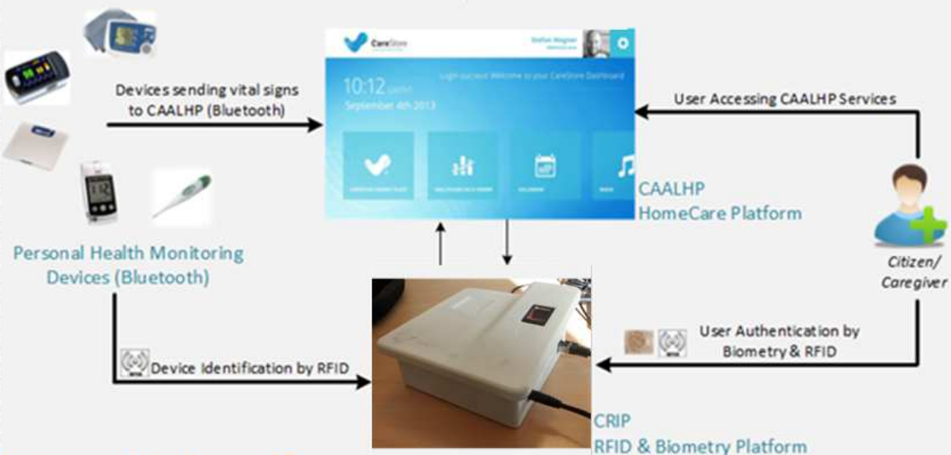
CARESTORE CRIP
Common Recognition and Identification Device

Slide 24
REFERENCES
Apple Inc., “Bonjour Concepts”, April 23, 2013,
  available at https://developer.apple.com/library/mac/#documentation/Cocoa/Conceptual/NetServices/Articles/about.html
Apple Inc., “Domain Naming Conventions”, April 23, 2013,
  available at https://developer.apple.com/library/mac/#documentation/Cocoa/Conceptual/NetServices/Articles/domainnames.html#//apple_ref/doc/uid/TP40002460-SW1
Apple Inc., “Bonjour Operations”, April 23, 2013,
  available at https://developer.apple.com/library/mac/#documentation/Cocoa/Conceptual/NetServices/Articles/NetServicesArchitecture.html#//apple_ref/doc/uid/20001074-SW1

