Slide 1
Brain age: predicting individual's age by neuroimaging data
May 16 2023

Slide 2
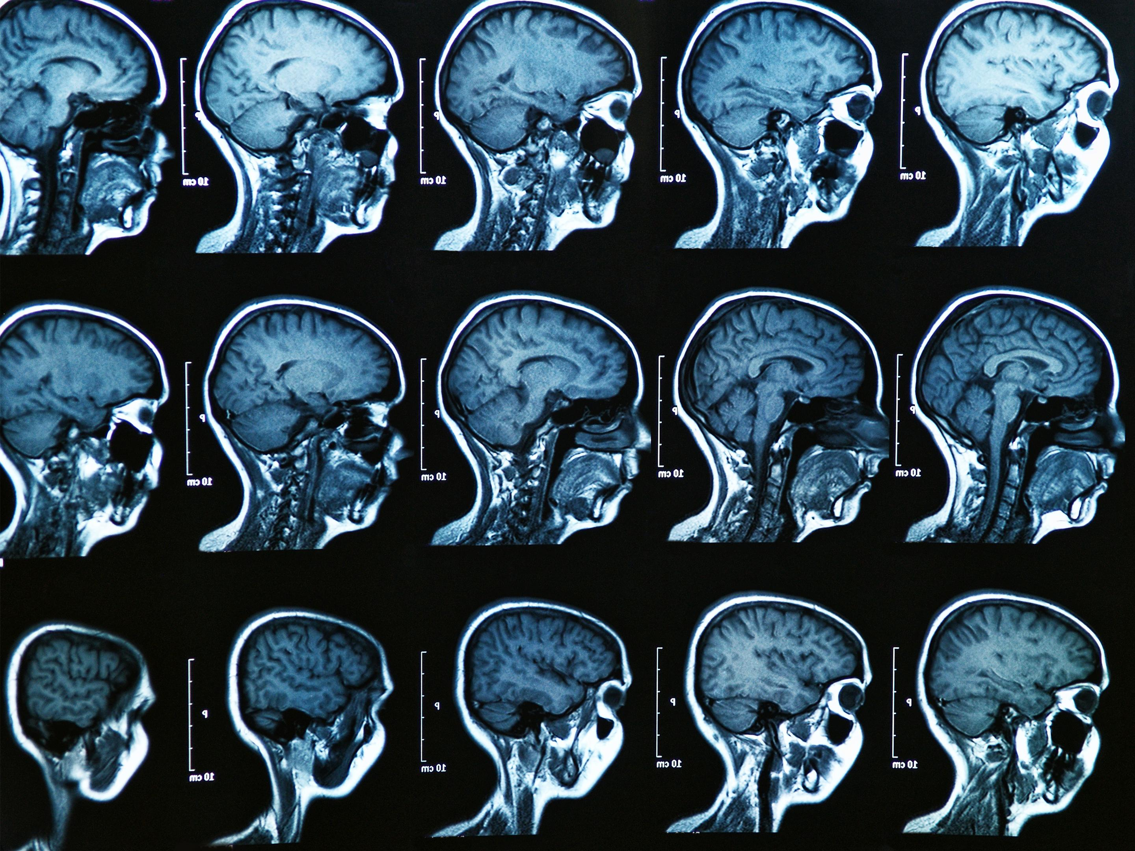


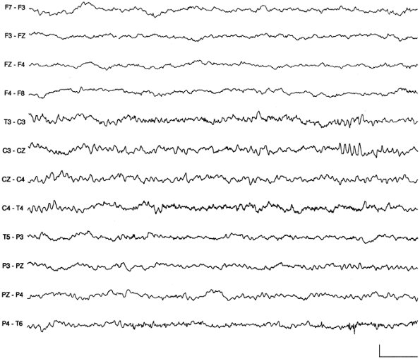
Model
Age
Brain data
62

Slide 3
Challenges
Sample size
Definition of ”one sample”
Multimodal imaging integration
Missing data
Low-rank data

Slide 4
Opportunities: source data
Whole-brain prediction
Regional prediction
The accuracy and sensitivity of region-age relationship can disclose its biological implication
Definition of “a region” (structural or functional parcellation)
Connectivity prediction
Spectral prediction (EEG)
Dynamic (time-varying) prediction?

Slide 5
Opportunities: approaches
MLP
Transformers

Slide 6
Databases

Slide 7
HCP: 1200 Young adult
1103 subjects
Structural MRI (T1w+ T2w contrasts; 0.7 mm isotropic)→ FreeSurfer reconstruction
Resting-state fMRI (2 mm isotropic; .720 ms; 14’33’’ (1200 frames) x 4 runs
Task fMR:
Head coil
Circular flat coil
Curved coil
https://www.humanconnectome.org/study/hcp-young-adult/document/1200-subjects-data-release

Slide 8
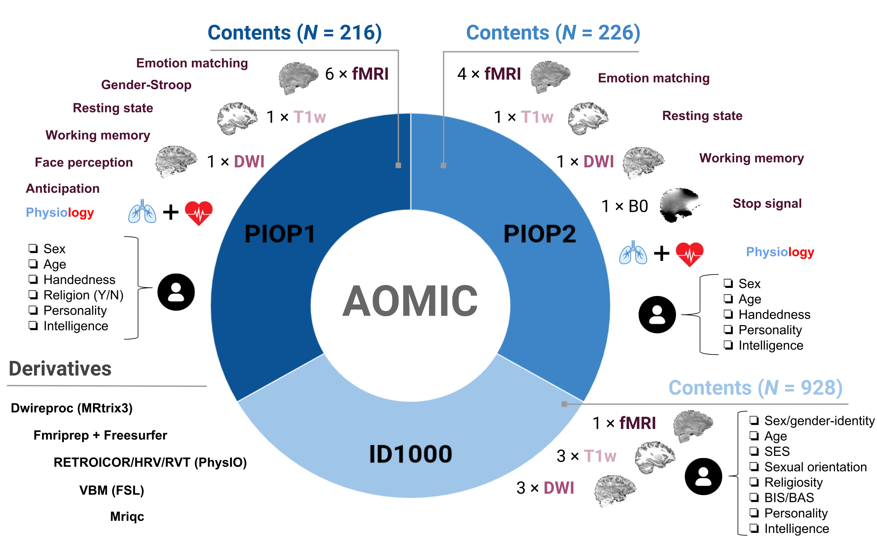
Aomic: the Amsterdam Open MRI Collection
Head coil
Circular flat coil
Curved coil
https://nilab-uva.github.io/AOMIC.github.io/

Slide 9
Task: literature review
Modalities (MRI, EEG, behaviours)
MRI: structural + diffusion
fMRI: resting + tasks
Sample size
Age range
Prediction accuracy (with error metrics)
Modeling approaches

Slide 10
Task: modeling
Brain age by public data (~1,000 subjects)
Brain age by our own EEG-MRI data (~200 subjects)

