Slide 1
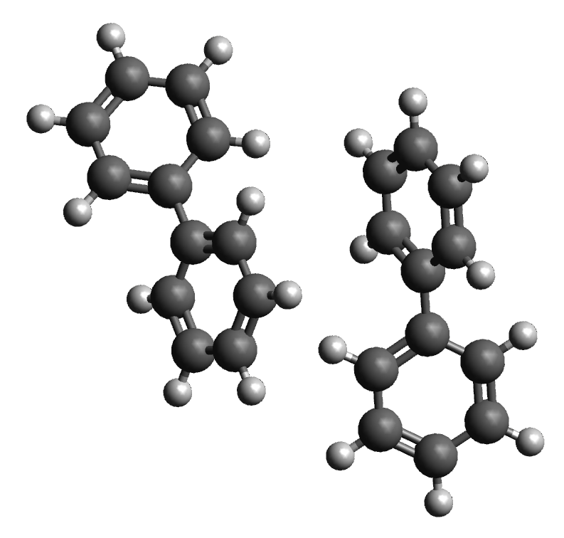
MXMNet
PAMNet
embedding module
multiplex
molecular
module
local graphs
local layer
fusion module
prediction module
local message passing
attention pooling
system
many-body properties
cross layer mapping
pooling
global message passing
attention pooling
global graph
global layer

