Slide 1
Project3 Trajectory Planning
Hints
by 11911012 Lishuang Wang

Slide 2
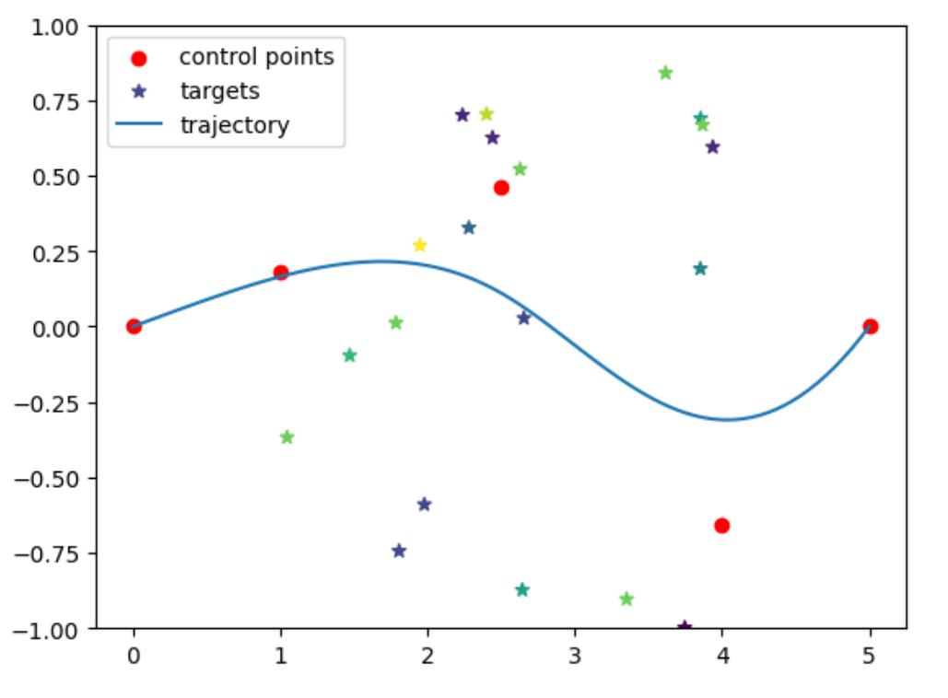
1. Given n targets, each target has its location and features.
2. A target can be distinguish to a class. Each class has its score.
3. We can control a curve by setting the location of three control points.
4. When the curve closed to a target, it means we can get the score of the target’s class.
5. Our goal is to maximum the total score we obtained.

Slide 3
We can split this work into two parts.
1. Train a classifier to distinguish the class of a target. (the input parameters is targets’ features and classes’ scores, we need to obtain the targets’ scores)
2. Once we obtain such classifier, we can evaluate our control points by ourselves.
Decision Tree
K-Nearest Neighbors
Logistic Regression
ANN
Support Vector Machines

Slide 4
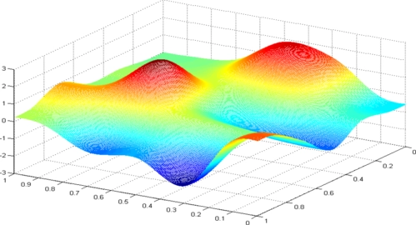
Now, we can treat this problem as a optimization problem.
We need to Maximize f(x):
f means the total score we get, x means the coordinateds of the control points.
We have learn some black box optimization algorithm before, like genetic algorithms. But, in this work, we have only 0.3s for each question.
Out time is too tight to genarate a solution population run the algorithms for iterations.

Slide 5
However, we still have some methods to optimize our solution, that is gradient descent.
We can obtain the gradient on our current solution, and change the solution along with its gradient to optimize the solution.

Slide 6
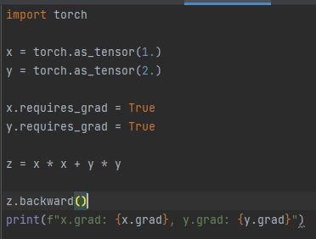

How to obtain the gradient?
We can take advantage of the autograd funtion of pytorch.
For example,
We can examine the gradient by hand :)

Slide 7
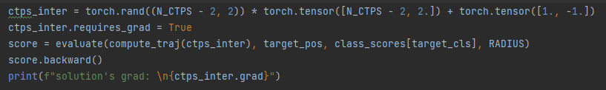
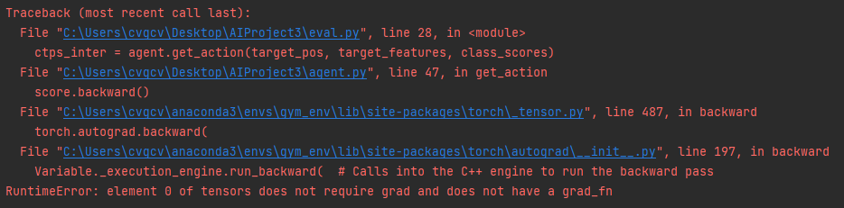
In our project, we can also get the gradient by autograd.
However, when we want to use above code to obtain the gradient of the solution, we get such exceptions:

Slide 8
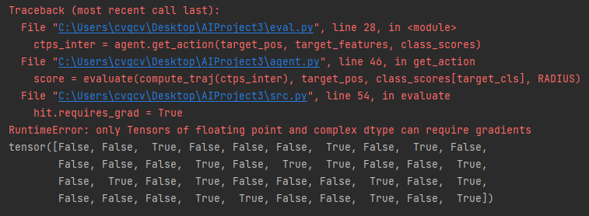
Why?
notice the original given function evaluate
When we modified above code to
We can get

Slide 9
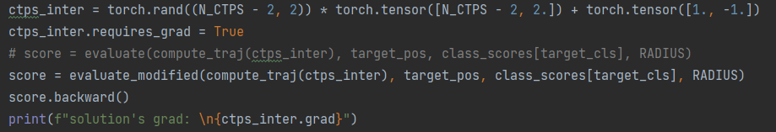
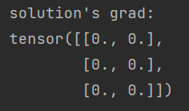
So, we need to change the evaluation function to avoid boolean opearants.
This time, we can correctly obtain the gradients of the solution.

Slide 10
Why zeros? Something wrong?
No, that is exactly the right gradient.
Notice the line in your code:
this function “hit”, which funcion graph is:
And its derivative is:

Slide 11


So, we also need to design another function to replace the origin hit function.
For example, we use:
Using, such surrogate function, we can successfully get the gradient of the solution.
Its derivative is not equal to zero when d > 0.3.

Slide 12
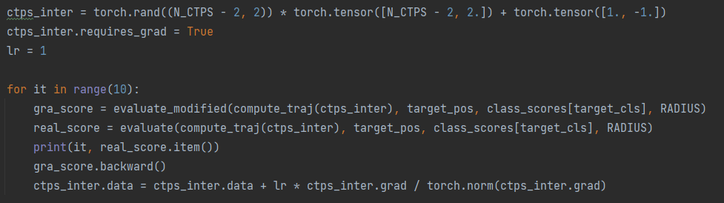
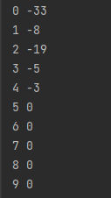
Then, we can optimize our solution using the gradient.
After 10 iterations, the score of such solution rise from -58 to -9.

Slide 13
What can be done to obtain the further performance?
1. use multiple initial points.
2. design another surrogate function.
3. use advanced optimizer, like SGD, Adam.
4. shedule the learning rate in iterations.
5. .....
That’s all. Hope this can be helpful. Thx :).

