Slide 1
What is Success?
Freedom, Will, and Uniqueness
******, Lin Ruipeng

Slide 2

Intro: A standard template for success
good grades ?
a high-paying job ?
a house ?
a car ?

Slide 3
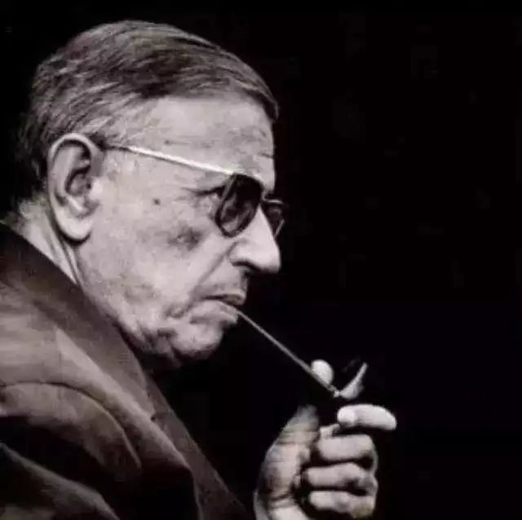
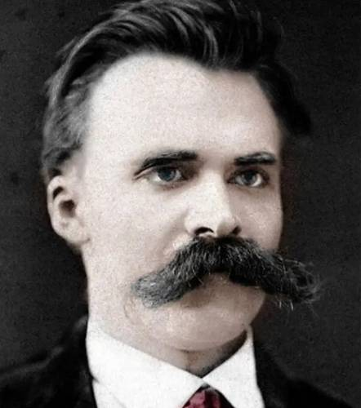
Jean-Paul Sartre
让-保罗·萨特
Friedrich Nietzsche
弗里德里希·尼采

Slide 4
Part 1: The Freedom to Define
🗡️
A Knife
(To cut)
Purpose is fixed
🧍
A Human
? (for what)
No built-in purpose
“Existence precedes essence.” — Sartre
“存在先于本质”——萨特 (存在主义哲学家)

Slide 5

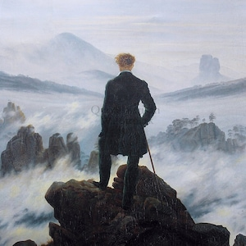

Part 2: The Discipline of the Übermensch
Übermensch
超人哲学
德语：超人 (特指尼采的超人学说)
Doing nothing = Excuse
(Lazy)
Will to Power
权力意志
Patch:
Logic & Reason
逻辑 和 理性

Slide 6
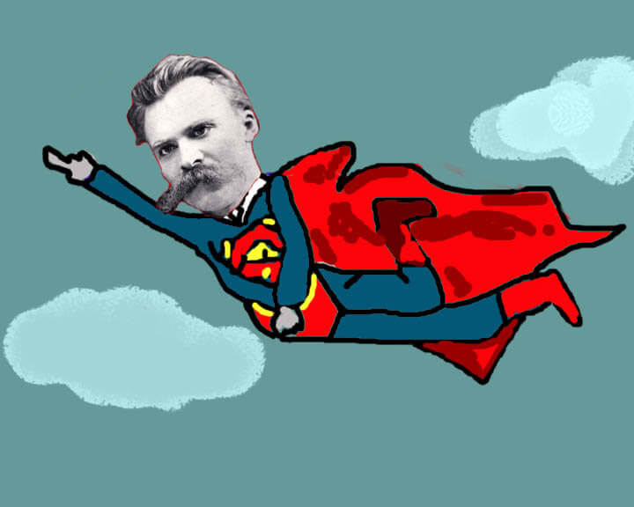
Part 2: The Discipline of the Übermensch
The Übermensch is someone who creates their own values and has the willpower to make them real.

Slide 7
My extra point:
1. Willpower alone is not enough;
2. it must be guided by logic and reason.

Slide 8
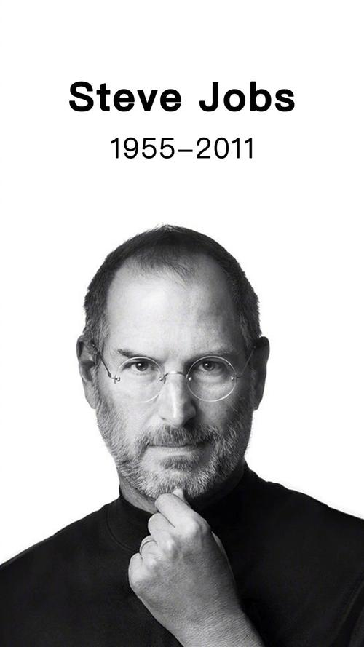
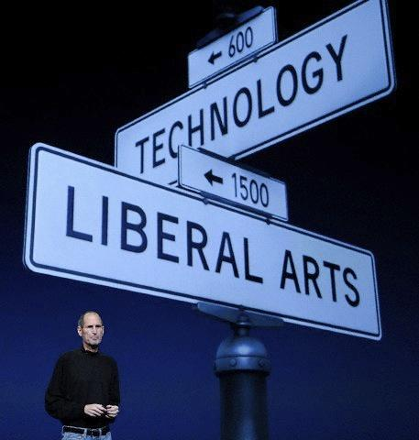
Part 3: A Real-World Example
The values of Apple Inc. :
“Technology alone is not enough, it's technology married with liberal arts, married with humanities, that makes our heart sing.”
“走在科技和人文的十字路口”

Slide 9

Part 3: A Real-World Example
“Think Different”
非同凡响
“Because the people who are crazy enough to think they can change the world, are the ones who do.”
只有那些疯狂到认为自己可以改变世界的人，才能真正的改变世界。
---- Think Different

Slide 10
To conclude: What is success?
1. Find your unique “why”
知道自己为什么独特
2. use your reason to figure out the “how”
运用理性达到它!

Slide 11
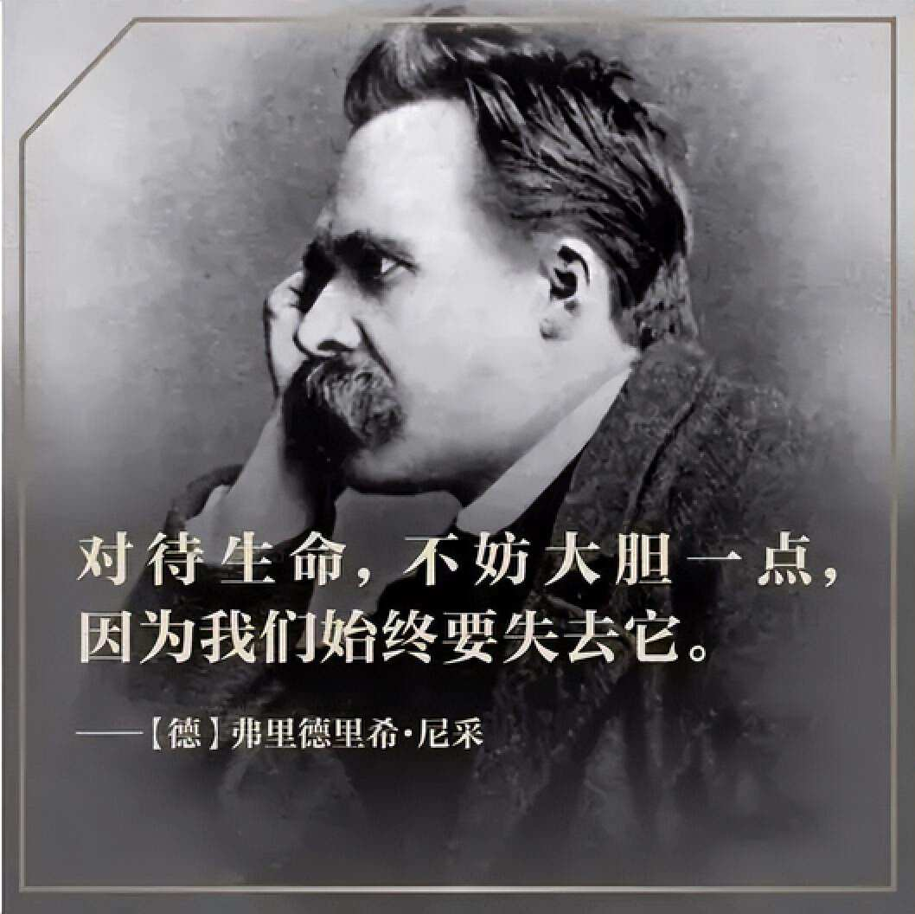
Epilogue
"He who has a why to live for can bear almost any how."
一个人知道自己为什么而活，就可以忍受任何一种生活。
--- Nietzsche

