Slide 1
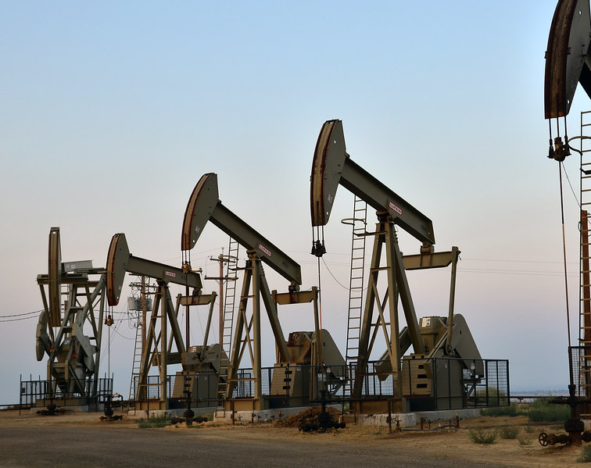
Proof of Concept by Group 7
Teammates :
Uthmani Ambawattage
Sudeesha Warunasinghe
Lin Gao

Slide 2
Introduction
Client : XYZ Energy, an integrated oil & gas company
Number of Business Units : 3
New technology to be implemented : 5G connectivity & IoT devices
Financial Constrains : Budget of $6 Million & maximum of 1/3 of funds can be allocated to a given business unit
Number of user-cases considered : 4 across 3 BU's
Final Financial Goal : Increasing Return of Investment (ROI) across all BU's

Slide 3
Upstream Use Case Analysis
Predictive Maintenace
Equipping 0.15% of all production assets will reduce the downtime by same proportion.
Lower loss of barrels in extracting process.
Difference between loss of barrels before & after is the saving !
Connected Worker
Equipping 2.5% of workers it IoT devices will reduce the safety incidents in same proportion.
Lower the Avg. Safety Incident cost.
Difference between Avg. Safety Incident cost before & after is the saving !

Slide 4
Midstream Use Case Analysis
Leakage Detection
Once IoT applied, 1.5% reducing in spill sizes reduces the avg. Size of each spill size by same proportion.
1.5% reduction in likelihood will reduce the number of occurrence by the same proportion of each spill size category.
Difference between cost of damages and cleanup before and after is the saving !
Predictive Maintenace
Equipping 1% of all production assets will reduce the downtime by same proportion.
Lower loss of barrels in storing and transporting process.
Difference between loss of barrels before & after is the saving !

Slide 5
Downstream Use Case Analysis
Predictive Maintenace
Equipping 0.25% of all production assets will reduce the downtime by same proportion.
Lower loss of barrels in refinery process.
Difference between loss of barrels before & after is the saving !
Intelligent Operations
Reduction in 0.2% and M&M cost and 0.35% Ops cost will be the saving!

Slide 6
Saving Analysis - Per 1M
High
Low
 | Upstream | Midstream | Downstream
Predictive Maintenace | 526,500.00 | 487,500.00 | 487,500.00
Connect Workers | 450,003.94
Leakage Detection |  | 491,840.72
Intelligent Operations |  |  | 481,800.00

Slide 7
Optimal Use Case
Business Unit | Use Case | Investment (Millions) | Saving Per 1 Million | Total Expected Saving | ROI
Upstream | PM | 3 | 526,500.00 | 1,579,500.00 | 0.53
 | CW | - | 450,003.94 | - | -
Midstream | PM | 0.5 | 487,500.00 | 243,750.00 | 0.49
 | LD | 2 | 491,840.72 | 983,681.44 | 0.49
Downstream | PM | 0.5 | 487,500.00 | 243,750.00 | 0.49
 | IO | 0 | 481,800.00 | - | -
Total |  | 6 | - | 3,050,681.44 | 0.51

Slide 8
Rationale – Optimal Use Case
Priority to Predictive Maintenace
1
Captial Assets are usually older in oil and gas industry
Highest Financial Benefit
2
Financial goal is to reduce cost for upcoming fiscal year
Enable varity of analysis on CAPEX items
Better return on the Investment
Affect workers safety
Coverage
3
Cover all three BU's with predictive maintence

Slide 9
Predictive Maintenace Use case
Functional Requirements | Technical Requirements
Ability to send alerts to workers and management on anomalies. | Ability to be automate the process when needed
Efficient spare parts management, and automatically send purchase requests to XYZ's ERP | Ability to connect to the aerial scanners
Ability to work under minimum human supervision | Ability to store large capacity of data with higher frequency
Ability to avoid unnecessary routine maintenance in all streams | Ability to connect the flow to data to XYZ's ERP

Slide 10
Leakage Detection Use case
Functional Requirements​​ | Technical Requirements​​
The ability to send real-time alerts to the central system and therefore to all connected workers while minimizing false alarm | Have a wide operating range that includes both steady-state and transient states, including startup and shutdown and flow adjustments
​The pipeline to be auto-block to prevent continuous leakage till workers arrive​ | Ability to connect the flow to data to XYZ's ERP
Ability to evacuate the premises in case of harmful leakage | Ability to store large capacity of data with higher frequency

Slide 11









Technical Design
Detect
Leakage Analysis
React
React
Real-Time Pipeline Sensor
Power BI Dashboard
Instructions to the
maintenance team
Safety alert to site workers
Notifications to the
emergency assistance
Calculate flow rate, temperature, pressure, etc
IoT Hub,
Database
Pipeline Inspection
Leak signature analysis
leak rate, leak position
ILI: gather pipeline anomaly data such as corrosion, mill defect, metal gain, etc
Aerial Scanning: at remote locations, for geohazards
Maintenance Prediction
Act
Statistical modelling on
future maintenance needs
Time, duration, location, repair, etc
Adjust the inspection
schedule

Slide 12
Outcomes of POC & Stakeholder Analysis
Reducing in losses due to downtime and leakages across BU's
The Investment for this will be recovered by 2-year time
Chief Financial Officer goal is achieved.
Chief Executive Officer short term cost reduction is achieved (without considering the Investment)
Reduction in downtime and reflect reduction in safety incidences.
Priority to predictive maintenance specially in Upstream, reflect lower accidents.
Since upstream has the highest number of workers per shift, majority of workers safety is assured indirectly.
Chief Operating Officer goal is achieved.

Slide 13
Cont.
Incorporating 5G and IoT across BU's
XYZ enables to gather data from remote places in real-time without compromising safety of workers.
Real-time data can be utilized to analysis and monitor production capacity, utilization, avoid unnecessary CAPEX.
Can access to data from any location.
Ability to access big data across the BU's and ability apply machine learning and AI algorithms to transform XYZ to a predictive manufacturing.
Goal of Chief Technology officer is achieved.

Slide 14
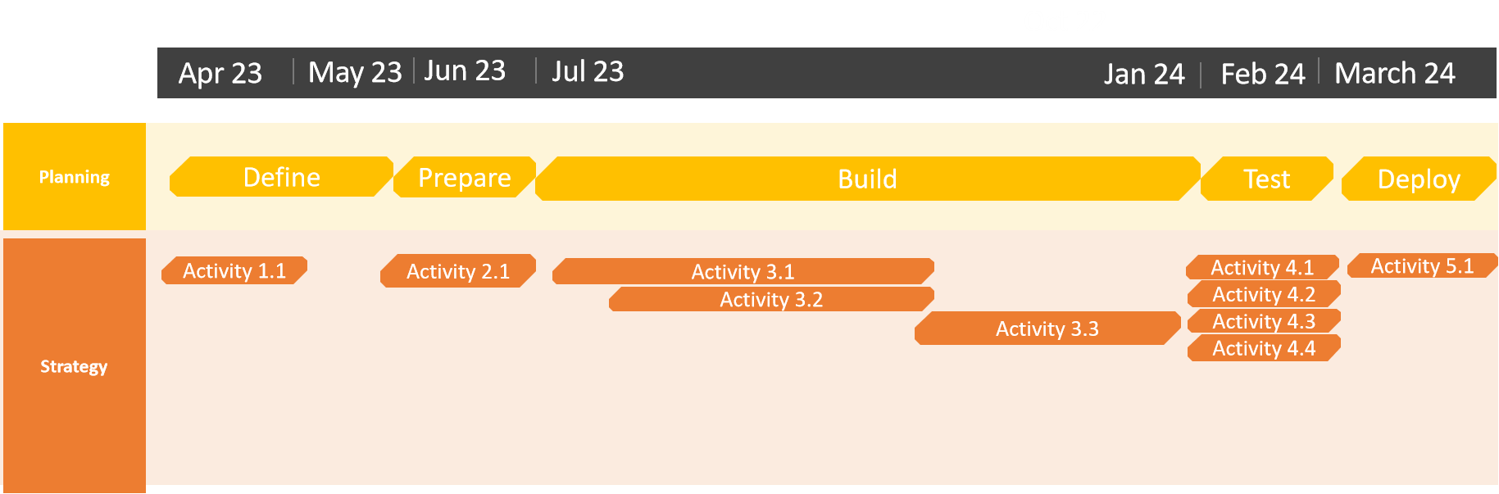
Implementation Timeline (1 fiscal Year)

Slide 15
Cont.
Activity ID | Activity
Activity 1.1 | Identifying the capital assets where we should install sensors to collect data
Activity 2.1 | Purchasing the sensors & required IoT devices
Activity 3.1 | Setting up the sensors
Activity 3.2 | Setting up the 5G network
Activity 3.3 | Connecting sensors and 5G network to the ERP
Activity 4.1 | Testing sensors
Activity 4.2 | Testing ERP connection
Activity 4.3 | Testing 5G network
Activity 5.1 | Deploying the Predictive maintenance system & Leakage detection system

Slide 16

THANK YOU FOR YOUR TIME!

Slide 17
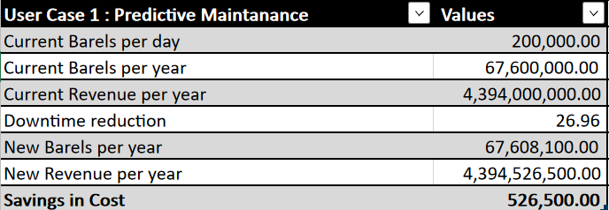
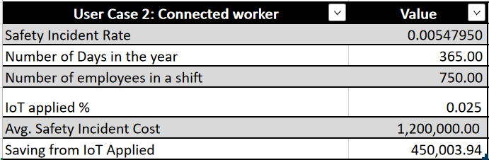
Appendix A – Upstream Predictive Maintenace Use case
Appendix B – Upstream Connected Workers Use case

Slide 18
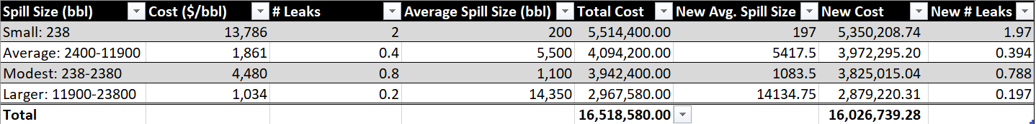
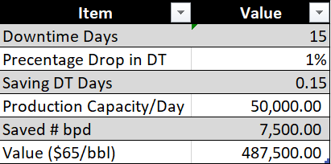
Appendix C – Midstream Leakage Use case
Appendix D– Midstream Predictive Maintenace Use case

Slide 19
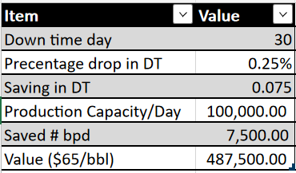
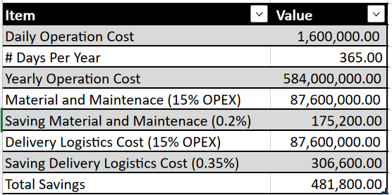
Appendix E– Downstream Predictive Maintenace Use Case
Appendix F– Downstream Intelligent Operations Use Case

