Slide 1
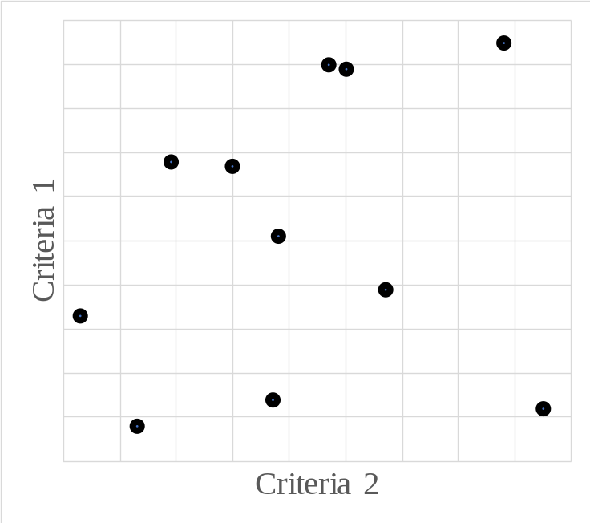
Positive Ideal Solution
Negative Ideal Solution

