Slide 1
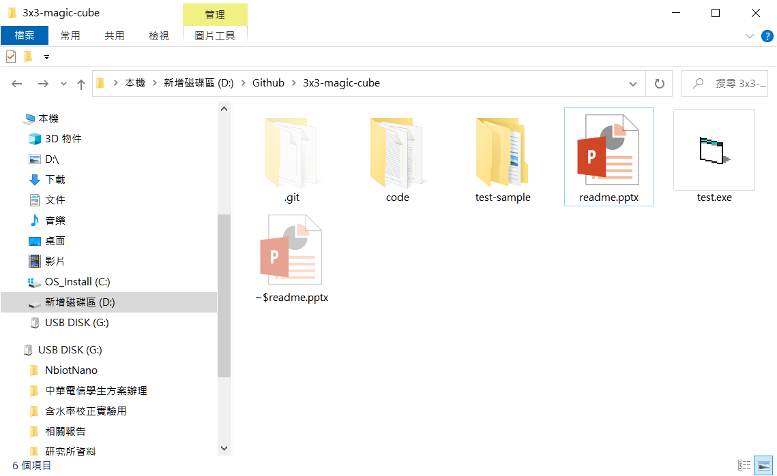
1.Click test.exe

Slide 2
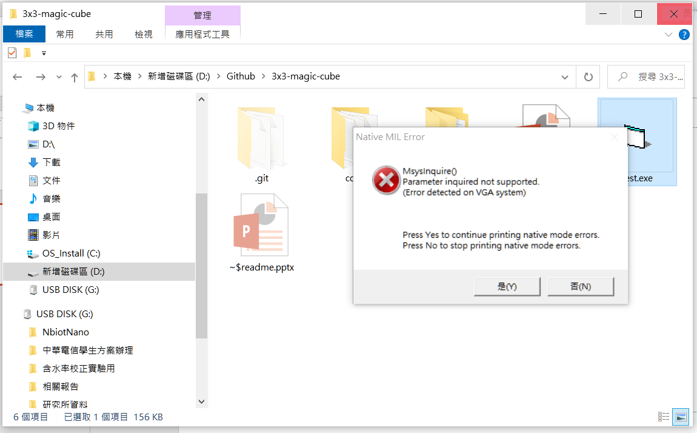
2.Click 是(Y) on the Native MIL Error window

Slide 3
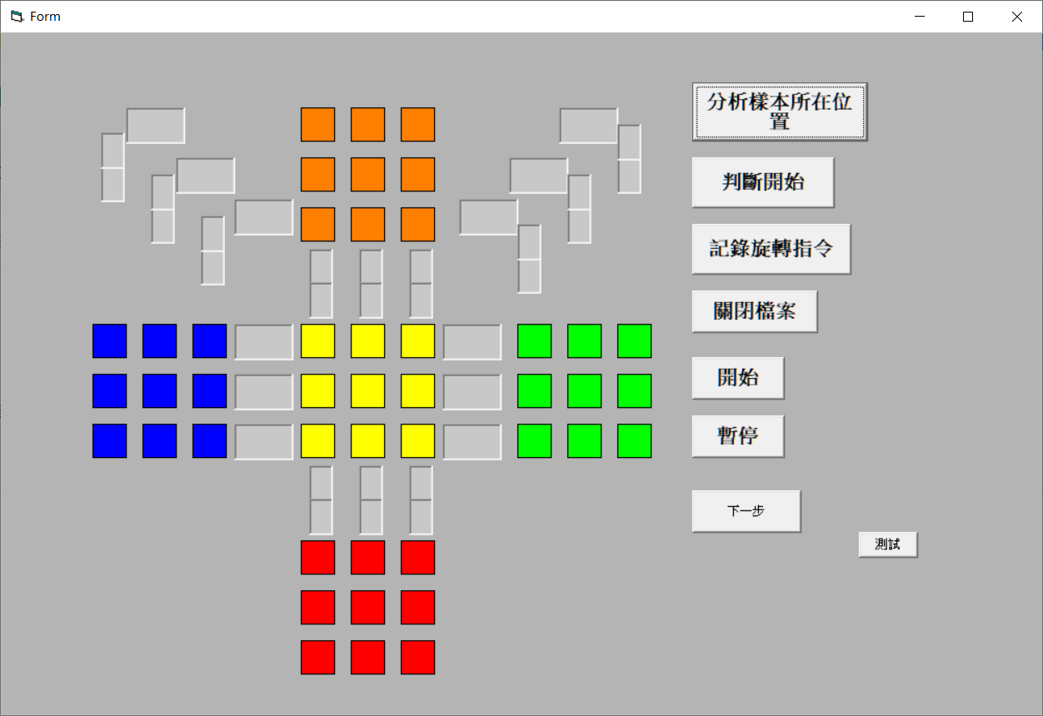
3.Click分析樣本所在位置

Slide 4
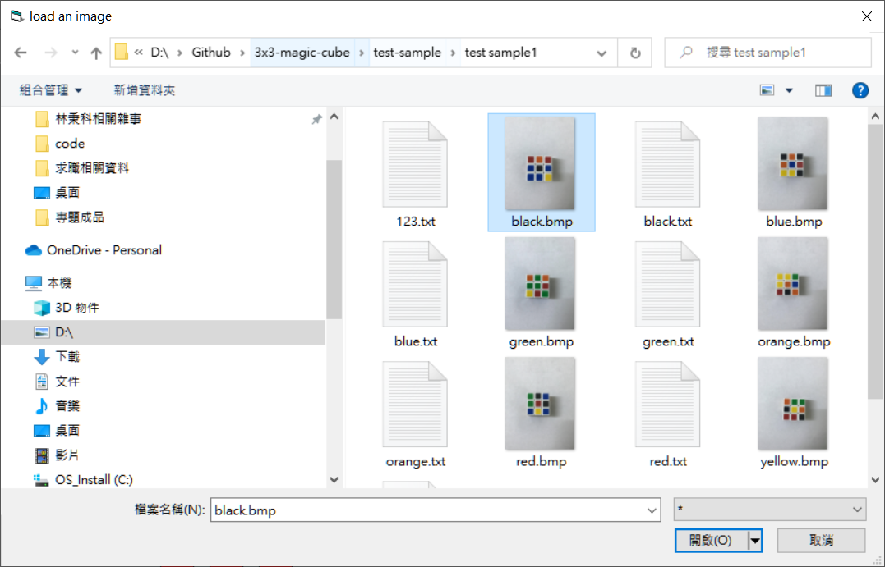
4.Choose example in the test-example file click any image for program to catch location

Slide 5
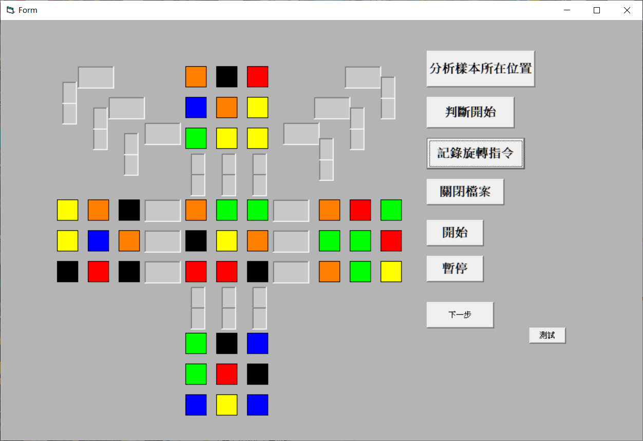
5. Click判斷開始, click紀錄旋轉指令
5(1)
5(2)

Slide 6
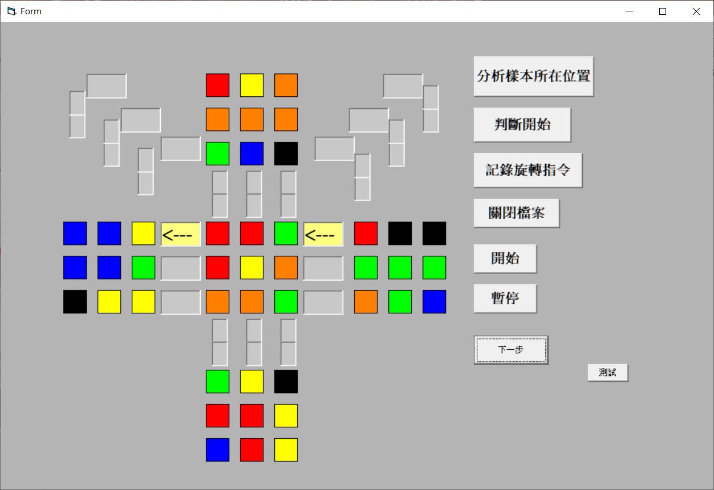
6.Click開始, the restore program will start very quickly, Click暫停to stop the program
6(1)
6(2)

Slide 7
7.Click下一步，the restore program will start step by step for operation

