Slide 1


Forecasting COVID-19 Using Neural Networks
By
Zhidong Zhang, Winston Lin, Justin Chen, Evan Yu

Slide 4
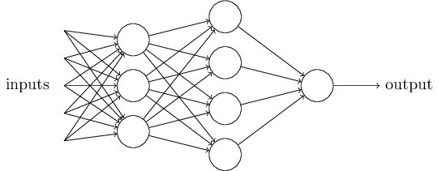
Survey of MIP Technique for Robustness
Neural networks tested for robustness using MIP’s are generally used in classification problems.
Network parameters and inputs are formulated as a MIP.

Slide 5

Survey of MIP Technique for Robustness Cont.
We define some example, E, from the dataset as a baseline.
The variables are given as a vector X (our features).
The constraint is that the network, given X, must output a prediction different from that given by a sample from the dataset.
The objective function serves to minimize the deviation of X from E.
An optimal X is called an Adversarial Example
An optimal X which does not differ too little or too much means the network is ROBUST.

