Slide 1
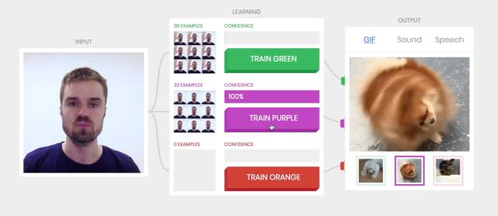
Google Teachable Machine

Slide 2

Toyhouse Learning Machine
Input
XLP Deep Learning
Output
Learning
Training
SGF
PDF
TEXT
Image
Audio
Video
wiki
nand2weiqi
Media goblin
Write
Coding
Make
MediaWiki(w) | go.toyhouse.cc(c) | Mediagoblin(m)
Docker | Git | OpenModelica
Netlify | Juypter | Jenkins…

