Slide 1
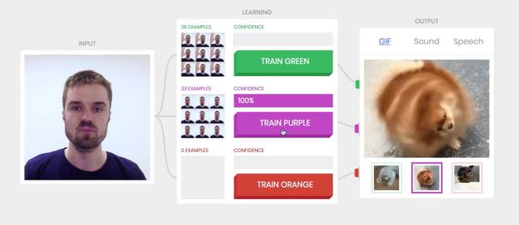
Google Teachable Machine

Slide 2

Toyhouse Learning Machine
Input
XLP Deep Learning
Output
Learning
Training
SGF
PDF
TEXT
Image
Audio
Video
wiki
nand2weiqi
Netlify
Write
Coding
Make
Phabricator | MediaWiki | Piwik
Netlify | Netlogo | JuyperHub
Jenkins | Nexus | Gitlab
 | Kubernetes
 | DC/OS

