Slide 1
DSD
Final Presentation
Team12
Team12 胡芝瑜 連茂翔 朱翔榆
2023.06.13

Slide 2
Outline
Design for Compressed Instructions
Design for Branch Prediction
Q-sort Results
Other Improvements
Work Distribution

Slide 3
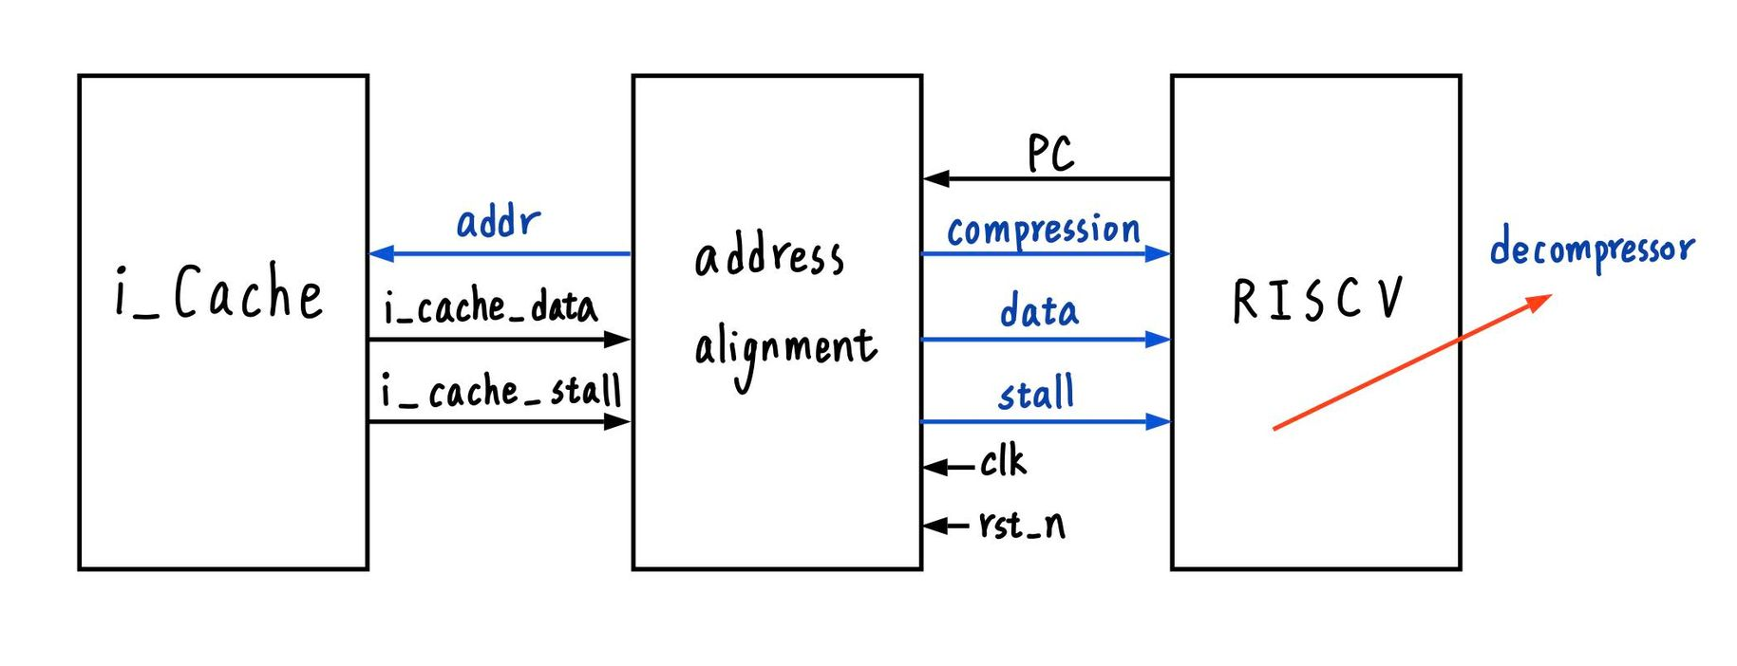

Compressed Instructions

Slide 4
Compressed result: AT score
Pure Compression Area(um²) | 18070.6
Execution Time(ns) | 2089.8
AT(um²×ns) | 3.77×10⁷

Slide 5
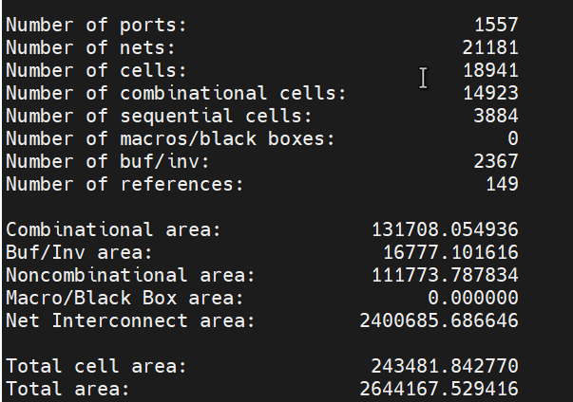
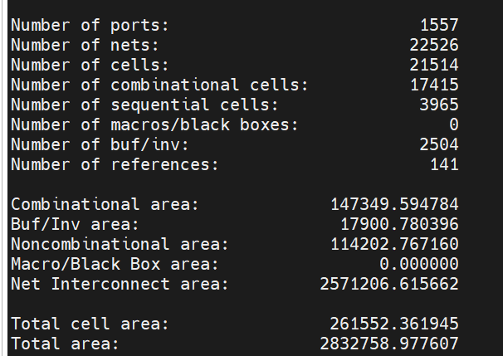
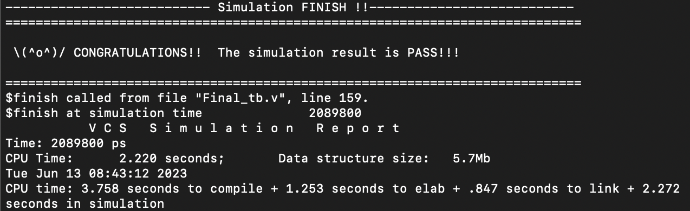
Compressed
Baseline area: 243481.8(um²)
Compression area: 261552.4(um²)
Cycle time: 3.6(ns)

Slide 6
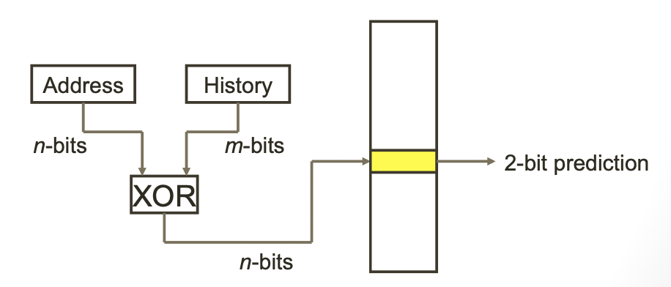
Branch Prediction
Always Not Taken, Always Taken
2-bit Saturating Counter
2-level Predictor (Global history, n=2, 3)
2-level Predictor (Gshare, n=2, 3)

Slide 7
Branch Prediction
 | 2-bit Saturating Counter | Global Predictor (n=3) | Global Predictor (n=2)
Total cycle (BrPred) | 390 | 375 | 373
Total cycle (hasHazard) | 2431 | 2310 | 2304

Slide 8
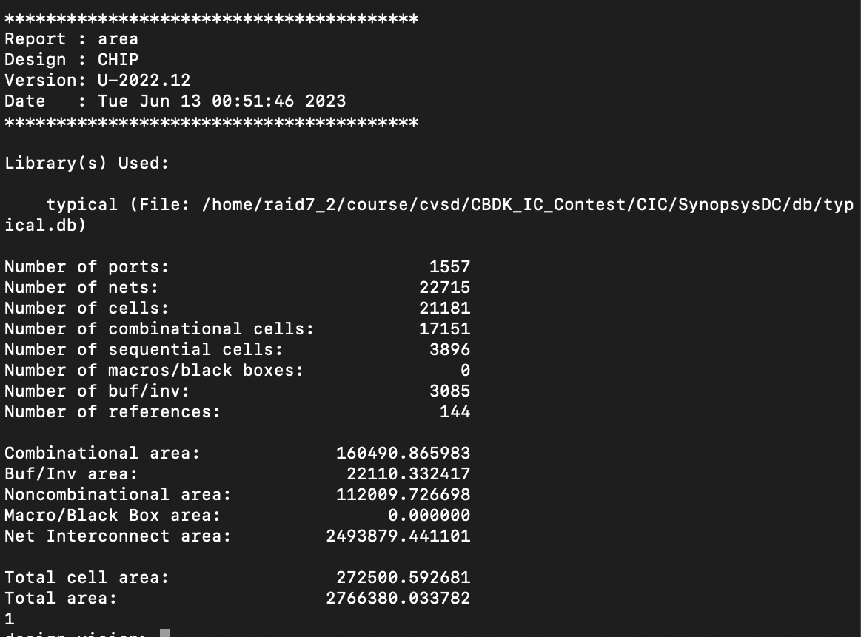
Branch Prediction
BPU Area:29019.6 (um²)

Slide 9
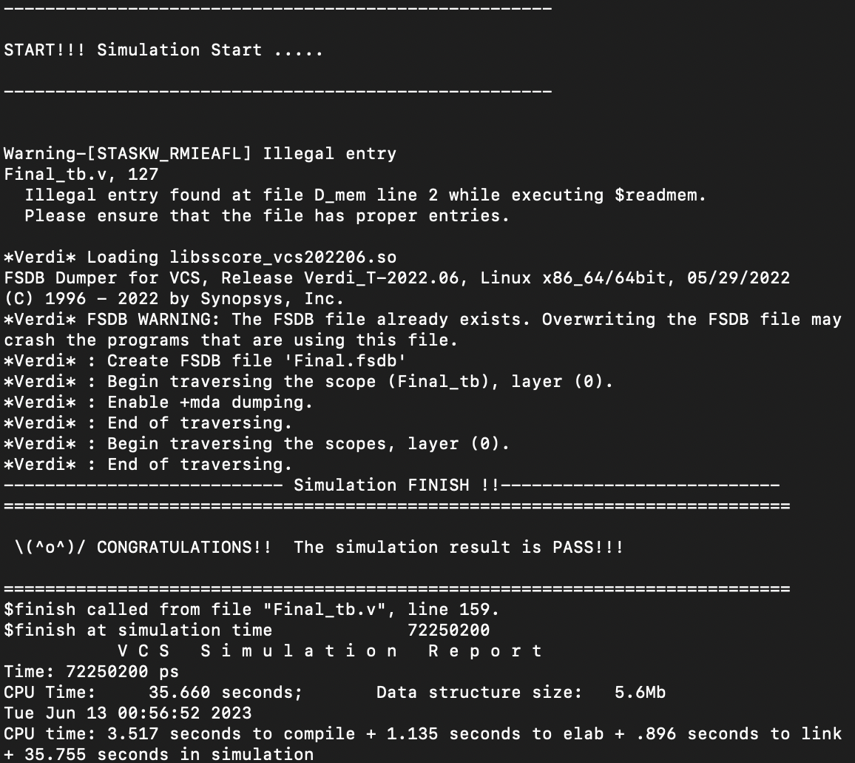
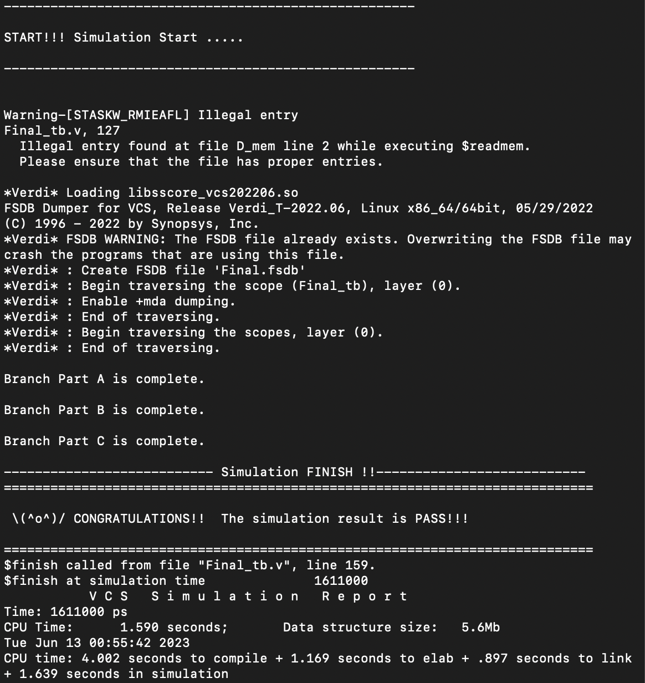
Branch Prediction
Cycle time = 3.6(ns)

Slide 10
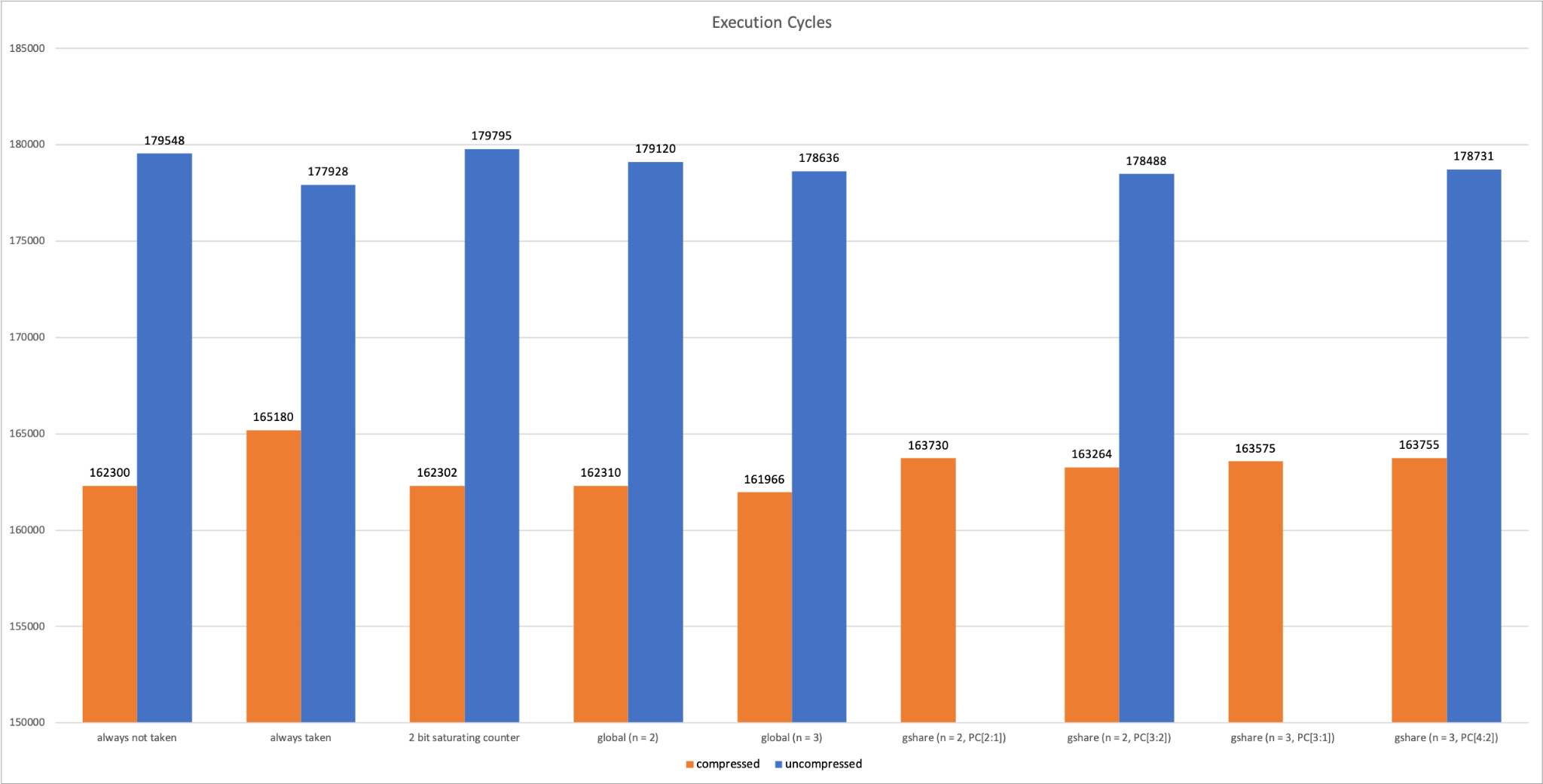
Q-Sort Results: Execution Cycles
1
3
2
2
3
1

Slide 11
Q-Sort Results: AT Score
Use compressed test pattern
 | Global Predictor (n=3) | Always Not Taken | 2-bit Saturating Counter
Clock cycle (ns) | 3.5 | 2.8 | 3.5
Execution time (ns) | 580592.25 | 506714.6 | 581768.25
Area (um² ) | 281221.835747 | 286701.040718 | 279812.9916
AT score (um²×ns) | 1.63275x10¹¹ | 1.45276x10¹¹ | 1.62786x10¹¹

Slide 12
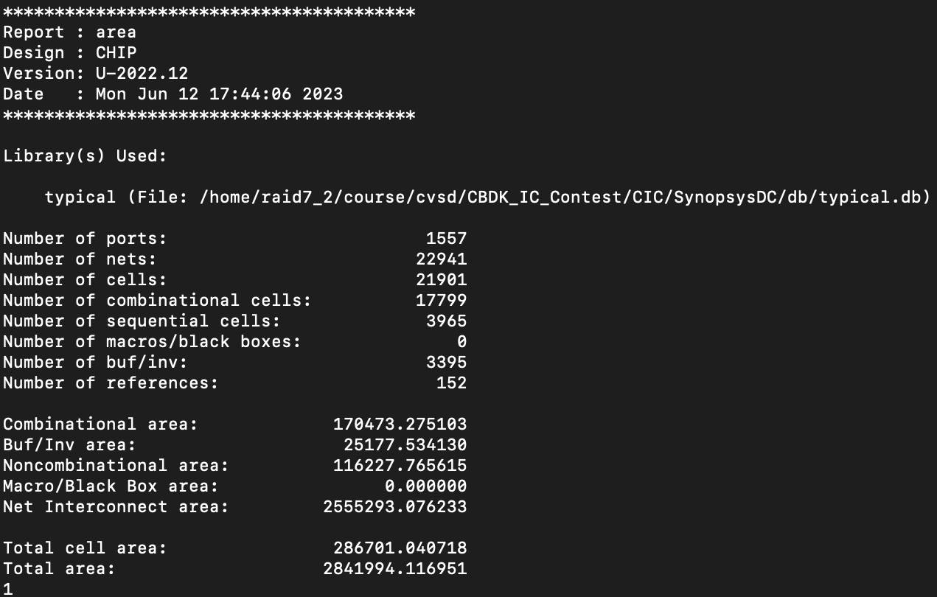
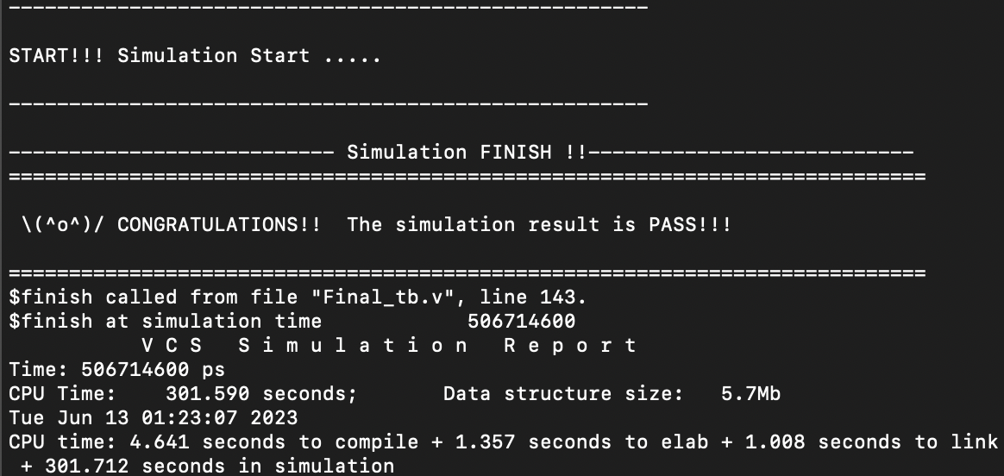
Q-Sort Results

Slide 13
Other Improvement
Cache
I Cache -> Read Only
Remove redundant states in FSM
Forwarding
Critical path: ME -> EX -> ID forwarding
Insert bubble when need to forward EX -> ID

Slide 14
Work Distribution
 | 朱翔榆 | 胡芝瑜 | 連茂翔
Baseline | Pipeline ALU & ALU control Branch Hazard | Cache Stall Load-use Hazard | Control Forwarding
Extension | Branch Prediction Optimization | Decompressor Compressed PC | Address Alignment Cross Boundary Instruction

Slide 15
Reference
https://people.cs.pitt.edu/~childers/CS2410/slides/lect-branch-prediction.pdf

