Slide 1
Accelerate Python for a Genetic Programming Project
Bocheng Lin
2024.6.5

Slide 2

Time Comparison for Developing a Project:
Coding Time and Execution Time
C++
Python

Slide 3

Time Comparison for Developing a Project:
Coding Time and Execution Time
C++
Python

Slide 4
Time Comparison for Developing a Project:
Coding Time and Execution Time
C++
Python
Python+
ChatGPT-4

Slide 5
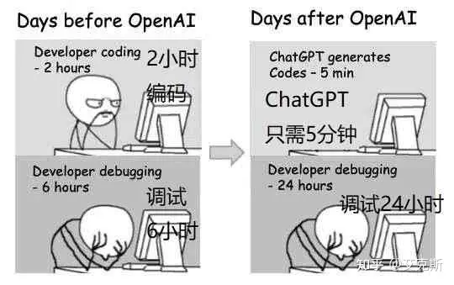
Time Comparison for Developing a Project:
Coding Time and Execution Time
C++
Python
Python+
ChatGPT-4

Slide 6
Time Comparison for Developing a Project:
Coding Time and Execution Time
C++
Python
Python+
ChatGPT-4
Python+
ChatGPT-4
+?

Slide 7
How to accelerate your python Genetic Programming Codes?

Slide 8
for individual in population: simulation(individual); offspring; end for

Slide 9
for individual in population: simulation(individual); offspring; end for

Slide 10
Parallel

Slide 11
Parallel Simulation/Evaluation
CPU
Thread 0
Simulation
Individual 0
Simulation
Individual 16
Simulation
Individual 32
···
CPU
Thread 1
Simulation
Individual 1
Simulation
Individual 17
Simulation
Individual 33
···
···
···
CPU
Thread 15
Simulation
Individual 15
Simulation
Individual 31
Simulation
Individual 47
···

Slide 12
# regist executor = concurrent.futures.ProcessPoolExecutor ( max_workers = cores ) toolbox.register ( "multiprocessing", executor.map )
# parallel evaluation invalid_ind = [ ind for ind in population ] fitnesses = toolbox.multiprocessing ( toolbox.evaluate, invalid_ind ) for ind, fit in zip ( invalid_ind, fitnesses ) : ind.fitness.values = ( fit, )

Slide 13
Efficiency
CPU Cores

Slide 14
Efficiency
CPU Cores

Slide 15
Efficiency
CPU Cores

Slide 16
Go into Simulation

Slide 17
Loops to Matrix

Slide 18
(Matrix A × Matrix B).sum (ms)
Intel i7-13700, Python3.8, PyTorch1.7

Slide 19
for individual in population: simulation(individual); offspring; end for

Slide 20
for individual in population:
#ACO simulation for ant in all_ants: while unvisited_cities is not empty: for cities in unvisted_cities: calculate_priority by individual; end for; choose next_city; end while; end for; offspring; end for

Slide 21
for individual in population:
#ACO simulation for ant in all_ants: while unvisited_cities is not empty: for cities in unvisted_cities: calculate_priority by individual; end for; choose next_city; end while; end for; offspring; end for

Slide 22
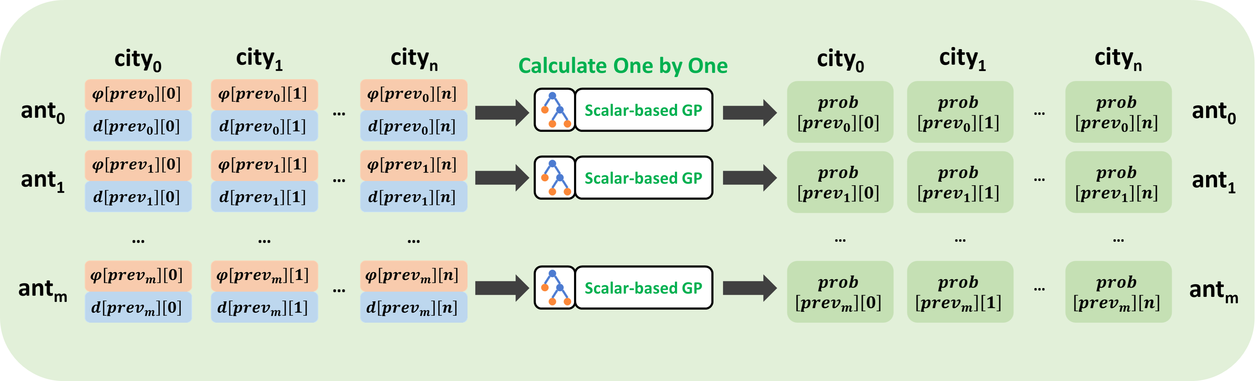
for ant in all_ants: while unvisited_cities is not empty: for cities in unvisted_cities: calculate_priority by individual; end for; choose next_city; end while; end for;

Slide 23
Parallel Simulation/Evaluation
CPU
Thread 0
Simulation
Individual 0
Simulation
Individual 16
Simulation
Individual 32
···
CPU
Thread 1
Simulation
Individual 1
Simulation
Individual 17
Simulation
Individual 33
···
···
···
CPU
Thread 15
Simulation
Individual 15
Simulation
Individual 31
Simulation
Individual 47
···

Slide 24
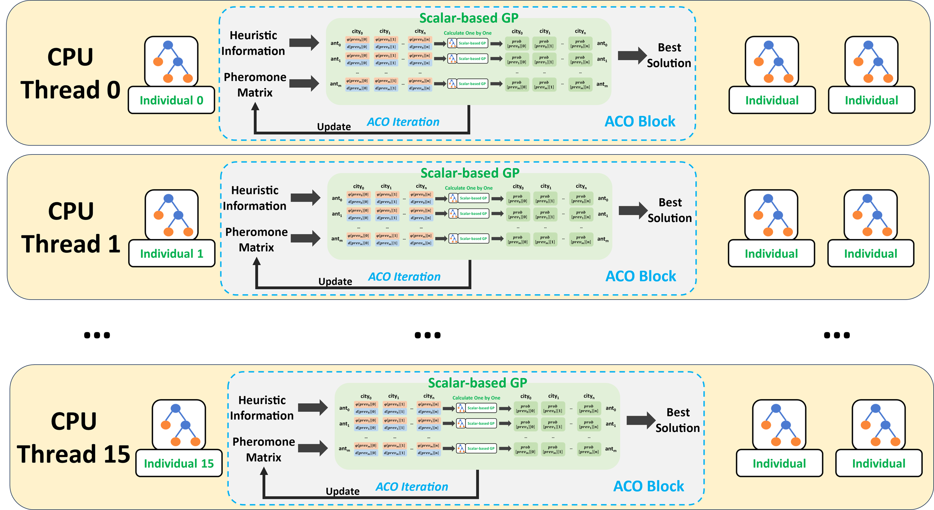
···
···
···

Slide 25
for ant in all_ants: while unvisited_cities is not empty: for cities in unvisted_cities: calculate_priority by individual; choose next_city; end for; end while; end for;
Loops to Matrix

Slide 26
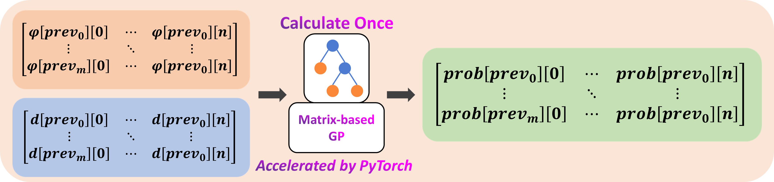
for ant in all_ants: while unvisited_cities is not empty: for cities in unvisted_cities: calculate_priority by individual; choose next_city; end for; end while; end for;

Slide 27
for individual in population:
#ACO simulation for ant in all_ants: while unvisited_cities is not empty: for cities in unvisted_cities: calculate_priority by individual; choose next_city; end for; end while; end for; offspring; end for

Slide 28
for individual in population:
#ACO simulation for ant in all_ants: while unvisited_cities is not empty: for cities in unvisted_cities: calculate_priority by individual; choose next_city; end for; end while; end for; offspring; end for
How to deal with
unvisited_cities ?

Slide 29
for individual in population:
#ACO simulation for ant in all_ants: while unvisited_cities is not empty: for cities in unvisted_cities: calculate_priority by individual; choose next_city; end for; end while; end for; offspring; end for
Matrix A × Matrix B × Mask

Slide 30
Parallel inside Simulation/Evaluation
CPU
Main
Thread 0
CPU Sub-Thread 0-3
for PyTorch
to accelerate
matrix calculation
Simulation
Individual 0
Simulation
Individual 4
Simulation
Individual 8
···
CPU
Main
Thread 1
CPU Sub-Thread 0-3
for PyTorch
to accelerate
matrix calculation
Simulation
Individual 1
Simulation
Individual 5
Simulation
Individual 9
···
CPU
Main
Thread 2
CPU Sub-Thread 0-3
for PyTorch
to accelerate
matrix calculation
Simulation
Individual 2
Simulation
Individual 6
Simulation
Individual 10
···
CPU
Main
Thread 3
CPU Sub-Thread 0-3
for PyTorch
to accelerate
matrix calculation
Simulation
Individual 3
Simulation
Individual 7
Simulation
Individual 11
···

Slide 31
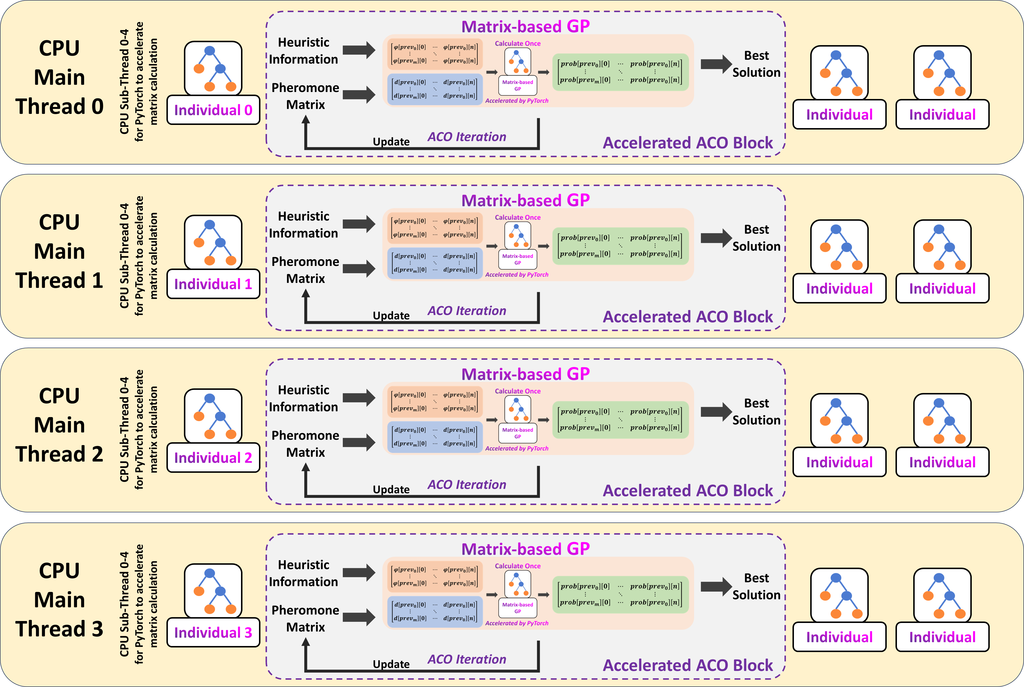

Slide 32
Efficiency
5x +
1x
CPU Cores
16 Cores

Slide 33
Save Over 80% of
Total Execution Time
Efficiency
5x +
1x
CPU Cores
16 Cores

Slide 34
Interesting Blogs and GitHub Projects
How to accelerate matrix calculation
· https://github.com/flame/how-to-optimize-gemm/wiki
· http://technicaldiscovery.blogspot.com/2011/06/speeding-up-python-numpy-cython-and.html
· https://scipy.github.io/old-wiki/pages/PerformancePython.html#An_implementation_in_C.2B-.2B-

Slide 35
Interesting Blogs and GitHub Projects
Implementing PyTorch Operators with CUDA
· https://zhuanlan.zhihu.com/p/595851188?utm_campaign=shareopn&utm_content=group3_article&utm_medium=social&utm_psn=1779857889484021760&utm_source=wechat_session
· https://github.com/YuxueYang1204/CudaDemo/tree/main

Slide 36
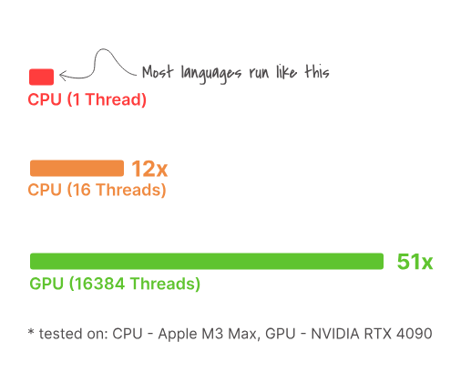

Interesting Blogs and GitHub Projects
Bend : A PARALLEL LANGUAGE on CUDA, feels just like Python
https://higherorderco.com/

Slide 37
Any Questions?
Thank you for your listening!
Bocheng Lin 2024.6.5

