Slide 1
6312 Programming
Welcome

Slide 2
Topics for the day
Introduction, Overview and Welcome
The Team
Survey
Motivations
Course Overview
Teaching methodology and assessment
Expectations
Resources

Slide 3

The Team
Theory - BillR, Majid, Tito
Labs – Artimy, Ying, Tito, Majid, Rakesh and Aayaush
Lab Staff / Teaching Assistance. (We don’t have any atm) ☹

Slide 4
Inwk 6312
What do you want from this?
Survey !

Slide 5
Background
RTOS
Python - RTOS
Programming and RTOS
Programming for INWK Applications

Slide 6
Motivations
The world of Networking is becoming increasingly software based
Software defined “Popular-Network-Technology”
Careers in Networking now consider scripting and testing knowledge essential
Automation and Intelligence are the future
Programming is for everyone

Slide 7

Motivations

Slide 8
6312 Overview
Programming with a focus on internetworking applications
Learning a programming language
Understanding of Algorithms, Data structures and Software Design through practice
Project and Applications of Programming

Slide 9
6312 Overview
6 weeks – We start on 11 Sept(Today) and end on the week on June 12!
First 3 weeks – Introduction to programming with Python
Next 3 weeks – Programming Applications and Project
Last week Project review and final exam

Slide 10
6312 OVERVIEW
13 – Quizzes. Every day! (No specific timing)
Tasks in the lab.
Assignment submission on case to case basics (Pay attention to the lab and Brightspace)
Reading material

Slide 11
Teaching methodology

Slide 12
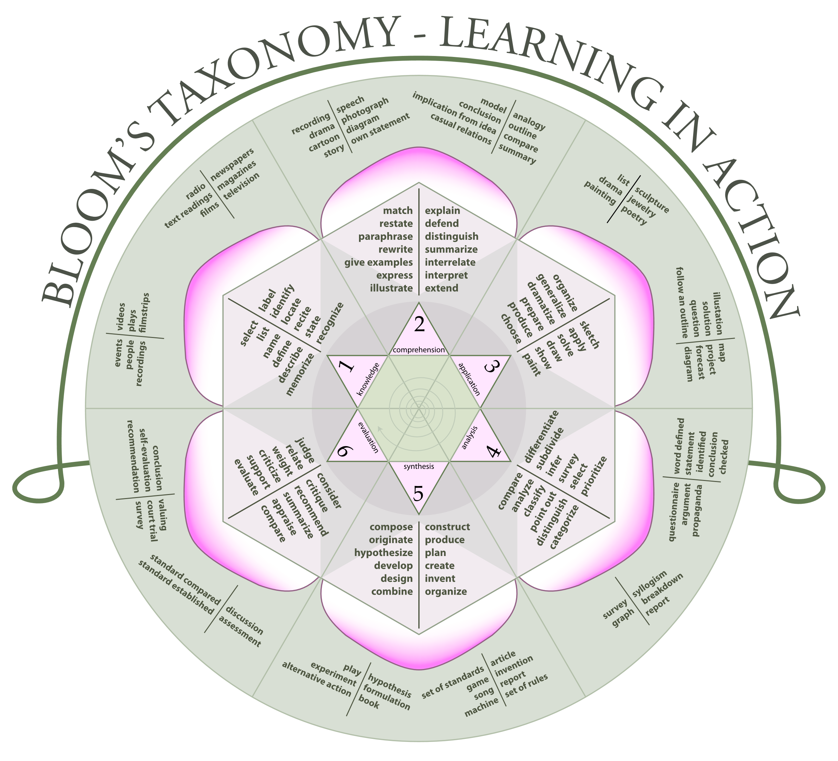
Source: Wiki

Slide 13
Teaching methodology
Bloom’s Taxonomy
Problem Based Learning
Hybrid approach

Slide 14
Assessment
Continuous assessment - You will be asked questions during the lab and will be assessed based on your tasks
Quizzes - track acuminated knowledge, understanding and applications
Programming quizzes track application and synthesis
Exams tracks all domains
Projects tracks analysis, application and evaluation

Slide 15
6312 Grading
Grading will be as follows:
Attendance 10%
Homework / Assignment 10%
Continuous Assessment 10%
Quizzes 15%
Mid-examination (Exam 1) 15%
Final Examination (Exam 2) 15%
Project 25%

Slide 16
Expectations
What can you expect from us?
What is expected of you?
Practice

Slide 17
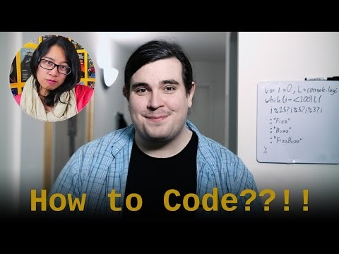
How to learn to code

Slide 18
Resources
The Book
Brightspace and Website
Notes, Labs and Guides

Slide 19
Resources
Setting up your PC
Windows, Mac and Linux Tips
Using Linux and Git
Virtual Machines and Cloud Setup
Offline and Online Interpreters and IDEs
More details on the lab sessions

Slide 20
Today’s Topics
Think python – How to think like a computer scientist and Resources
Chapter 1 – The way of the program
Chapter 2 – Variables, Expression and Statements
Chapter 3 – Functions

Slide 21
Why python
https://www.youtube.com/watch?v=ZyjCqQEUa8o&feature=youtu.be&t=1160

