Slide 1
WPF 4 Unleased
Chapter 4-5-21 in a nutshell

Slide 2
Chapter 4
Sizing, Positioning, and Transforming Elements

Slide 3
Chapter 4 – Sizing, Positioning, and Transforming Elements
Layout
~ Sizing and positioning of controls and other elements.
In WPF, parents and children are working together to determine the final size and position:
Parents ultimately tell kids where to render, and in what size
Kids have a chance to tell their parents how much space they need
System.Windows.Controls.Panel – supports arranging multiple child elements
System.Windows.UIElement – All elements taking place in the layout process

Slide 4
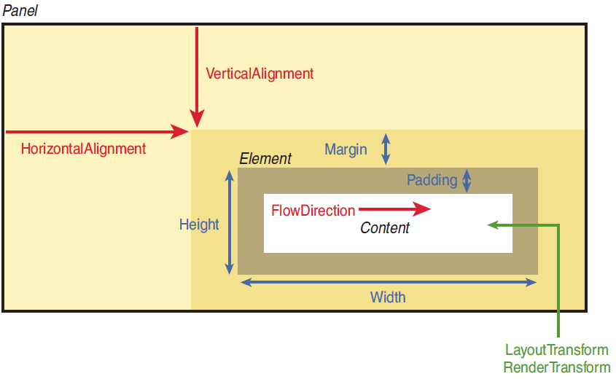
Chapter 4 – Sizing, Positioning, and Transforming Elements
Overview
{Live Demo}

Slide 5
Chapter 4 – Sizing, Positioning, and Transforming Elements
Controlling Size
~ WPF Elements tend to size to their content.
FrameworkElement properties (all accessible from XAML)
Layout process input
Height & Width – default Double.NaN (or Auto!)
MinHeight & MinWidth – default 0.0
MaxHeight & MaxWidth – default Double.PositiveInfinity
{Live Demo}
Layout process output (read-only)
DesiredSize
Inherited from UIElement
Calculated during layout, based on child’s properties like Height, Width, etc.
RenderSize
Inherited from UIElement
Represents the final size of the element
ActualHeight & ActualWidth (WARNING – use only in LayoutUpdated eventhandler)
Equals to RenderSize.Width & RenderSize.Height

Slide 6
Chapter 4 – Sizing, Positioning, and Transforming Elements
Margin and Padding
~ refer to box model
Margin
Controls how much extra space gets placed around the outside edges of the element
Padding
{Live Demo}
Controls how much extra space gets placed around the inside edges of the element
System.Windows.Thickness
Can represent 1, 2 or 4 double values
XAML vs. C# → System.Windows.ThicknessConverter
myLabel.Margin = new Thickness(10); // Same as Margin=”10” in XAML
myLabel.Margin = new Thickness(20,5,20,5); // Same as Margin=”20,5” in XAML
myLabel.Margin = new Thickness(0,10,20,30); // Same as Margin=”0,10,20,30” in XAML

Slide 7
Chapter 4 – Sizing, Positioning, and Transforming Elements
Unit of measurement & Visibility
Various unit types
LengthConverter associated with explicit units (cm, pt, in, px)
WPF works with device-independent pixels (1/96 inch)
Visibility
{Live Demo}
Visible – The element is rendered and participates in layout.
Collapsed – The element in invisible and does not participate in layout.
Hidden – The element is invisible yet still participates in layout.

Slide 8
Chapter 4 – Sizing, Positioning, and Transforming Elements
Controlling Position
Alignment
HorizontalAlignment - Left, Center, Right, and Stretch
VerticalAlignment - Top, Center, Bottom, and Stretch
Content Alignment
HorizontalContentAlignment - Left, Center, Right, and Stretch
VerticalContentAlignment - Top, Center, Bottom, and Stretch
{Live Demo}
FlowDirection
Can reverse the way an element’s inner content flows.
It does not reverse strings!
System.Windows.Documents.FlowDocument for versatile UI composition (image + text + Multilanguage support)

Slide 9
Chapter 4 – Sizing, Positioning, and Transforming Elements
Applying Transforms
Transform Types
LayoutTransform - which is applied before the element is laid out
RenderTransform - (inherited from UIElement), which is applied after the layout process has finished (immediately before the element is rendered)
Built-in 2D transforms
RotateTransform
ScaleTransform
SkewTransform
TranslateTransform
MatrixTransform
{Live Demo}
GOOD TO KNOW
Applying a transform to FrameworkElement never changes the values of ActualWidth and ActualHeight. Yes, they can lie.
Padding is scaled along with the rest of the content (because Padding is internal to the element), but Margin does not get scaled.
Not all FrameworkElements support transforms!

Slide 10
Chapter 5
Layout with Panels

Slide 11
Chapter 5 – Layout with Panels
Layout

