Slide 1
WPF 4 Unleased
Chapter 4-5-21 in a nutshell

Slide 2
Chapter 4
Sizing, Positioning, and Transforming Elements

Slide 3
Chapter 4 – Sizing, Positioning, and Transforming Elements
Layout
~ Sizing and positioning of controls and other elements.
In WPF, parents and children are working together to determine the final size and position:
Parents ultimately tell kids where to render, and in what size
Kids have a chance to tell their parents how much space they need
System.Windows.Controls.Panel – supports arranging multiple child elements
System.Windows.UIElement – All elements taking place in the layout process

Slide 4
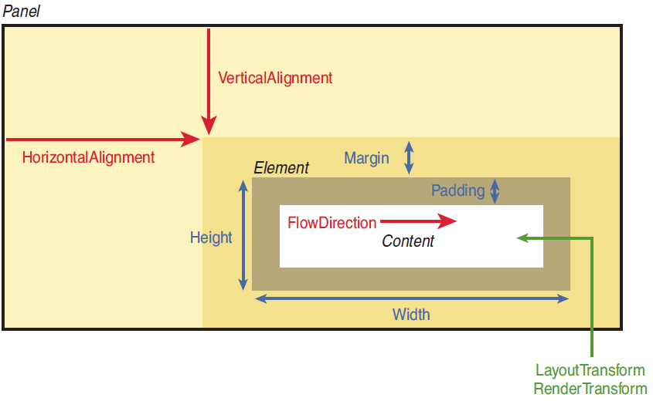
Chapter 4 – Sizing, Positioning, and Transforming Elements
Overview
{Live Demo}

Slide 5
Chapter 4 – Sizing, Positioning, and Transforming Elements
Controlling Size
~ WPF Elements tend to size to their content.
FrameworkElement properties (all accessible from XAML)
Layout process input
Height & Width – default Double.NaN (or Auto!)
MinHeight & MinWidth – default 0.0
MaxHeight & MaxWidth – default Double.PositiveInfinity
{Live Demo}
Layout process output (read-only)
DesiredSize
Inherited from UIElement
Calculated during layout, based on child’s properties like Height, Width, etc.
RenderSize
Inherited from UIElement
Represents the final size of the element
ActualHeight & ActualWidth (WARNING – use only in LayoutUpdated eventhandler)
Equals to RenderSize.Width & RenderSize.Height

Slide 6
Chapter 4 – Sizing, Positioning, and Transforming Elements
Margin and Padding
~ refer to box model
Margin
Controls how much extra space gets placed around the outside edges of the element
Padding
{Live Demo}
Controls how much extra space gets placed around the inside edges of the element
System.Windows.Thickness
Can represent 1, 2 or 4 double values
XAML vs. C# → System.Windows.ThicknessConverter
myLabel.Margin = new Thickness(10); // Same as Margin=”10” in XAML
myLabel.Margin = new Thickness(20,5,20,5); // Same as Margin=”20,5” in XAML
myLabel.Margin = new Thickness(0,10,20,30); // Same as Margin=”0,10,20,30” in XAML

Slide 7
Chapter 4 – Sizing, Positioning, and Transforming Elements
Unit of measurement & Visibility
Various unit types
LengthConverter associated with explicit units (cm, pt, in, px)
WPF works with device-independent pixels (1/96 inch)
Visibility
{Live Demo}
Visible – The element is rendered and participates in layout.
Collapsed – The element in invisible and does not participate in layout.
Hidden – The element is invisible yet still participates in layout.

Slide 8
Chapter 4 – Sizing, Positioning, and Transforming Elements
Controlling Position
Alignment
HorizontalAlignment - Left, Center, Right, and Stretch
VerticalAlignment - Top, Center, Bottom, and Stretch
Content Alignment
HorizontalContentAlignment - Left, Center, Right, and Stretch
VerticalContentAlignment - Top, Center, Bottom, and Stretch
{Live Demo}
FlowDirection
Can reverse the way an element’s inner content flows.
It does not reverse strings!
System.Windows.Documents.FlowDocument for versatile UI composition (image + text + Multilanguage support)

Slide 9
Chapter 4 – Sizing, Positioning, and Transforming Elements
Applying Transforms
Transform Types
LayoutTransform - which is applied before the element is laid out
RenderTransform - (inherited from UIElement), which is applied after the layout process has finished (immediately before the element is rendered)
Built-in 2D transforms
RotateTransform
ScaleTransform
SkewTransform
TranslateTransform
MatrixTransform
{Live Demo}
GOOD TO KNOW
Applying a transform to FrameworkElement never changes the values of ActualWidth and ActualHeight. Yes, they can lie.
Padding is scaled along with the rest of the content (because Padding is internal to the element), but Margin does not get scaled.
Not all FrameworkElements support transforms!

Slide 10
Chapter 5
Layout with Panels

Slide 11
Chapter 5 – Layout with Panels
Canvas
~ System.Windows.Controls
You can position elements in a Canvas by using its attached properties: Left, Top, Right,
and Bottom.
Usable Inside Canvas?
Margin | Partially. On the two sides used to position the element (Top and Left by default), the relevant two out of four margin values are added to the attached property values.
HorizontalAlignment and VerticalAlignment | No. Elements are given only the exact space they need.
LayoutTransform | Yes. Differs from RenderTransform because when LayoutTransform is used, elements always remain the specified distance from the selected corner of the Canvas.
{Live Demo}
Z-Index
Canvas.ZIndex=“1”
Panel.SetZIndex(redButton, 0);

Slide 12
Chapter 5 – Layout with Panels
StackPanel
~ System.Windows.Controls
As its name suggests, it simply stacks its children sequentially.
Orientation
Horizontal
Vertical
{Live Demo}
FlowDirection affects stacking order!
VirtualizingStackPanel
derive from the abstract System.Windows.Controls.VirtualizingPanel class
temporarily discards any items offscreen to optimize performance (only when data binding).

Slide 13
Chapter 5 – Layout with Panels
WrapPanel
~ System.Windows.Controls
In addition to stacking its child elements, it wraps them to additional rows or columns when there’s not enough space for a single stack
Orientation
This is just like StackPanel’s property, except Horizontal is the default.
ItemHeight
{Live Demo}
A uniform width for all child elements. The way each child fills that height depends on its own VerticalAlignment, Height, and so forth. Any elements taller than ItemHeight get clipped
ItemWidth
A uniform width for all child elements. The way each child fills that width depends on its own HorizontalAlignment, Width, and so forth. Any elements wider than ItemWidth get clipped.
FlowDirection affects stacking order!

Slide 14
Chapter 5 – Layout with Panels
DockPanel
~ System.Windows.Controls
DockPanel enables easy docking of elements to an entire side of the panel, stretching it to
fill the entire width or height.
DockPanel.Dock
Top
Bottom
Left
Right
{Live Demo}
LastChildFill
When set to true (the default), the last child’s Dock setting is ignored.

Slide 15
Chapter 5 – Layout with Panels
Grid
~ System.Windows.Controls
It enables you to arrange its children in a multirow and multicolumn fashion, without relying on wrapping.
Attached Properties
ShowGridLines="True"
Grid.Row
{Live Demo}
Grid.Column
Grid.ColumnSpan
Grid.RowSpan
Grid.RowDefinitions
Grid.ColumnDefinitions
Sizing
Absolute – Width=“500”
Auto – Width=“Auto”
Proportional – Width=“2*”
Interactive Sizing with GridSplitter

Slide 16
Chapter 5 – Layout with Panels
Primitive Panels
~ System.Windows.Controls
TabPanel
ToolBarPanel
ToolBarOverflowPanel
{Live Demo}
ToolBarTray
UniformGrid
SelectiveScrollingGrid

Slide 17
Chapter 5 – Layout with Panels
Handling Content Overflow
~ System.Windows.Controls
Clipping
Scrolling
Scaling
Wrapping
Trimming
{Live Demo}

