Slide 1
1aq3 – RNA Complex

Slide 2
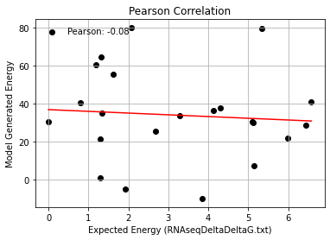
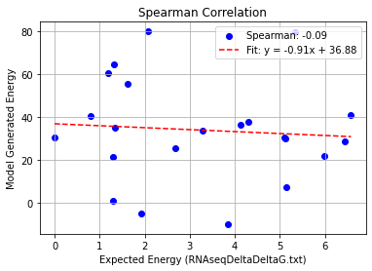
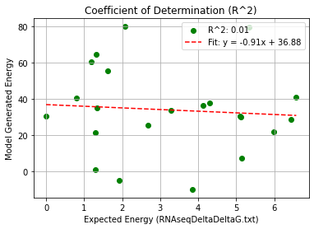
1AQ3_Single Mutation – PHI 9.5
Pearson rank correlation coefficient: -0.078
Spearman rank correlation coefficient: -0.091
Coefficient of Determination (R^2): 0.006

Slide 3
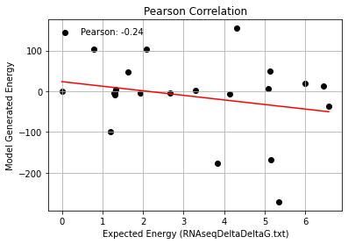
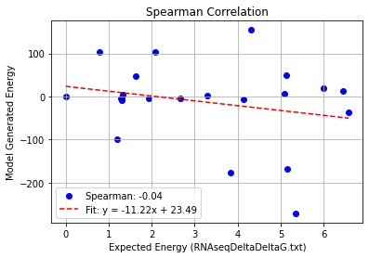
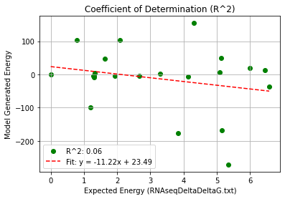
1AQ3(AS)_Single Mutation – PHI 9.5
Pearson rank correlation coefficient: -0.240
Spearman rank correlation coefficient: -0.045
Coefficient of Determination (R^2): 0.058

Slide 4
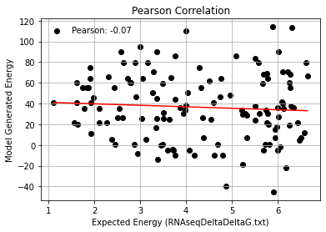
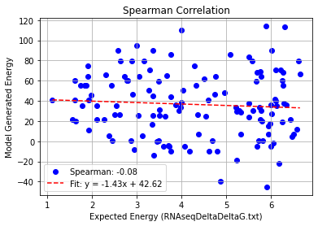
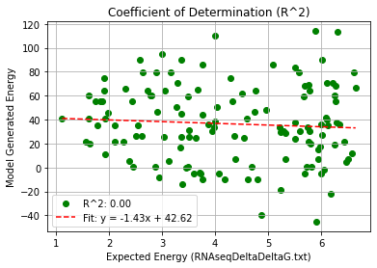
1AQ3_Double Mutation – PHI 9.5
Pearson rank correlation coefficient: -0.069
Spearman rank correlation coefficient: -0.076
Coefficient of Determination (R^2): 0.005

Slide 5
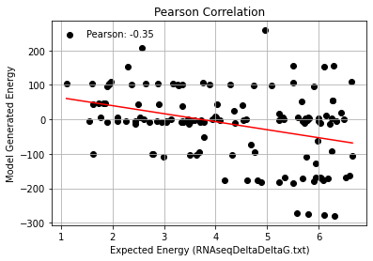
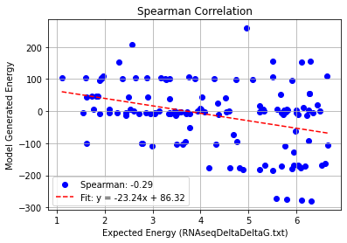
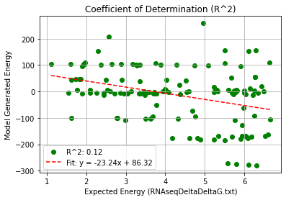
1AQ3(AS)_Double Mutation – PHI 9.5
Pearson rank correlation coefficient: -0.353
Spearman rank correlation coefficient: -0.290
Coefficient of Determination (R^2): 0.125

Slide 6
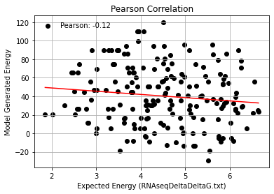
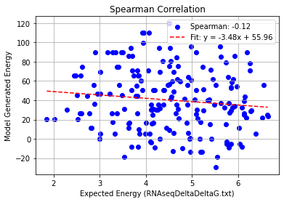
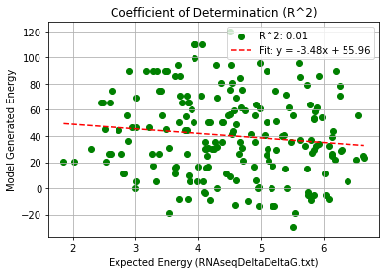
1AQ3_Triple Mutation – PHI 9.5
Pearson rank correlation coefficient: -0.121
Spearman rank correlation coefficient: -0.120
Coefficient of Determination (R^2): 0.015

Slide 7
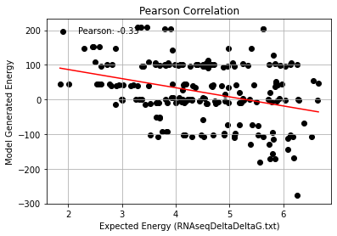
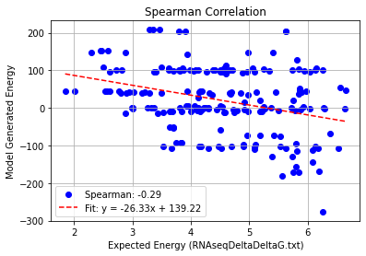
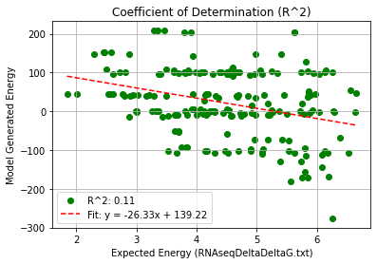
1AQ3(AS)_Triple Mutation – PHI 9.5
Pearson rank correlation coefficient: -0.326
Spearman rank correlation coefficient: -0.285
Coefficient of Determination (R^2): 0.107

Slide 8
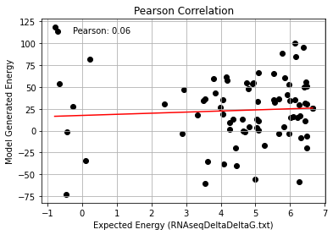
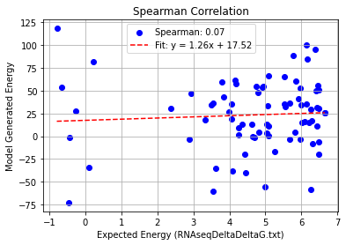
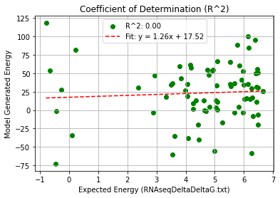
1AQ3_Quadruple Mutation – PHI 9.5
Pearson rank correlation coefficient: 0.063
Spearman rank correlation coefficient: 0.074
Coefficient of Determination (R^2): 0.004

Slide 9
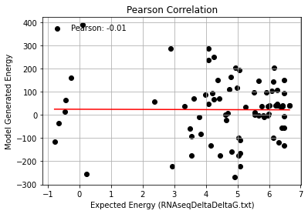
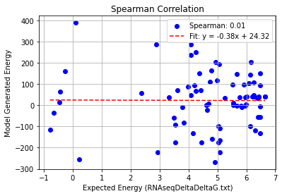
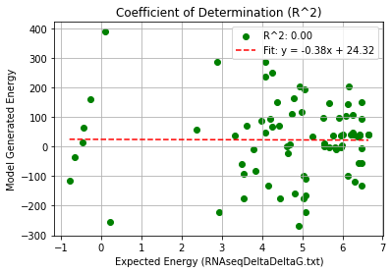
1AQ3(AS)_Quadruple Mutation – PHI 9.5
Pearson rank correlation coefficient: -0.006
Spearman rank correlation coefficient: 0.015
Coefficient of Determination (R^2): 0.000

Slide 10
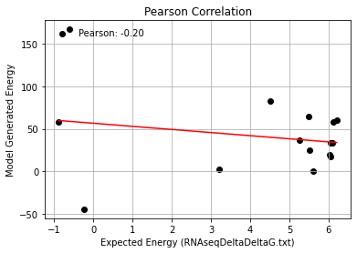
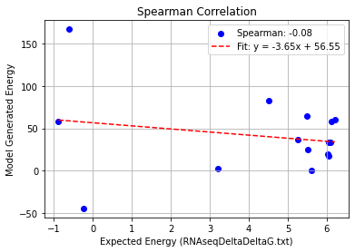
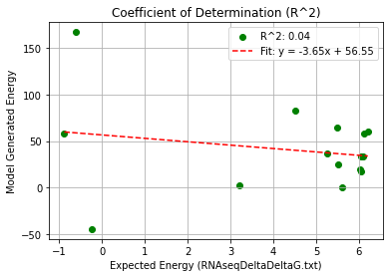
1AQ3_Quintuple Mutation – PHI 9.5
Pearson rank correlation coefficient: -0.205
Spearman rank correlation coefficient: -0.077
Coefficient of Determination (R^2): 0.042

Slide 11
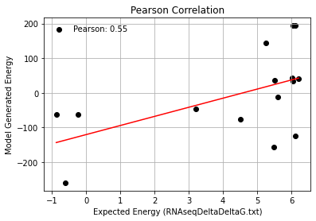
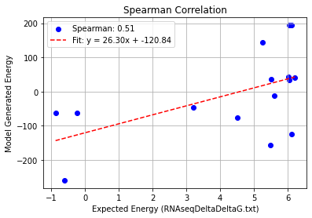
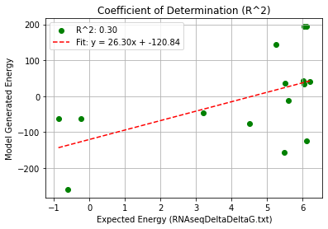
1AQ3(AS)_Quintuple Mutation – PHI 9.5
Pearson rank correlation coefficient: 0.547
Spearman rank correlation coefficient: 0.513
Coefficient of Determination (R^2): 0.300

