Slide 1
2bu1, 2c4q, 2c4y, 2c4z – RNA Complex

Slide 2
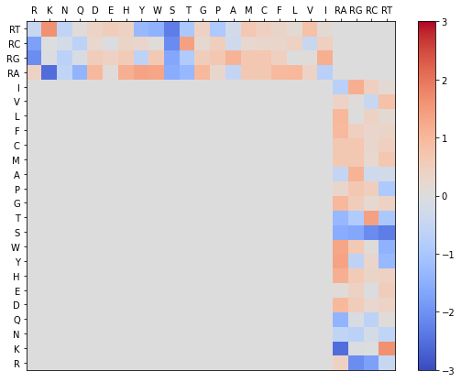
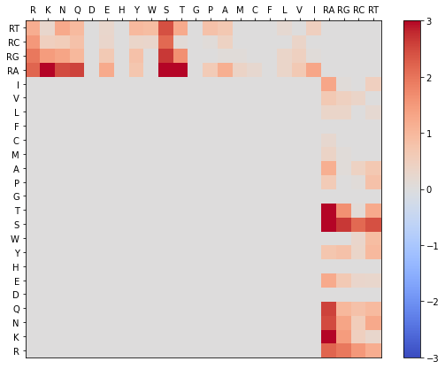
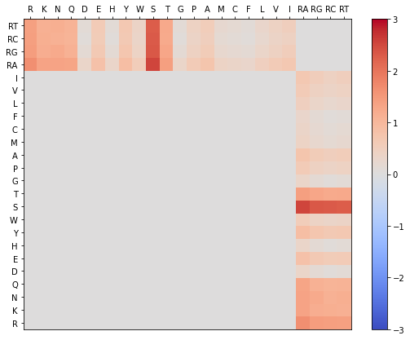
2bu1, 2c4q, 2c4y, 2c4z Phi & Gamma Graphs
Gamma Randomization
Phis Native
Phis Decoy

Slide 3
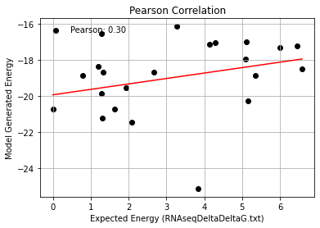
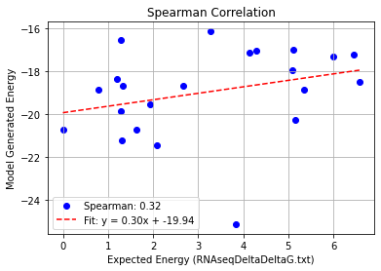
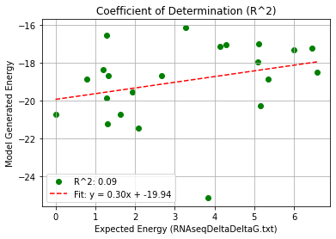
MS2_Nat_Single Mutation – PHI 9.5
Pearson rank correlation coefficient: 0.297
Spearman rank correlation coefficient: 0.317
Coefficient of Determination (R^2): 0.088

Slide 4
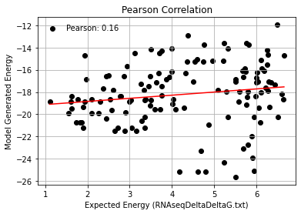
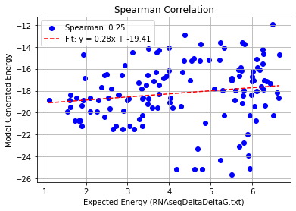
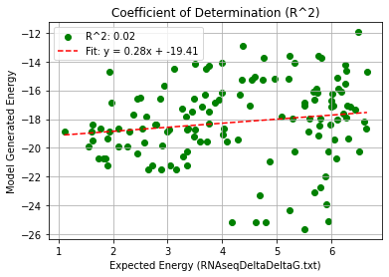
MS2_Nat_Double Mutation – PHI 9.5
Pearson rank correlation coefficient: 0.158
Spearman rank correlation coefficient: 0.245
Coefficient of Determination (R^2): 0.025

Slide 5
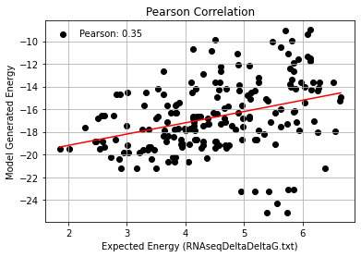
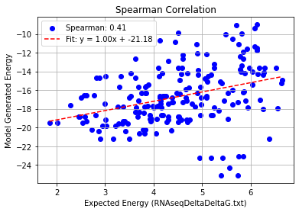
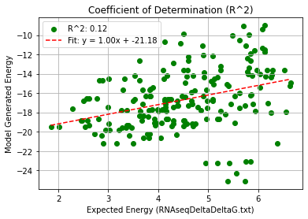
MS2_Nat_Triple Mutation – PHI 9.5
Pearson rank correlation coefficient: 0.348
Spearman rank correlation coefficient: 0.408
Coefficient of Determination (R^2): 0.121

Slide 6
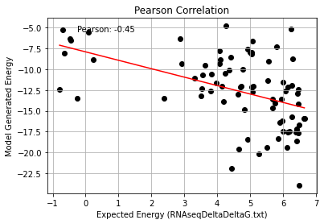
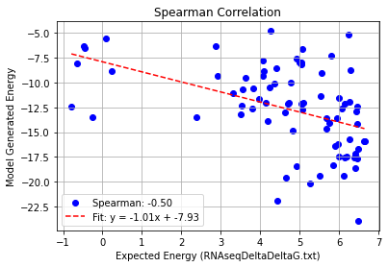
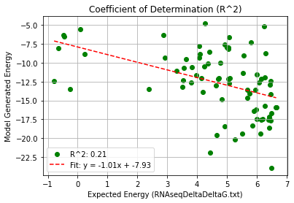
MS2_Nat_Quadruple Mutation – PHI 9.5
Pearson rank correlation coefficient: -0.453
Spearman rank correlation coefficient: -0.503
Coefficient of Determination (R^2): 0.205

Slide 7
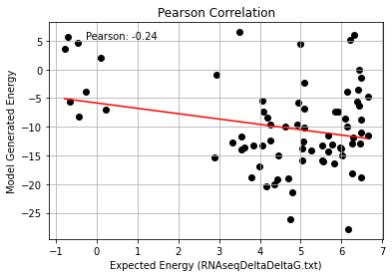
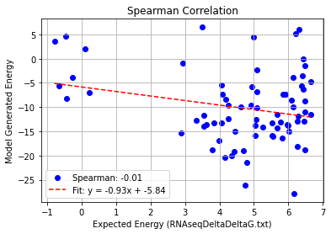
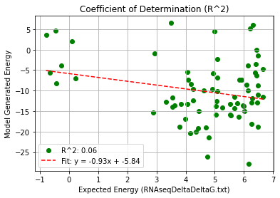
MS2_Nat_AF_Quadruple Mutation – PHI 9.5
Pearson rank correlation coefficient: -0.245
Spearman rank correlation coefficient: -0.007
Coefficient of Determination (R^2): 0.060

