Slide 1
2c4q – RNA Complex

Slide 2
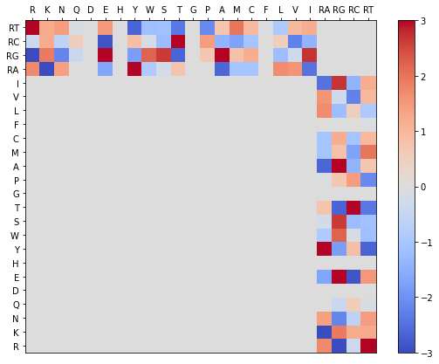
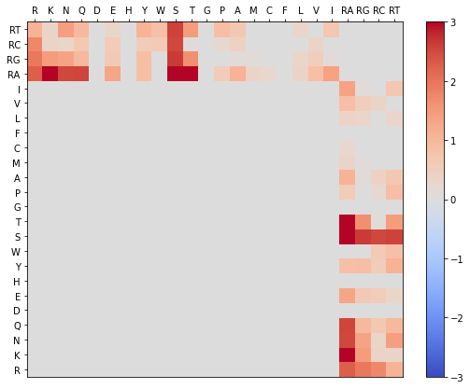
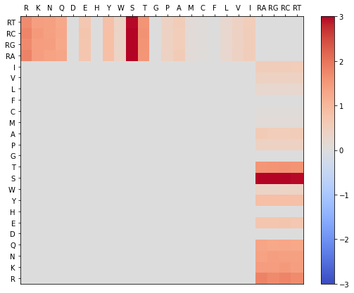
2c4q Phi & Gamma Graphs
Gamma Randomization
Phis Native
Phis Decoy

Slide 3
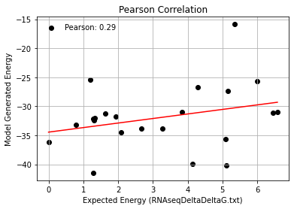
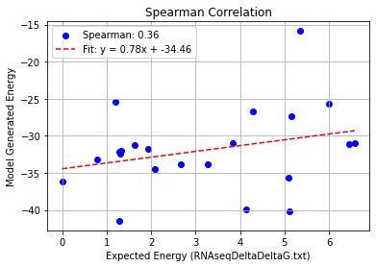
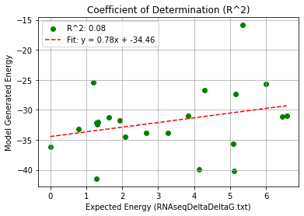
(half_AA_seq)2c4q_Single Mutation – PHI 9.5
Pearson rank correlation coefficient: 0.285
Spearman rank correlation coefficient: 0.362
Coefficient of Determination (R^2): 0.081

Slide 4
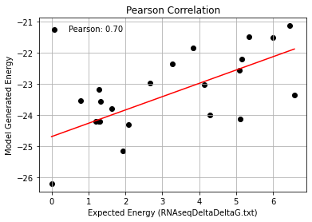
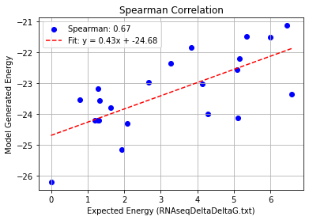
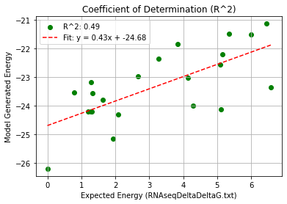
2c4q_Single Mutation – PHI 9.5
Pearson rank correlation coefficient: 0.697
Spearman rank correlation coefficient: 0.669
Coefficient of Determination (R^2): 0.486

Slide 5
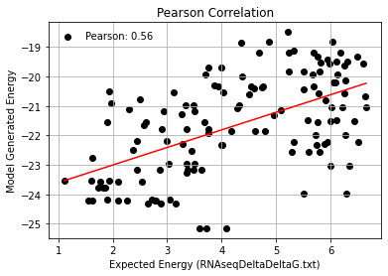
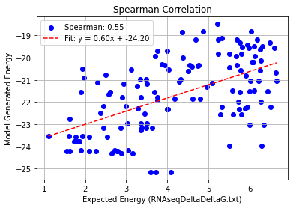
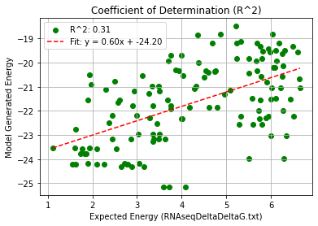
2c4q_Double Mutation – PHI 9.5
Pearson rank correlation coefficient: 0.556
Spearman rank correlation coefficient: 0.545
Coefficient of Determination (R^2): 0.309

Slide 6
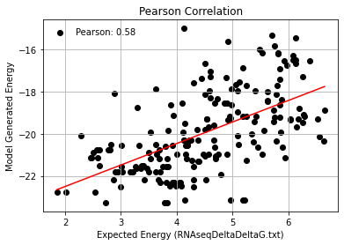
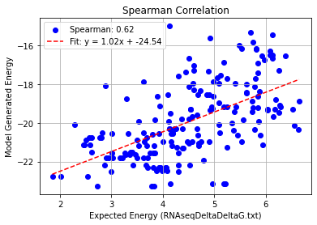
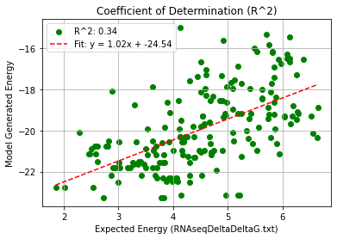
2c4q_Triple Mutation – PHI 9.5
Pearson rank correlation coefficient: 0.581
Spearman rank correlation coefficient: 0.615
Coefficient of Determination (R^2): 0.338

Slide 7
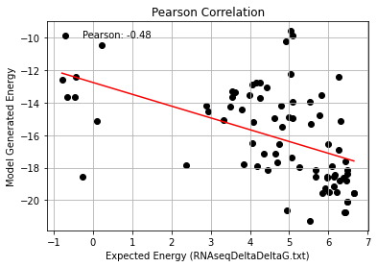
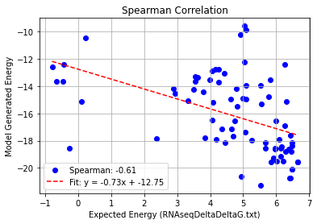
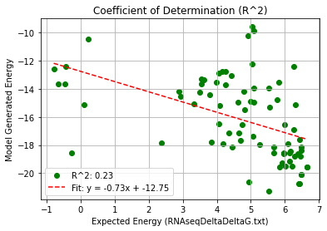
2c4q_Quadruple Mutation – PHI 9.5
Pearson rank correlation coefficient: -0.478
Spearman rank correlation coefficient: -0.607
Coefficient of Determination (R^2): 0.228

Slide 8
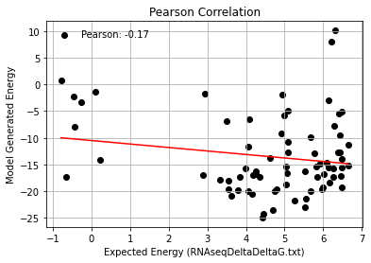
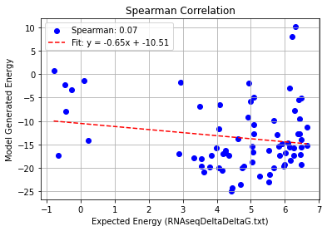
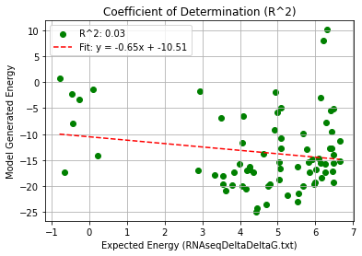
2c4q_AF_Quadruple Mutation – PHI 9.5
Pearson rank correlation coefficient: -0.174
Spearman rank correlation coefficient: 0.070
Coefficient of Determination (R^2): 0.030

Slide 9
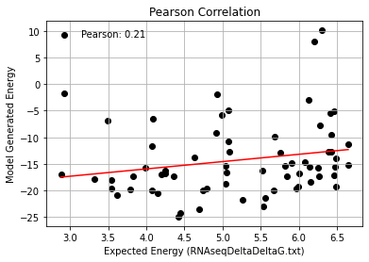
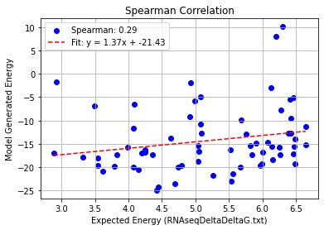
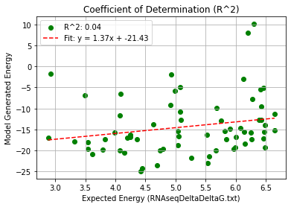
2c4q_AF_Quadruple Mutation – Remove Low Expected Energy
Pearson rank correlation coefficient: 0.210 Spearman rank correlation coefficient: 0.288 Coefficient of Determination (R^2): 0.044

Slide 10
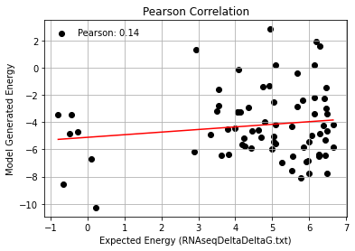
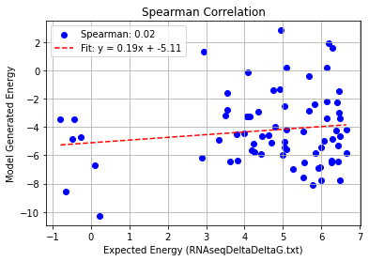
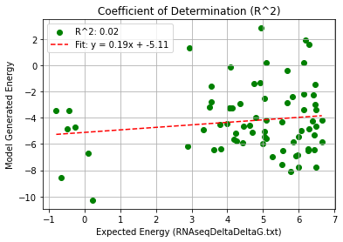
AF_Outliers_Quadruple Mutation – PHI 9.5
Pearson rank correlation coefficient: 0.143
Spearman rank correlation coefficient: 0.022
Coefficient of Determination (R^2): 0.020

Slide 11
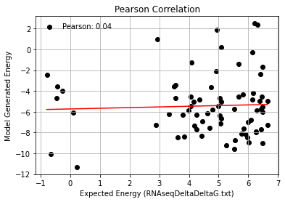
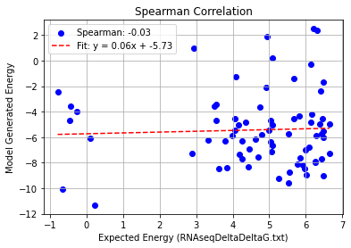
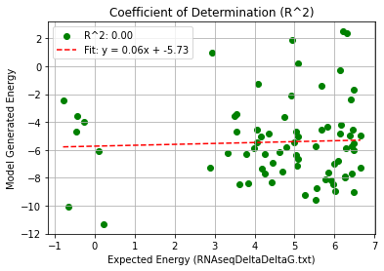
2c4q+AF_Outliers_Quadruple Mutation – PHI 9.5
Pearson rank correlation coefficient: 0.043
Spearman rank correlation coefficient: -0.025
Coefficient of Determination (R^2): 0.002

Slide 12
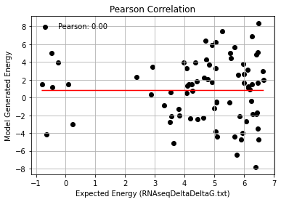
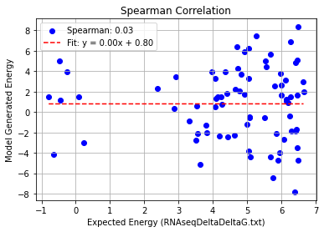
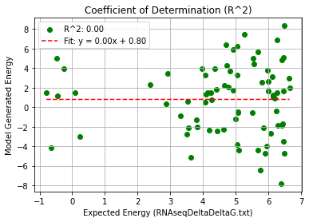
66-CCAUAAGGCACACCCAUGU - Testing
Pearson rank correlation coefficient: 0.000
Spearman rank correlation coefficient: 0.028
Coefficient of Determination (R^2): 0.000

Slide 13
77-ACCUGAAAAUAACCCAUGU - Testing
Pearson rank correlation coefficient: 0.000
Spearman rank correlation coefficient: 0.028
Coefficient of Determination (R^2): 0.000

