Slide 1
2c4y – RNA Complex

Slide 2
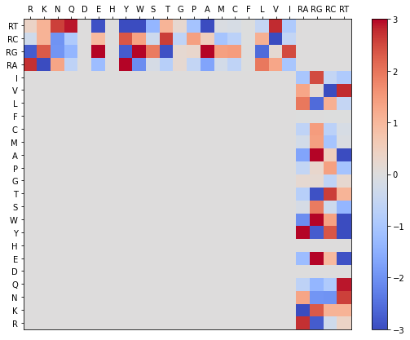
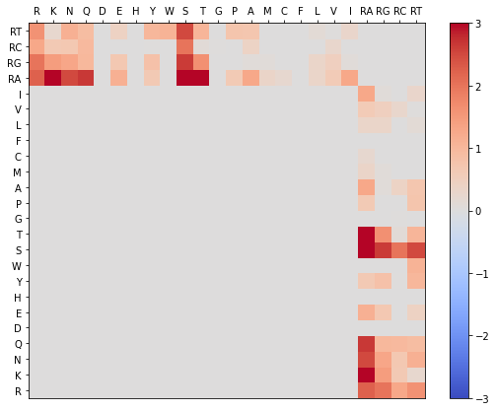
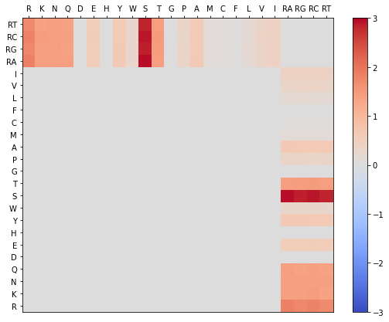
2c4y Phi & Gamma Graphs
Gamma Randomization
Phis Native
Phis Decoy

Slide 3
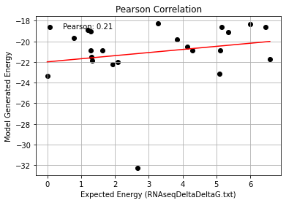
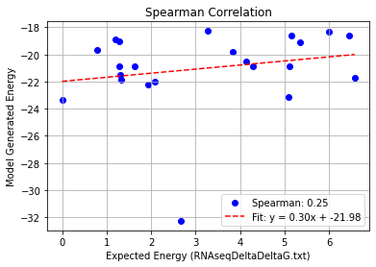
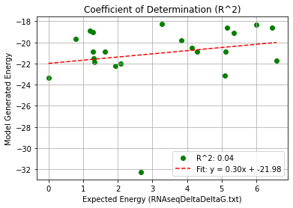
2c4y_Single Mutation – PHI 9.5
Pearson rank correlation coefficient: 0.209
Spearman rank correlation coefficient: 0.254
Coefficient of Determination (R^2): 0.044

Slide 4
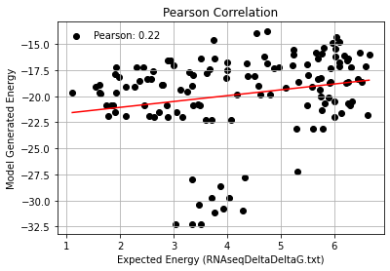
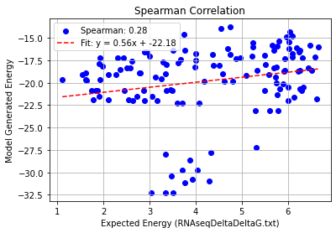
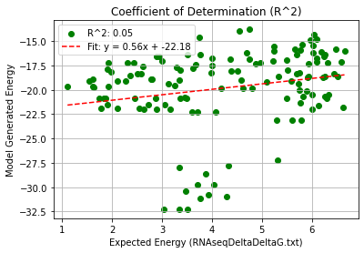
2c4y_Double Mutation – PHI 9.5
Pearson rank correlation coefficient: 0.215
Spearman rank correlation coefficient: 0.278
Coefficient of Determination (R^2): 0.046

Slide 5
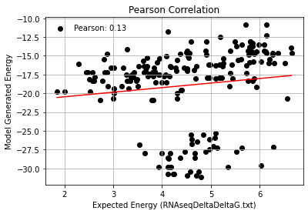
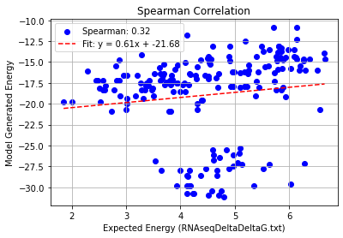
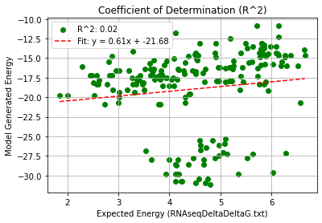
2c4y_Triple Mutation – PHI 9.5
Pearson rank correlation coefficient: 0.130
Spearman rank correlation coefficient: 0.319
Coefficient of Determination (R^2): 0.017

Slide 6
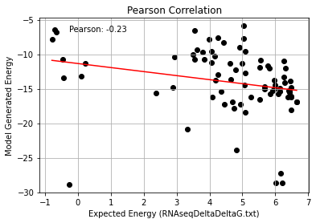
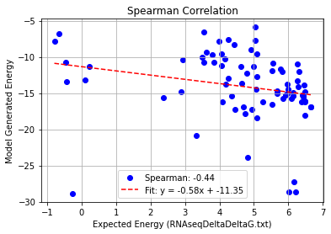
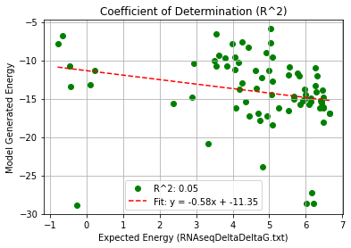
2c4y_Quadruple Mutation – PHI 9.5
Pearson rank correlation coefficient: -0.232
Spearman rank correlation coefficient: -0.438
Coefficient of Determination (R^2): 0.054

Slide 7
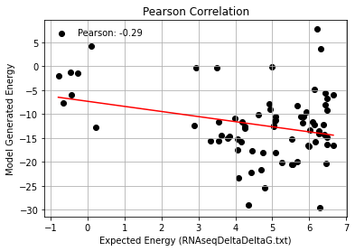
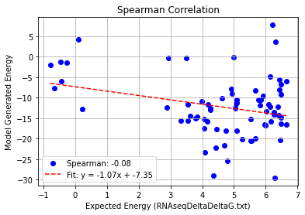
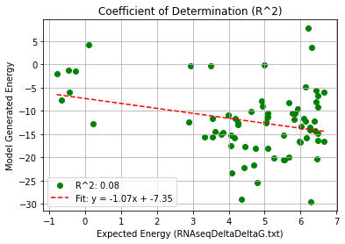
2c4y_AF_Quadruple Mutation – PHI 9.5
Pearson rank correlation coefficient: -0.285
Spearman rank correlation coefficient: -0.083
Coefficient of Determination (R^2): 0.081

