Slide 1
Alpha Fold Outliers: 71-77

Slide 2
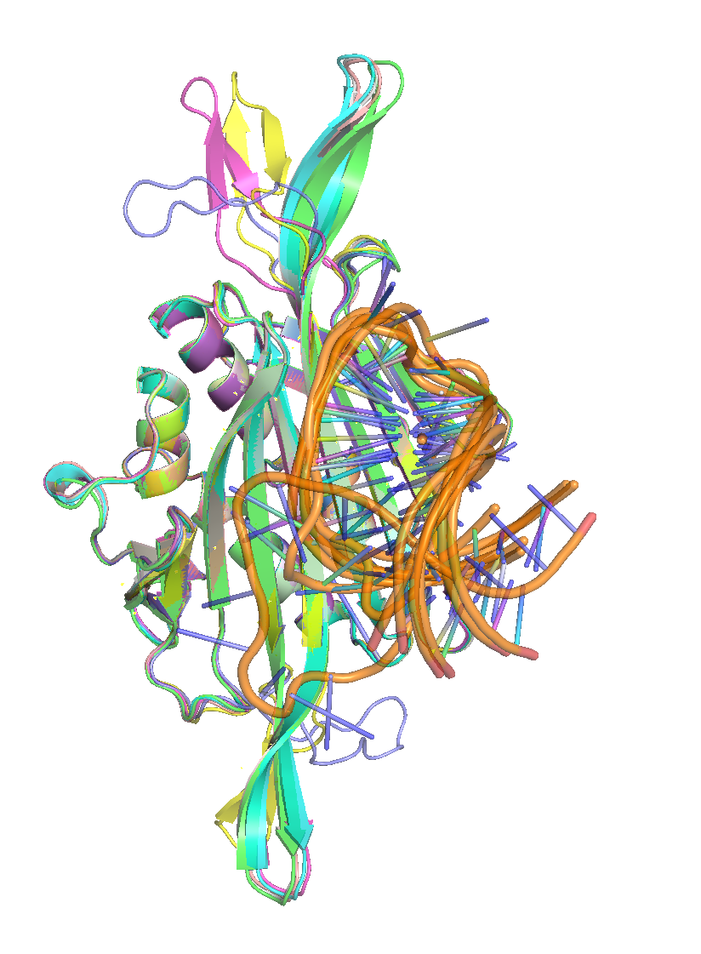
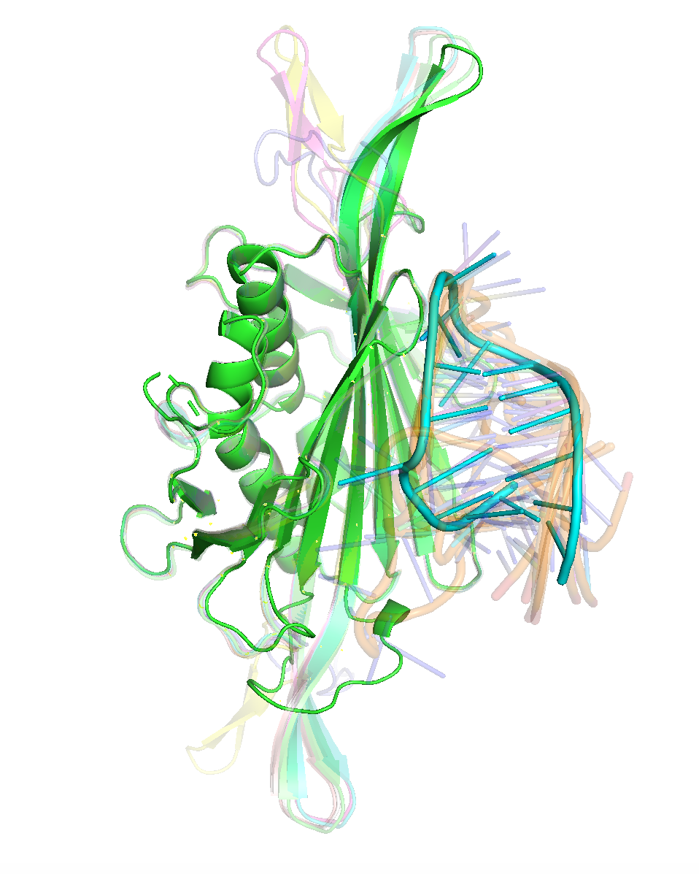
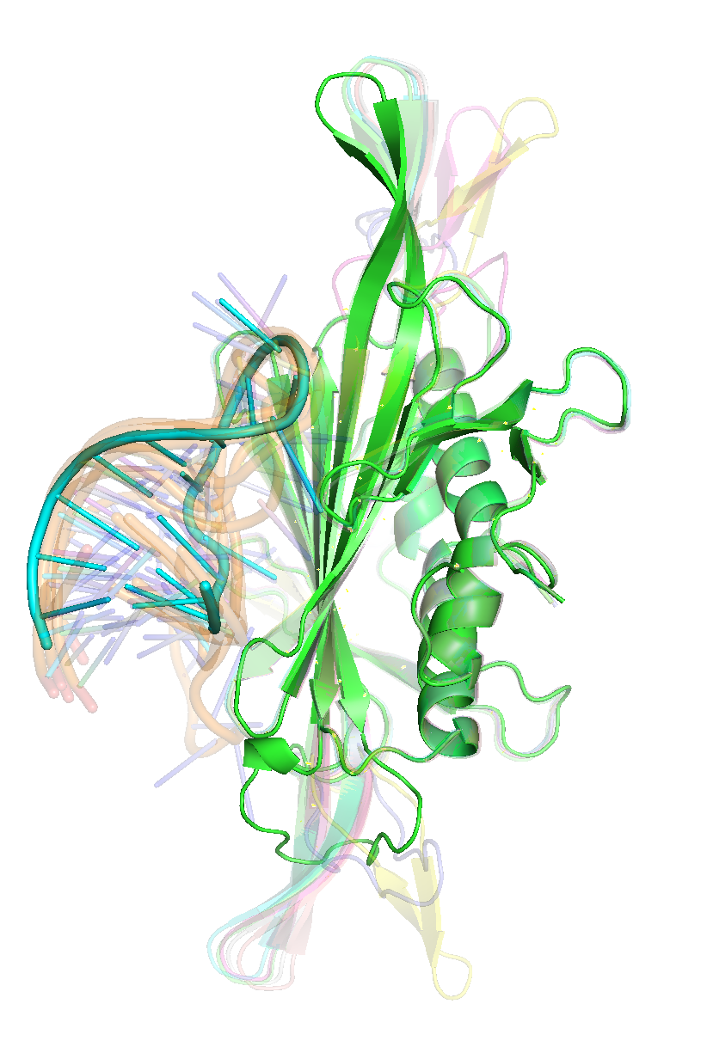
Outlier PDB Structure – (2c4q = green)

Slide 3
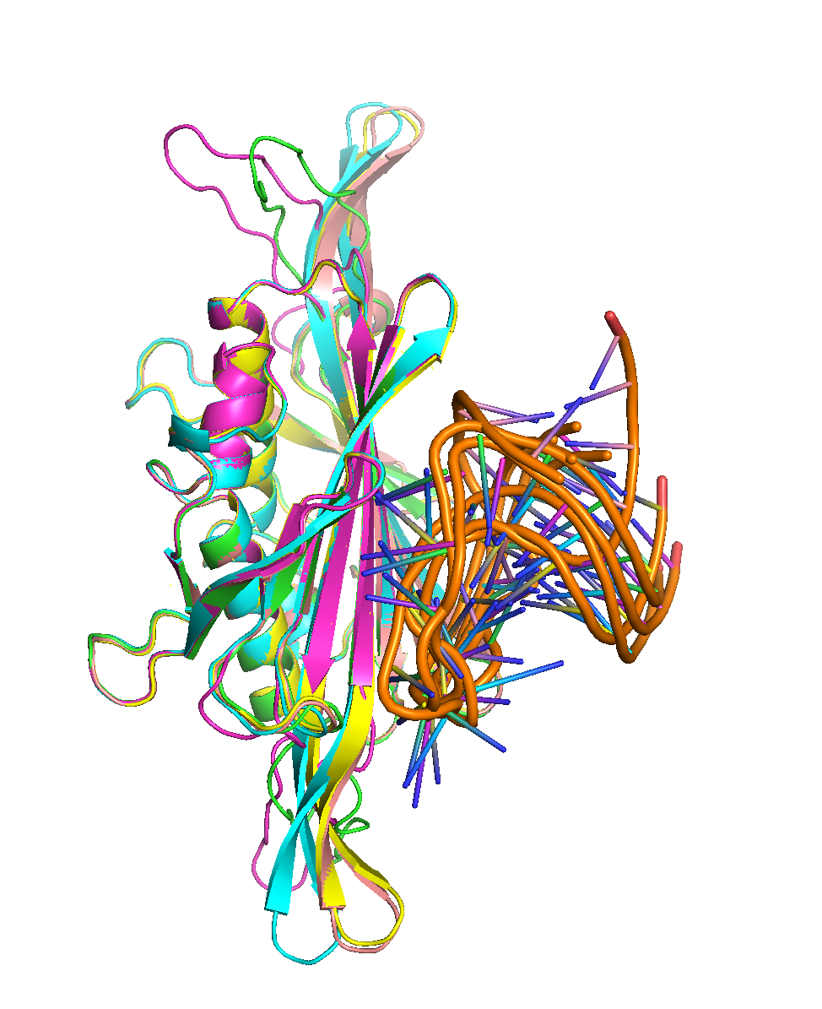
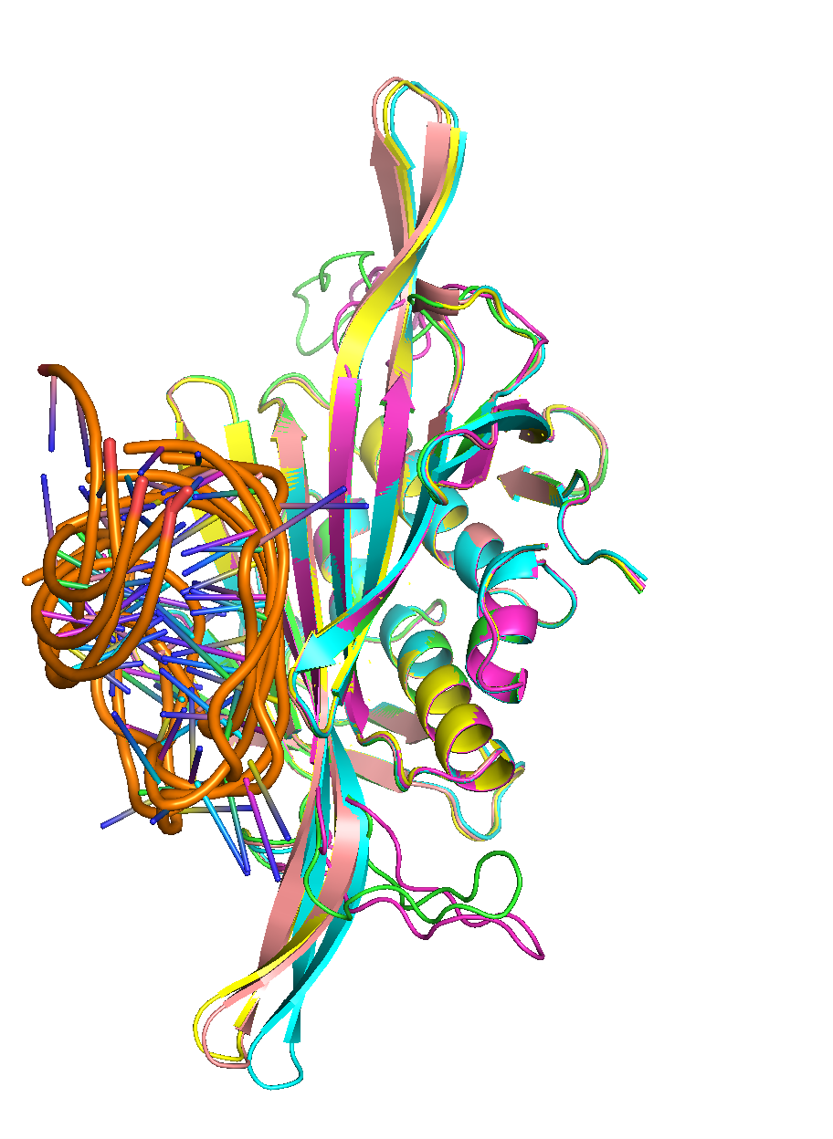
77_AF Outlier structure

Slide 4
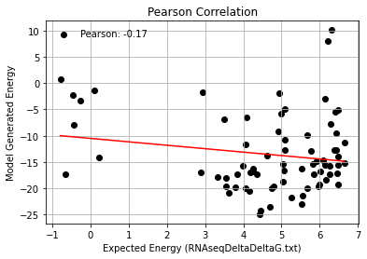
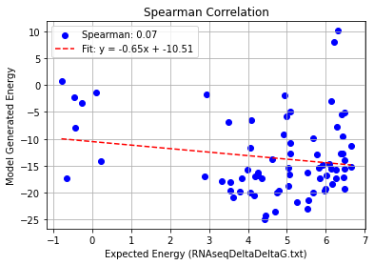
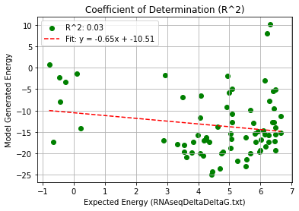
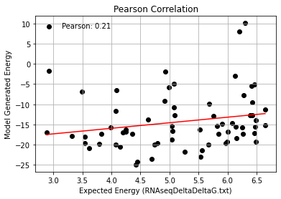
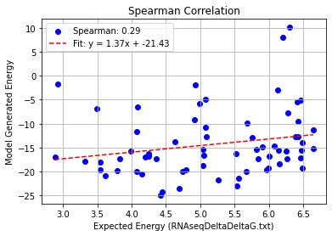
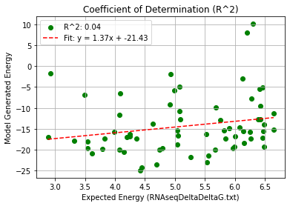
2c4q_AF_Quadruple Mutation – Remove Low Expected Energy
Pearson rank correlation coefficient: 0.210 Spearman rank correlation coefficient: 0.288 Coefficient of Determination (R^2): 0.044

Slide 5
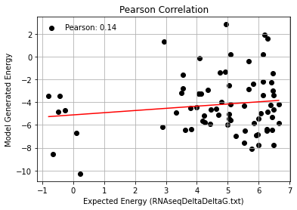
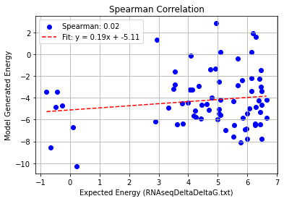
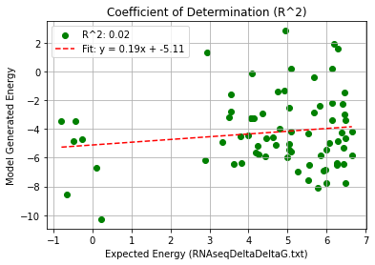
AF_Outliers_Quadruple Mutation – PHI 9.5
Pearson rank correlation coefficient: 0.143
Spearman rank correlation coefficient: 0.022
Coefficient of Determination (R^2): 0.020

Slide 6
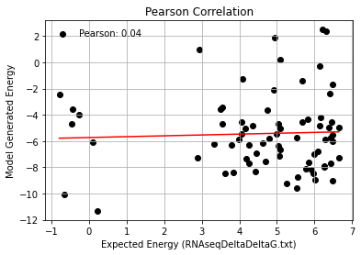
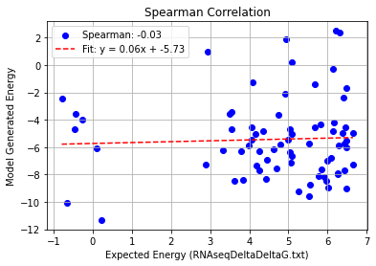
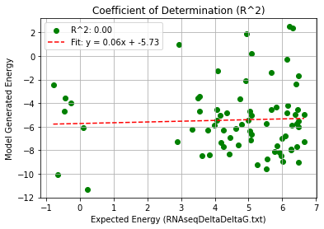
2c4q+AF_Outliers_Quadruple Mutation – PHI 9.5
Pearson rank correlation coefficient: 0.043
Spearman rank correlation coefficient: -0.025
Coefficient of Determination (R^2): 0.002

