Slide 1
MS2 Native Structures
2bu1, 2c4q, 2c4y, 2c4z

Slide 2
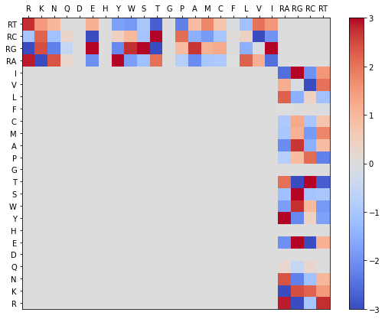
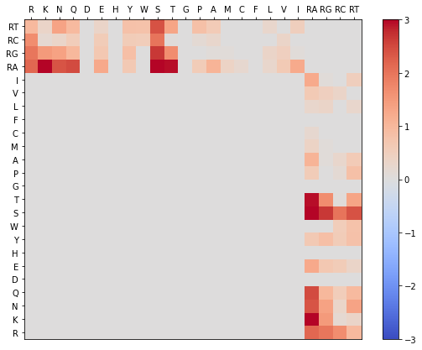
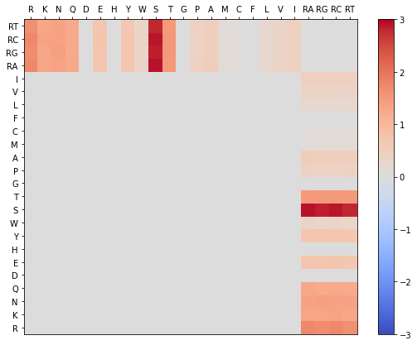
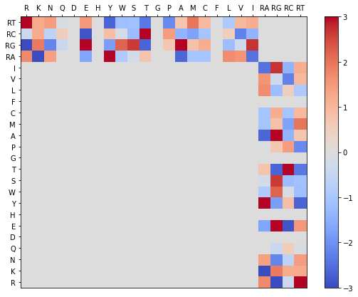
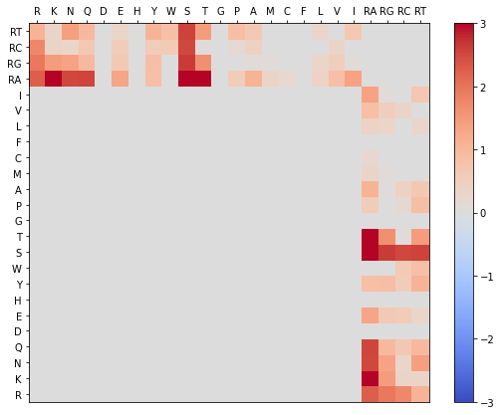

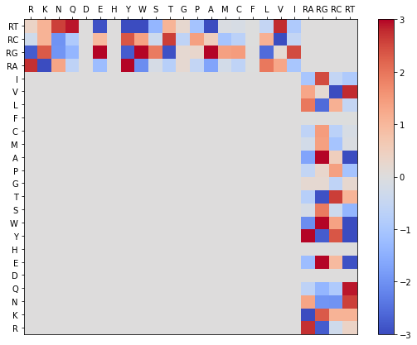
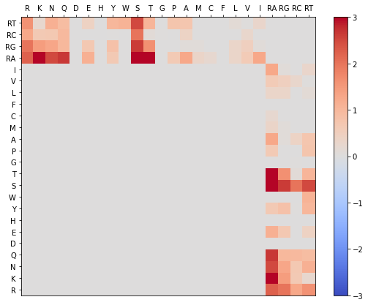
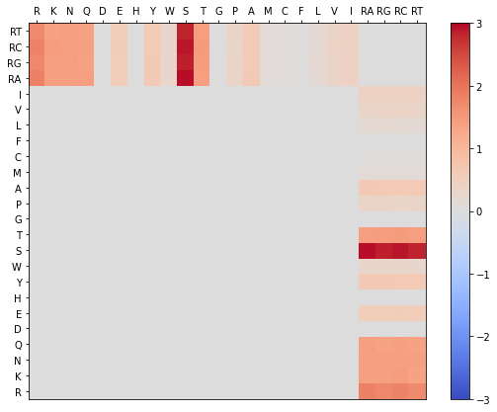
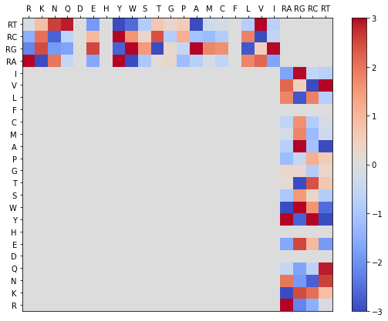
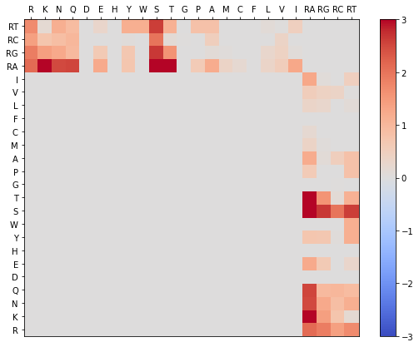

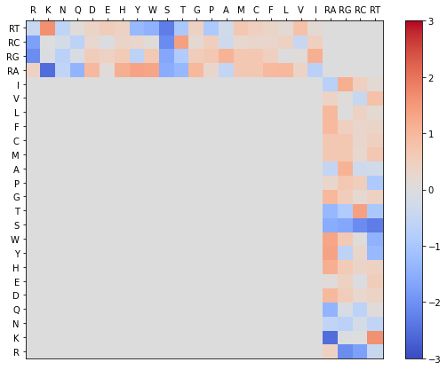

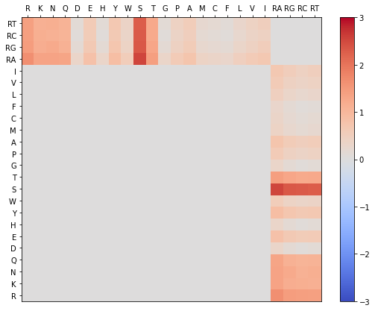
2bu1, 2c4q, 2c4y, 2c4z – MS2 Protein Complex
Gamma
Phis Native
Phis Decoy
2bu1
2c4q
2c4y
2c4z
2bu1, 2c4q, 2c4y, 2c4z

Slide 3
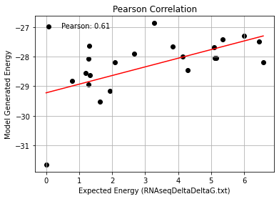
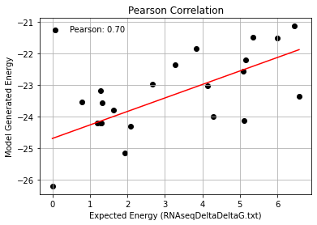
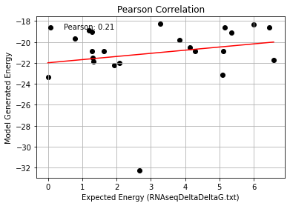
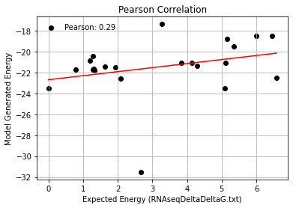
1_Mutations: 2c4q, 2bu1, 2c4y, 2c4z
2bu1
2c4q
2c4y
2c4z

Slide 4
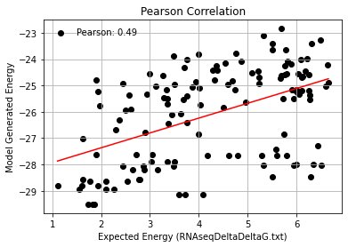
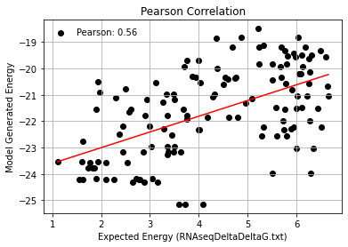
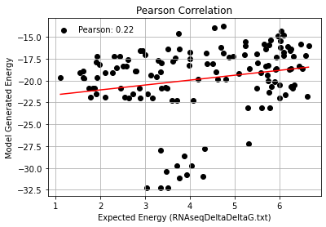
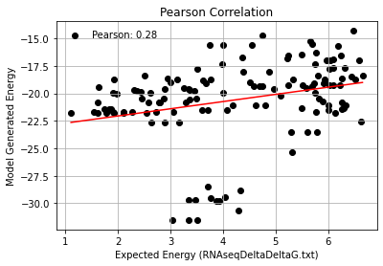
2_Mutations: 2c4q, 2bu1, 2c4y, 2c4z
2bu1
2c4q
2c4y
2c4z

Slide 5
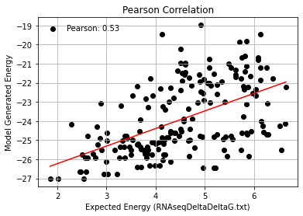
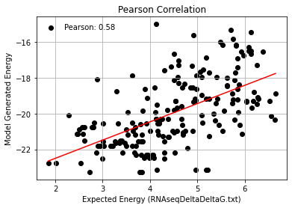
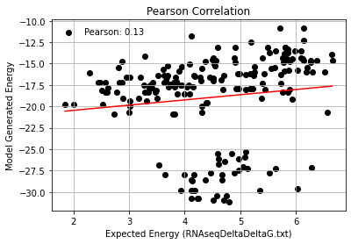
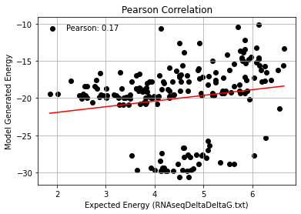
3_Mutations: 2c4q, 2bu1, 2c4y, 2c4z
2bu1
2c4q
2c4y
2c4z

Slide 6
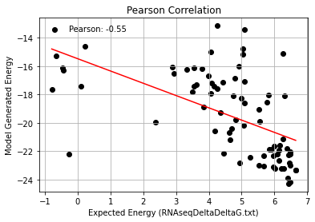
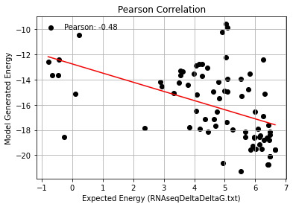
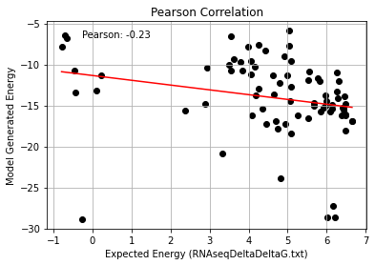
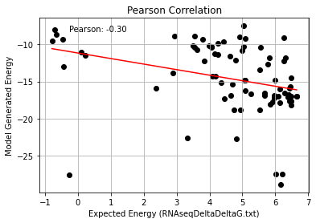
4_Mutations: 2c4q, 2bu1, 2c4y, 2c4z
2bu1
2c4q
2c4y
2c4z

Slide 7
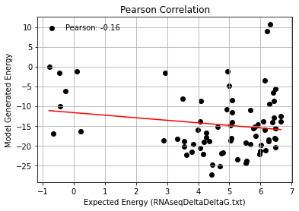
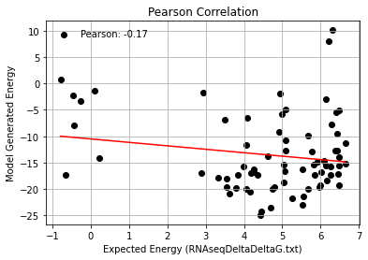
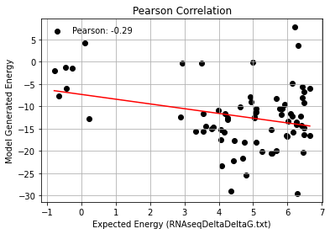
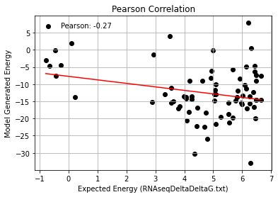
AF_Mutations: 2c4q, 2bu1, 2c4y, 2c4z
2bu1
2c4q
2c4y
2c4z

Slide 8
2bu1 Phi & Gamma Graphs
Gamma Randomization
Phis Native
Phis Decoy

Slide 9
2c4q Phi & Gamma Graphs
Gamma Randomization
Phis Native
Phis Decoy

Slide 10
2c4y Phi & Gamma Graphs
Gamma Randomization
Phis Native
Phis Decoy

Slide 11
2c4z Phi & Gamma Graphs
Gamma Randomization
Phis Native
Phis Decoy

Slide 12
2bu1, 2c4q, 2c4y, 2c4z Phi & Gamma Graphs
Gamma Randomization
Phis Native
Phis Decoy

