Slide 1
RNA Correlation Graphs

Slide 2
RNA Correlation

Slide 3
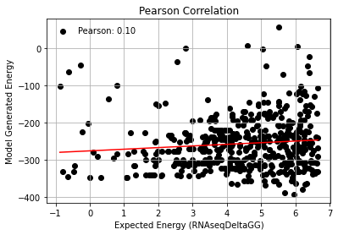
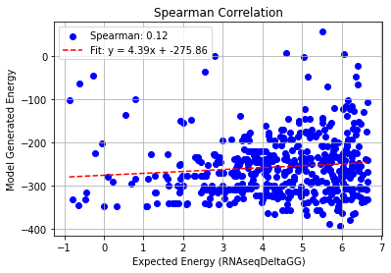
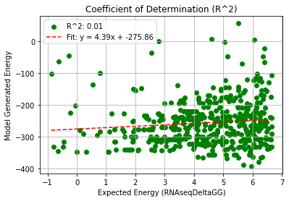
PHI: 8.0
Pearson rank correlation coefficient: 0.101
Spearman rank correlation coefficient: 0.122
Coefficient of Determination (R^2): 0.010

Slide 4
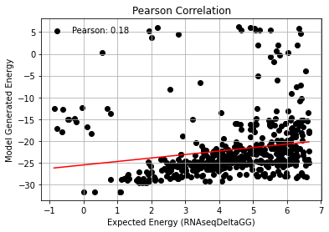
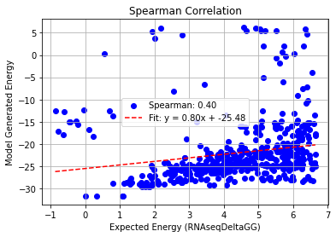
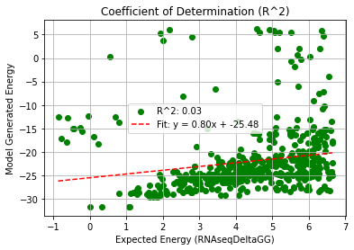
PHI: 9.5
Pearson rank correlation coefficient: 0.181
Spearman rank correlation coefficient: 0.402
Coefficient of Determination (R^2): 0.033

Slide 5
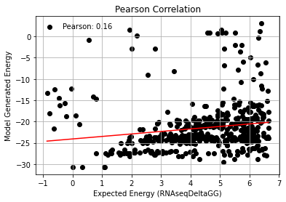
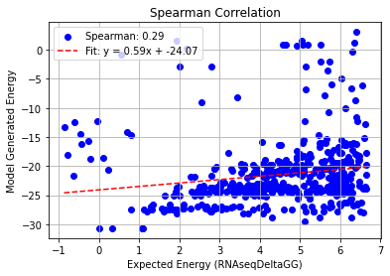
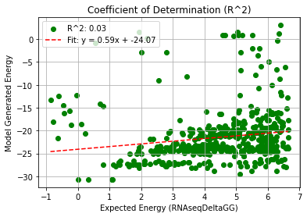
PHI: 11.0
Pearson rank correlation coefficient: 0.160
Spearman rank correlation coefficient: 0.285
Coefficient of Determination (R^2): 0.026

Slide 6
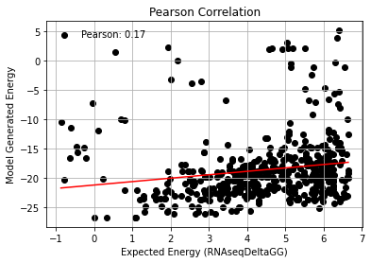
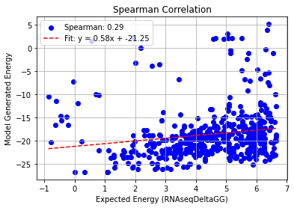
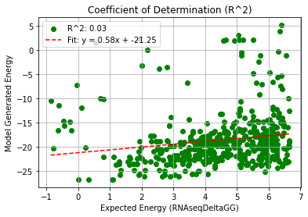
PHI: 12.5
Pearson rank correlation coefficient: 0.168
Spearman rank correlation coefficient: 0.289
Coefficient of Determination (R^2): 0.028

Slide 7
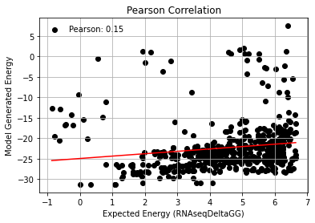
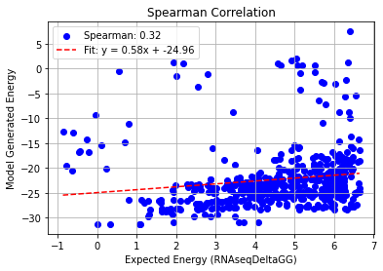
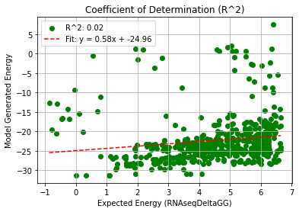
PHI: 14.0
Pearson rank correlation coefficient: 0.148
Spearman rank correlation coefficient: 0.318
Coefficient of Determination (R^2): 0.022

Slide 8
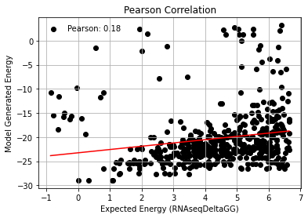
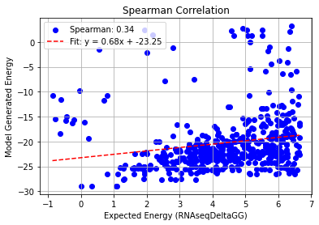
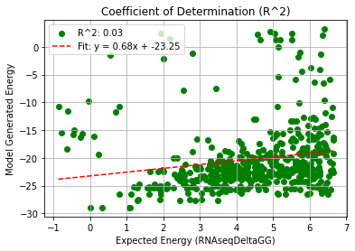
PHI: 15.5
Pearson rank correlation coefficient: 0.184
Spearman rank correlation coefficient: 0.337
Coefficient of Determination (R^2): 0.034

Slide 9
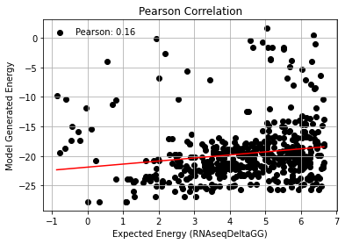
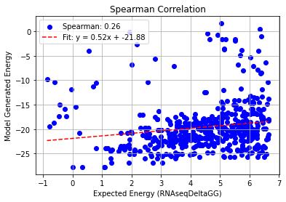
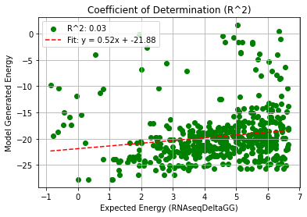
PHI: 17.0
Pearson rank correlation coefficient: 0.162
Spearman rank correlation coefficient: 0.262
Coefficient of Determination (R^2): 0.026

