Slide 1
2b2e – RNA Complex

Slide 2
2b2e Phi & Gamma Graphs
Gamma Randomization
Phis Native
Phis Decoy

Slide 3
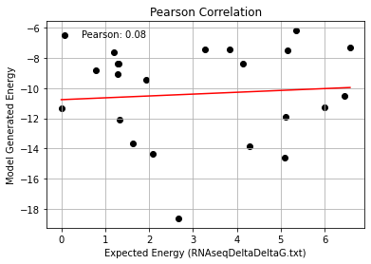
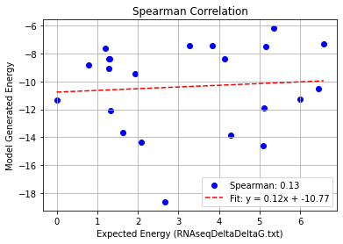
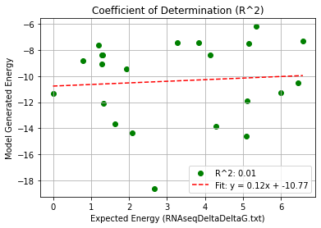
2b2e_Single Mutation – PHI 9.5
Pearson rank correlation coefficient: 0.079
Spearman rank correlation coefficient: 0.134
Coefficient of Determination (R^2): 0.006

Slide 4
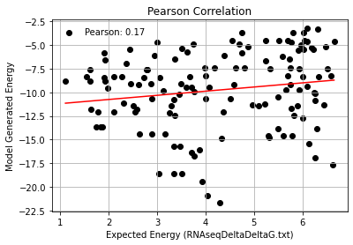
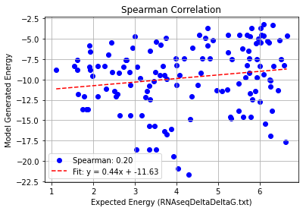
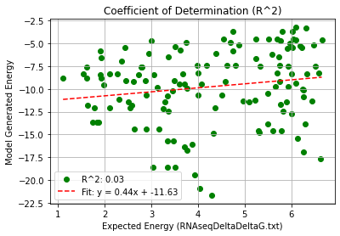
2b2e_Double Mutation – PHI 9.5
Pearson rank correlation coefficient: 0.167
Spearman rank correlation coefficient: 0.202
Coefficient of Determination (R^2): 0.028

Slide 5
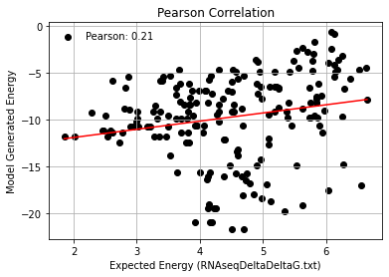
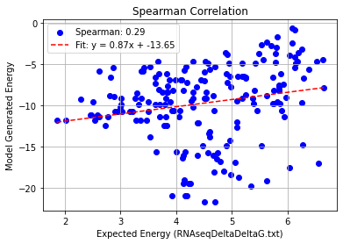
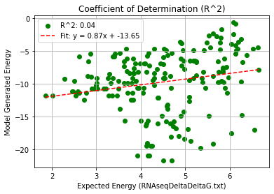
2b2e_Triple Mutation – PHI 9.5
Pearson rank correlation coefficient: 0.210
Spearman rank correlation coefficient: 0.287
Coefficient of Determination (R^2): 0.044

Slide 6
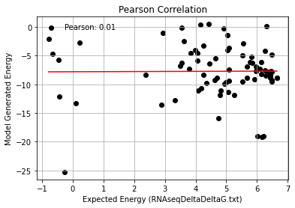
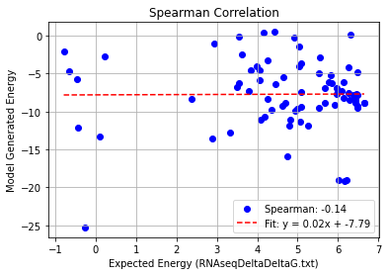
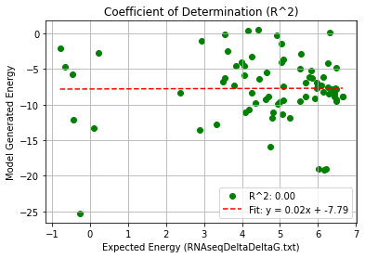
2b2e_Quadruple Mutation – PHI 9.5
Pearson rank correlation coefficient: 0.007
Spearman rank correlation coefficient: -0.136
Coefficient of Determination (R^2): 0.000

Slide 7
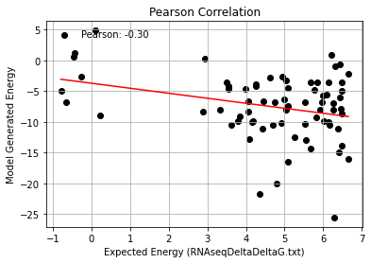
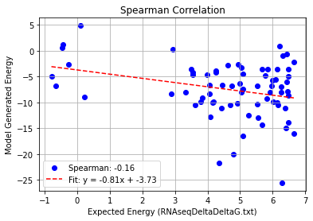
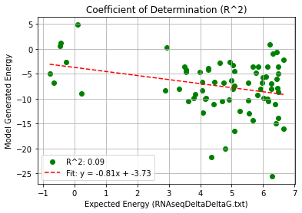
2b2e_AF_Quadruple Mutation – PHI 9.5
Pearson rank correlation coefficient: -0.299
Spearman rank correlation coefficient: -0.161
Coefficient of Determination (R^2): 0.089

