Slide 1
2b2g – RNA Complex

Slide 2
2b2g Phi & Gamma Graphs
Gamma Randomization
Phis Native
Phis Decoy

Slide 3
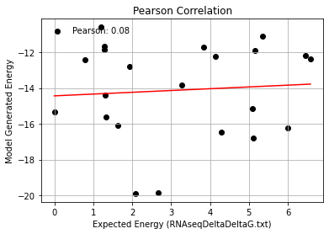
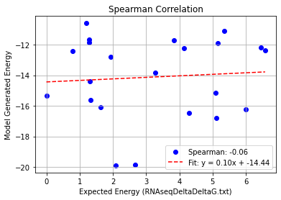
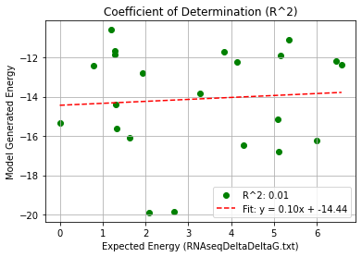
2b2g_Single Mutation – PHI 9.5
Pearson rank correlation coefficient: 0.076
Spearman rank correlation coefficient: -0.056
Coefficient of Determination (R^2): 0.006

Slide 4
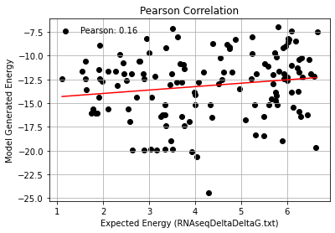
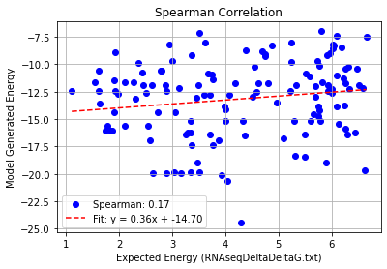
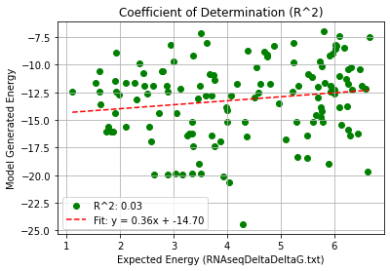
2b2g_Double Mutation – PHI 9.5
Pearson rank correlation coefficient: 0.161
Spearman rank correlation coefficient: 0.172
Coefficient of Determination (R^2): 0.026

Slide 5
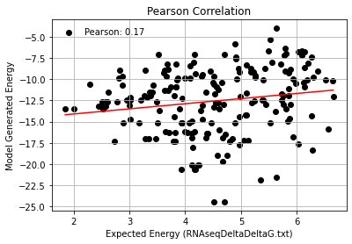
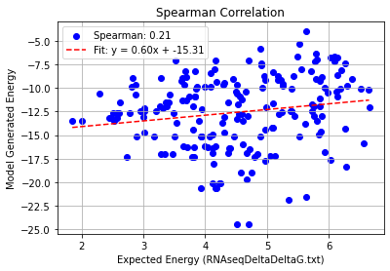
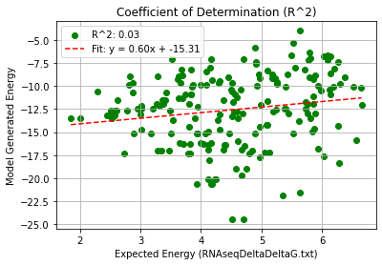
2b2g_Triple Mutation – PHI 9.5
Pearson rank correlation coefficient: 0.173
Spearman rank correlation coefficient: 0.206
Coefficient of Determination (R^2): 0.030

Slide 6
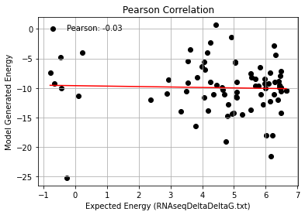
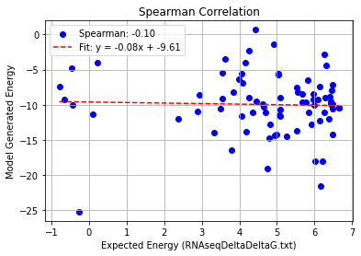
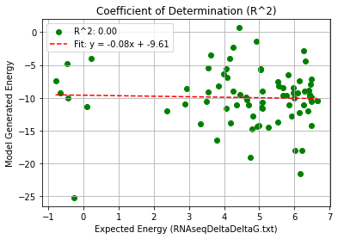
2b2g_Quadruple Mutation – PHI 9.5
Pearson rank correlation coefficient: -0.033
Spearman rank correlation coefficient: -0.099
Coefficient of Determination (R^2): 0.001

Slide 7
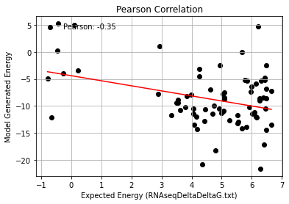
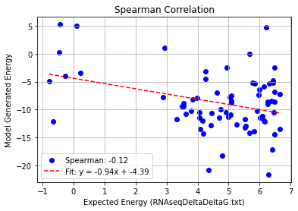
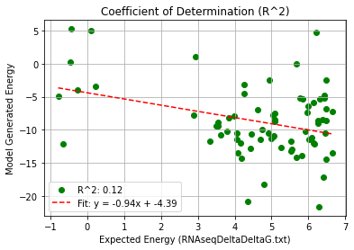
2b2g_AF_Quadruple Mutation – PHI 9.5
Pearson rank correlation coefficient: -0.347
Spearman rank correlation coefficient: -0.125
Coefficient of Determination (R^2): 0.120

