Slide 1
2bny – RNA Complex

Slide 2
2bny Phi & Gamma Graphs
Gamma Randomization
Phis Native
Phis Decoy

Slide 3
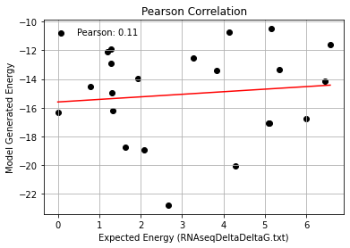
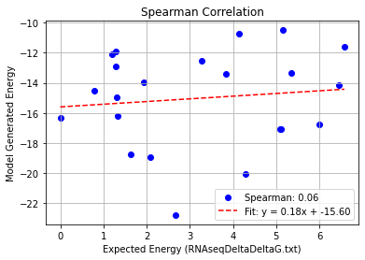
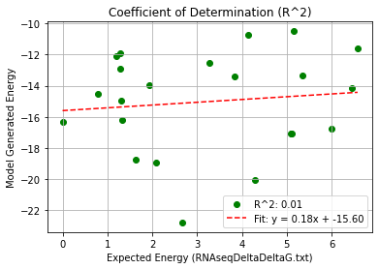
2bny_Single Mutation – PHI 9.5
Pearson rank correlation coefficient: 0.114
Spearman rank correlation coefficient: 0.058
Coefficient of Determination (R^2): 0.013

Slide 4
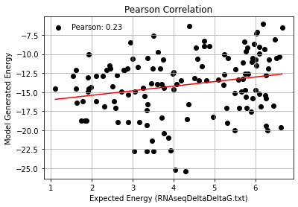
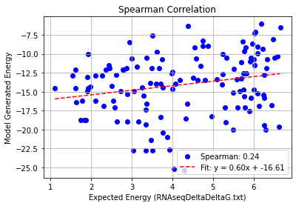
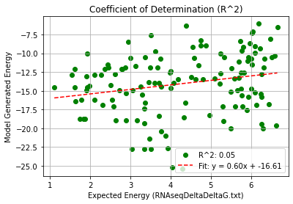
2bny_Double Mutation – PHI 9.5
Pearson rank correlation coefficient: 0.230
Spearman rank correlation coefficient: 0.238
Coefficient of Determination (R^2): 0.053

Slide 5
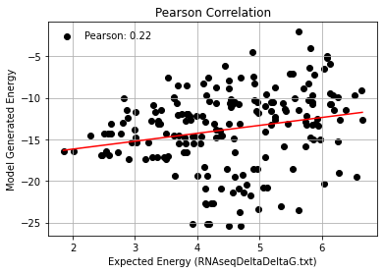
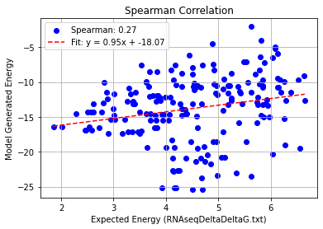
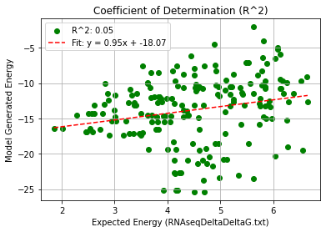
2bny_Triple Mutation – PHI 9.5
Pearson rank correlation coefficient: 0.224
Spearman rank correlation coefficient: 0.270
Coefficient of Determination (R^2): 0.050

Slide 6
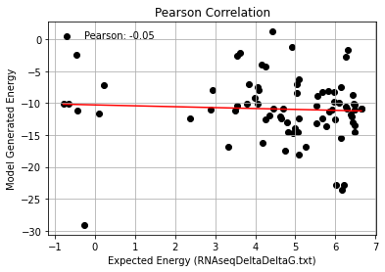
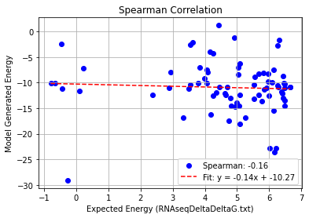
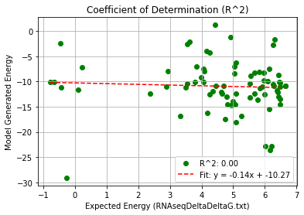
2bny_Quadruple Mutation – PHI 9.5
Pearson rank correlation coefficient: -0.053
Spearman rank correlation coefficient: -0.156
Coefficient of Determination (R^2): 0.003

Slide 7
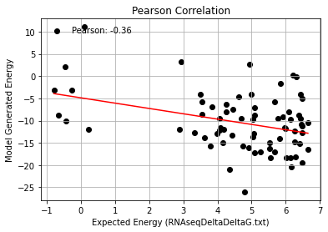
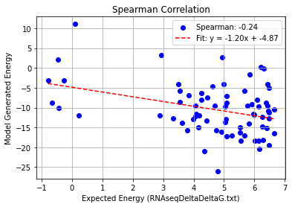
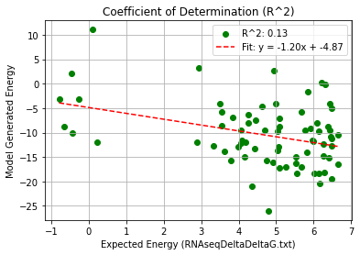
2bny_AF_Quadruple Mutation – PHI 9.5
Pearson rank correlation coefficient: -0.361
Spearman rank correlation coefficient: -0.243
Coefficient of Determination (R^2): 0.131

