Slide 1
2bq5 RNA Complex

Slide 2
2bq5 Phi & Gamma Graphs
Gamma Randomization
Phis Native
Phis Decoy

Slide 3
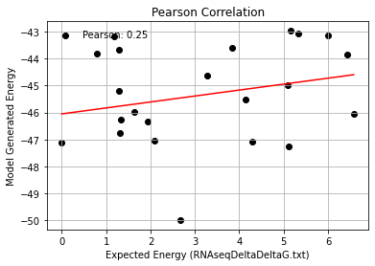
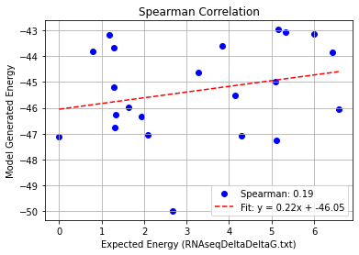
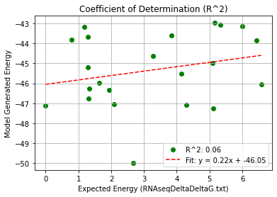
2bq5_Single Mutation – PHI 9.5
Pearson rank correlation coefficient: 0.246
Spearman rank correlation coefficient: 0.195
Coefficient of Determination (R^2): 0.061

Slide 4
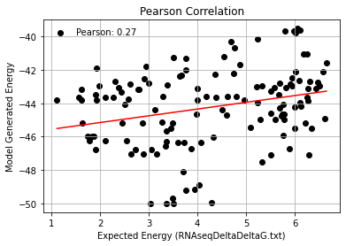
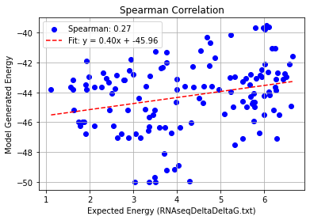
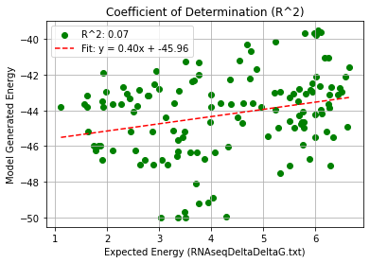
2bq5_Double Mutation – PHI 9.5
Pearson rank correlation coefficient: 0.271
Spearman rank correlation coefficient: 0.273
Coefficient of Determination (R^2): 0.073

Slide 5
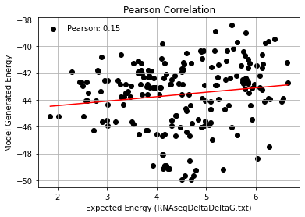
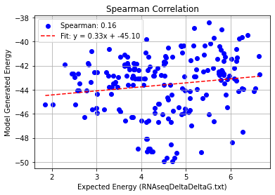
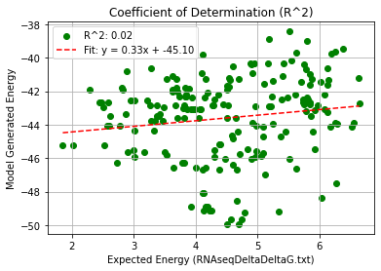
2bq5_Triple Mutation – PHI 9.5
Pearson rank correlation coefficient: 0.149
Spearman rank correlation coefficient: 0.160
Coefficient of Determination (R^2): 0.022

Slide 6
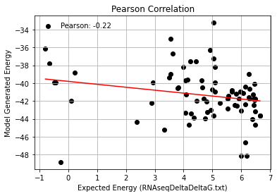
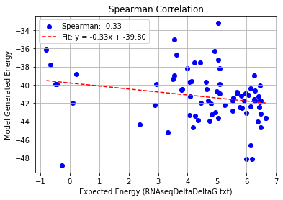
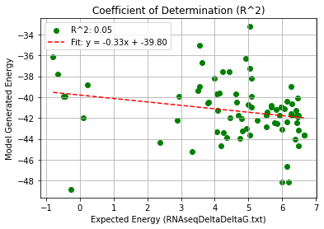
2bq5_Quadruple Mutation – PHI 9.5
Pearson rank correlation coefficient: -0.224
Spearman rank correlation coefficient: -0.330
Coefficient of Determination (R^2): 0.050

Slide 7
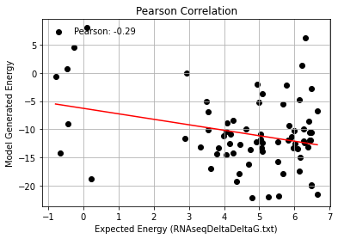
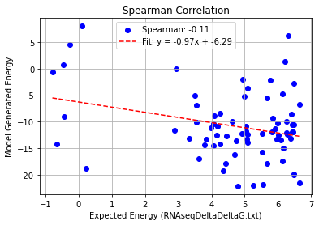
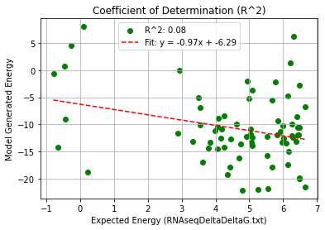
2bq5_AF_Quadruple Mutation – PHI 9.5
Pearson rank correlation coefficient: -0.29
Spearman rank correlation coefficient: 0.11
Coefficient of Determination (R^2): 0.08

