Slide 1
2c4z – RNA Complex

Slide 2
2c4z Phi & Gamma Graphs
Gamma Randomization
Phis Native
Phis Decoy

Slide 3
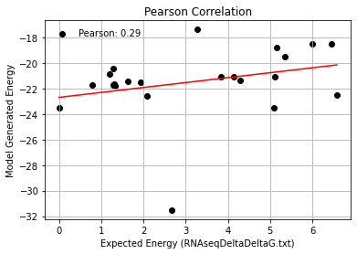
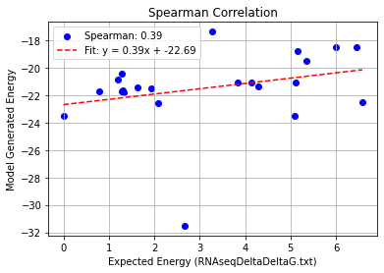
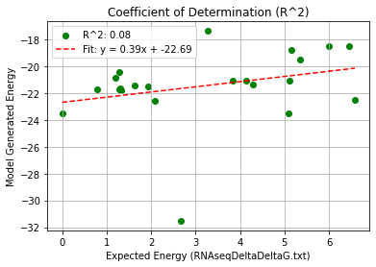
2c4z_Single Mutation – PHI 9.5
Pearson rank correlation coefficient: 0.287
Spearman rank correlation coefficient: 0.386
Coefficient of Determination (R^2): 0.082

Slide 4
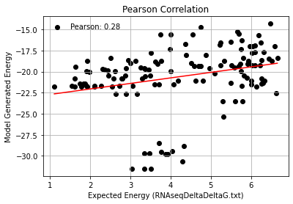
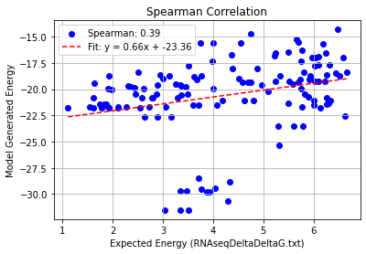
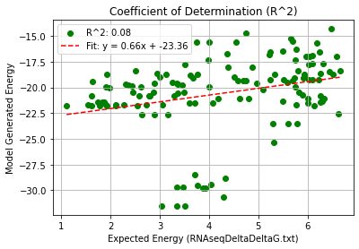
2c4z_Double Mutation – PHI 9.5
Pearson rank correlation coefficient: 0.282
Spearman rank correlation coefficient: 0.391
Coefficient of Determination (R^2): 0.080

Slide 5
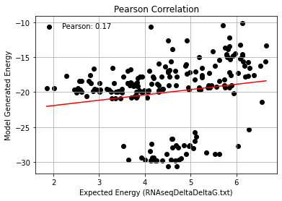
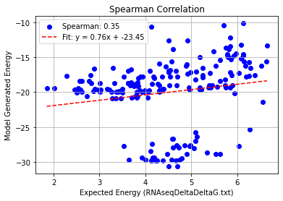
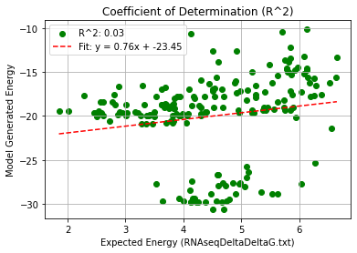
2c4z_Triple Mutation – PHI 9.5
Pearson rank correlation coefficient: 0.174
Spearman rank correlation coefficient: 0.346
Coefficient of Determination (R^2): 0.030

Slide 6
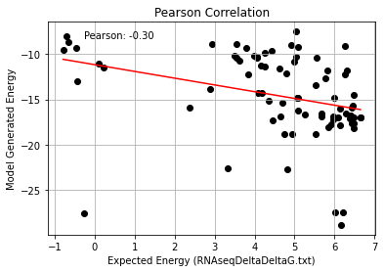
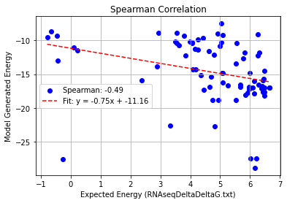
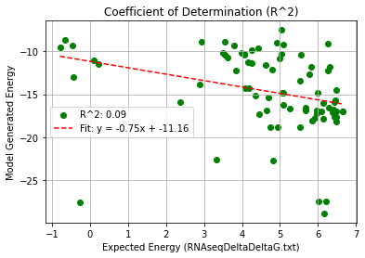
2c4z_Quadruple Mutation – PHI 9.5
Pearson rank correlation coefficient: -0.303
Spearman rank correlation coefficient: -0.493
Coefficient of Determination (R^2): 0.092

Slide 7
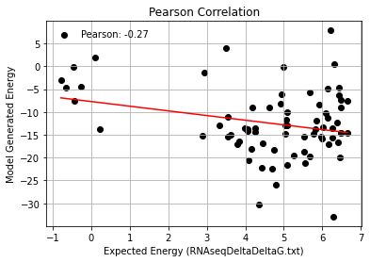
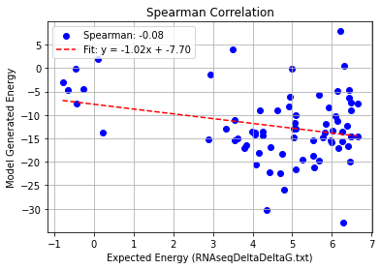
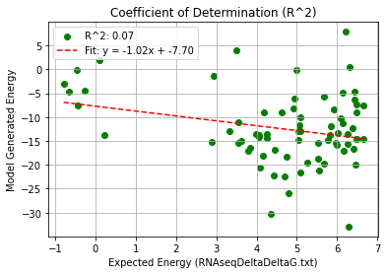
2c4z_AF_Quadruple Mutation – PHI 9.5
Pearson rank correlation coefficient: -0.267
Spearman rank correlation coefficient: -0.081
Coefficient of Determination (R^2): 0.071

