Slide 1
2c50 – RNA Complex

Slide 2
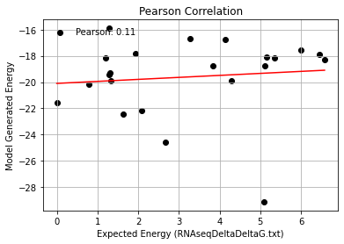
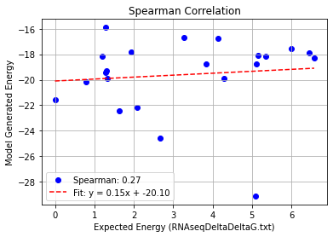
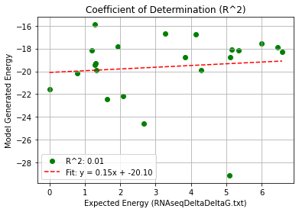
2c50_Single Mutation (2bu1) – PHI 9.5
Pearson rank correlation coefficient: 0.105
Spearman rank correlation coefficient: 0.270
Coefficient of Determination (R^2): 0.011

Slide 3
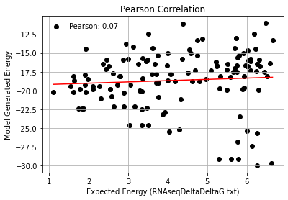
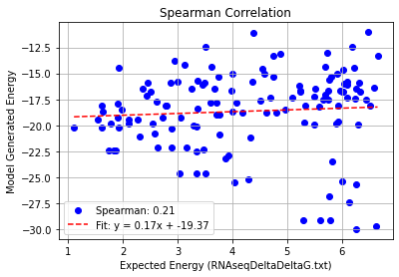
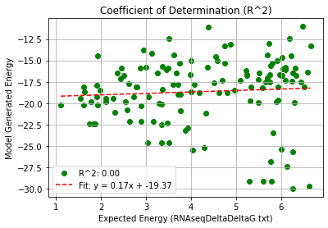
2c50_Double Mutation (2bu1) – PHI 9.5
Pearson rank correlation coefficient: 0.068
Spearman rank correlation coefficient: 0.215
Coefficient of Determination (R^2): 0.005

Slide 4
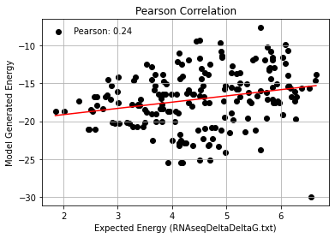
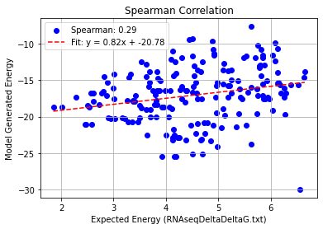
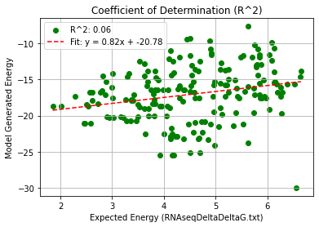
2c50_Triple Mutation (2bu1) – PHI 9.5
Pearson rank correlation coefficient: 0.240
Spearman rank correlation coefficient: 0.286
Coefficient of Determination (R^2): 0.058

Slide 5
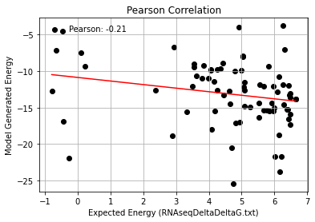
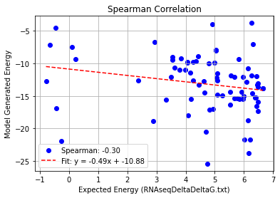
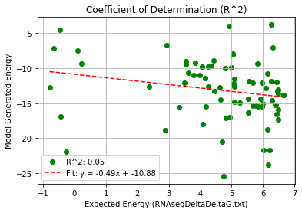
2c50_Quadruple Mutation (2bu1) – PHI 9.5
Pearson rank correlation coefficient: -0.214
Spearman rank correlation coefficient: -0.296
Coefficient of Determination (R^2): 0.046

Slide 6
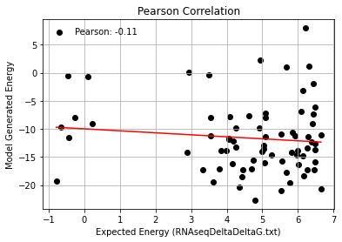
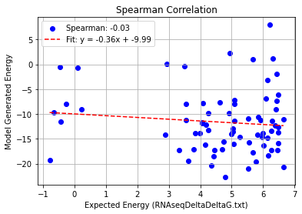
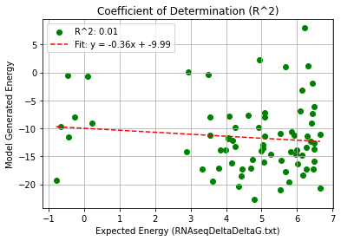
2c50_AF_Quadruple Mutation (2bu1) – PHI 9.5
Pearson rank correlation coefficient: -0.109
Spearman rank correlation coefficient: -0.031
Coefficient of Determination (R^2): 0.012

