Slide 1
2izm – RNA Complex

Slide 2
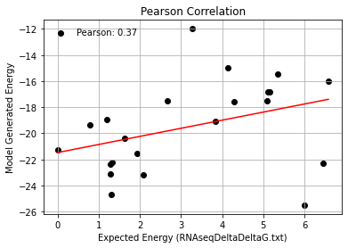
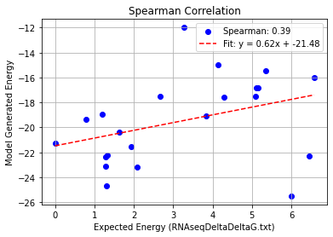
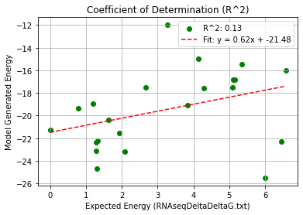
2izm_Single Mutation (2bu1) – PHI 9.5
Pearson rank correlation coefficient: 0.366
Spearman rank correlation coefficient: 0.389
Coefficient of Determination (R^2): 0.134

Slide 3
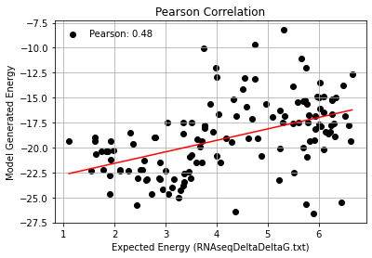
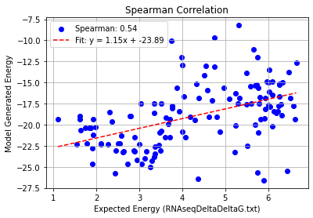
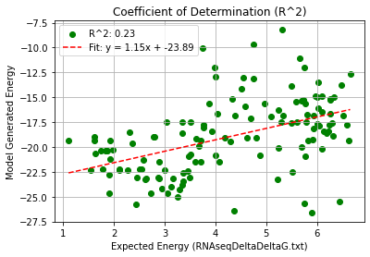
2izm_Double Mutation (2bu1) – PHI 9.5
Pearson rank correlation coefficient: 0.479
Spearman rank correlation coefficient: 0.537
Coefficient of Determination (R^2): 0.229

Slide 4
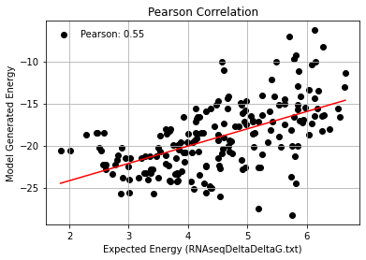
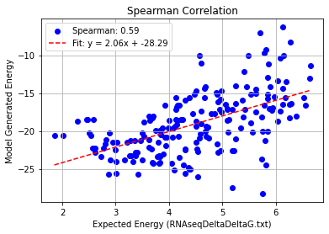
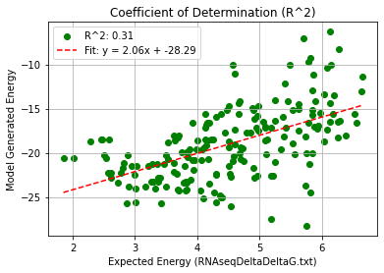
2izm_Triple Mutation – PHI 9.5
Pearson rank correlation coefficient: 0.554
Spearman rank correlation coefficient: 0.590
Coefficient of Determination (R^2): 0.307

Slide 5
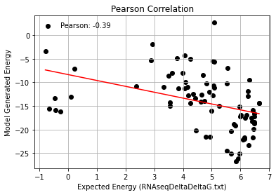
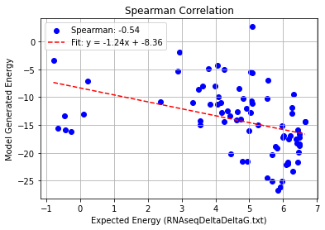
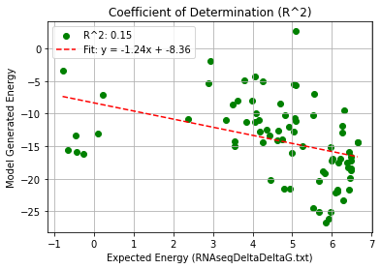
2izm_Quadruple Mutation – PHI 9.5
Pearson rank correlation coefficient: -0.388
Spearman rank correlation coefficient: -0.535
Coefficient of Determination (R^2): 0.151

Slide 6
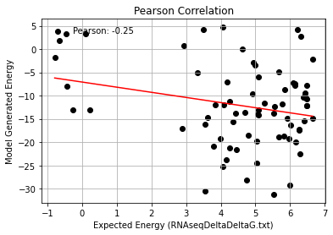
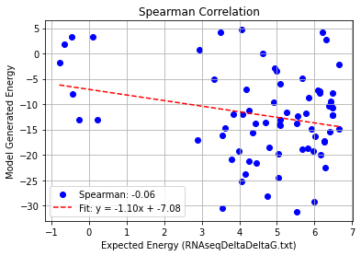
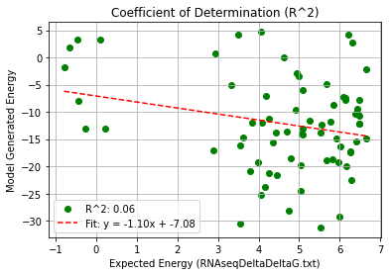
2izm_AF_Quadruple Mutation – PHI 9.5
Pearson rank correlation coefficient: -0.248
Spearman rank correlation coefficient: -0.055
Coefficient of Determination (R^2): 0.062

