Slide 1
2izn – RNA Complex

Slide 2
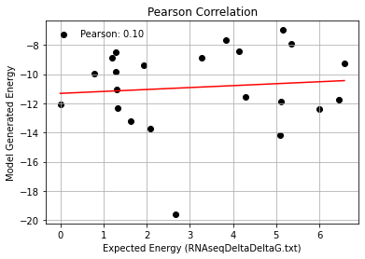
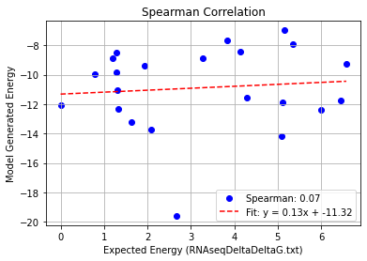
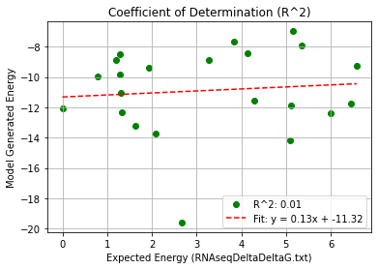
2izn_Single Mutation (2bu1) – PHI 9.5
Pearson rank correlation coefficient: 0.096
Spearman rank correlation coefficient: 0.074
Coefficient of Determination (R^2): 0.009

Slide 3
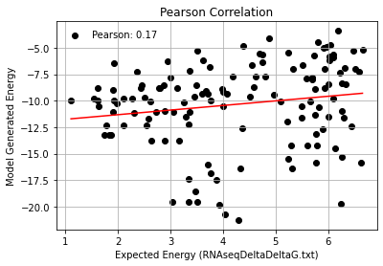
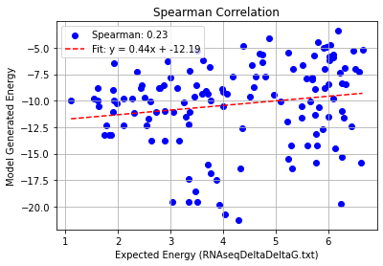
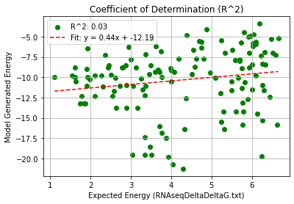
2izn_Double Mutation (2bu1) – PHI 9.5
Pearson rank correlation coefficient: 0.171
Spearman rank correlation coefficient: 0.232
Coefficient of Determination (R^2): 0.029

Slide 4
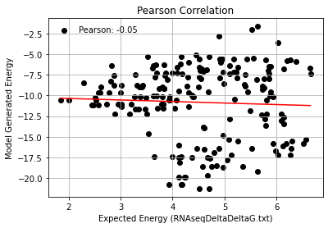
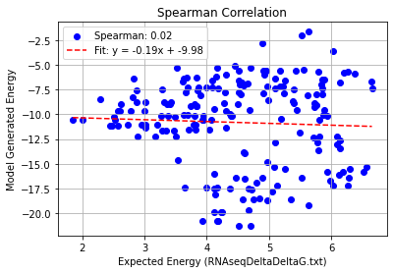
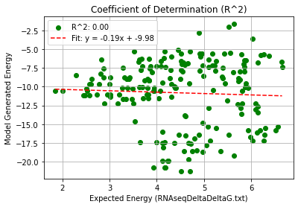
2izn_Triple Mutation (2bu1) – PHI 9.5
Pearson rank correlation coefficient: -0.046
Spearman rank correlation coefficient: 0.016
Coefficient of Determination (R^2): 0.002

Slide 5
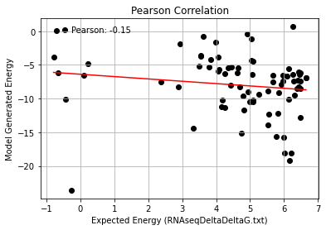
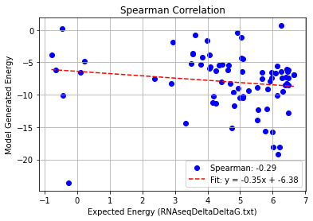
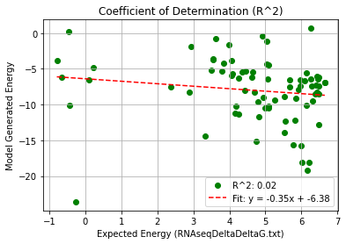
2izn_Quadruple Mutation (2bu1) – PHI 9.5
Pearson rank correlation coefficient: -0.146
Spearman rank correlation coefficient: -0.293
Coefficient of Determination (R^2): 0.021

Slide 6
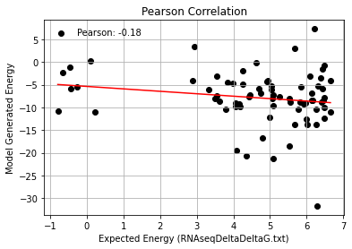
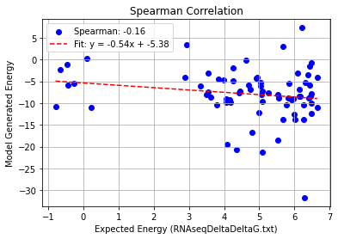
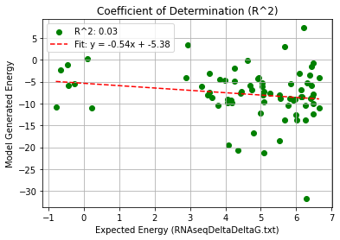
2izn_AF_Quadruple Mutation (2bu1) – PHI 9.5
Pearson rank correlation coefficient: -0.177
Spearman rank correlation coefficient: -0.158
Coefficient of Determination (R^2): 0.031

