Slide 1
RNA Complex: 2c4q, 2b2e, 2bny, 2c4y, 2c4z, 2b2g, 2bq5

Slide 2
2bq5 Phi & Gamma Graphs
Gamma Randomization
Phis Native
Phis Decoy

Slide 3
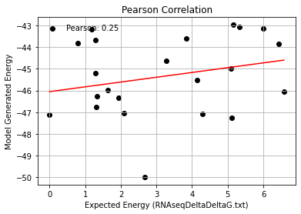
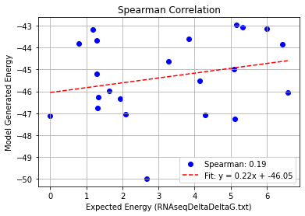
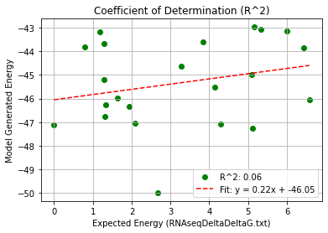
AA_Single Mutation – PHI 9.5
Pearson rank correlation coefficient: 0.246
Spearman rank correlation coefficient: 0.195
Coefficient of Determination (R^2): 0.061

Slide 4
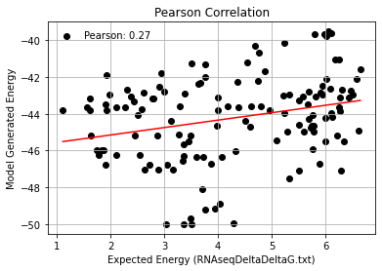
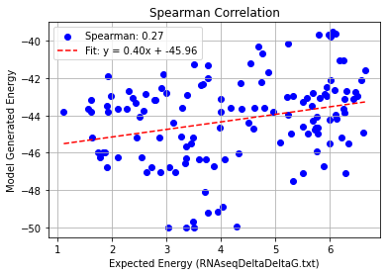
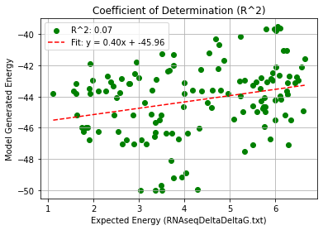
AA_Double Mutation – PHI 9.5
Pearson rank correlation coefficient: 0.271
Spearman rank correlation coefficient: 0.273
Coefficient of Determination (R^2): 0.073

Slide 5
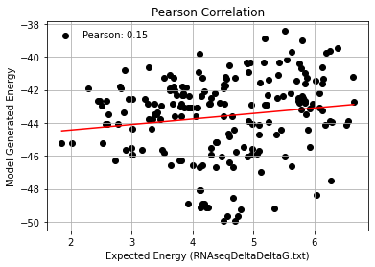
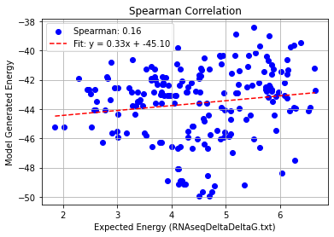
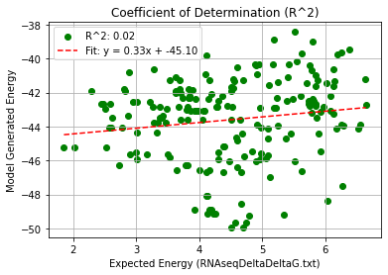
AA_Triple Mutation – PHI 9.5
Pearson rank correlation coefficient: 0.149
Spearman rank correlation coefficient: 0.160
Coefficient of Determination (R^2): 0.022

Slide 6
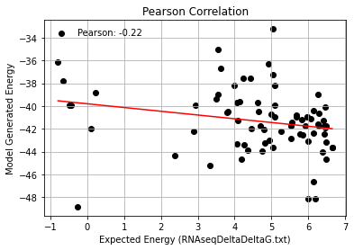
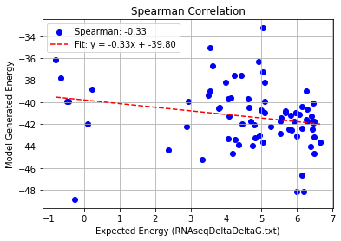
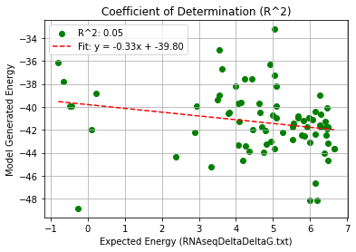
AA_Quadruple Mutation – PHI 9.5
Pearson rank correlation coefficient: -0.224
Spearman rank correlation coefficient: -0.330
Coefficient of Determination (R^2): 0.050

Slide 7
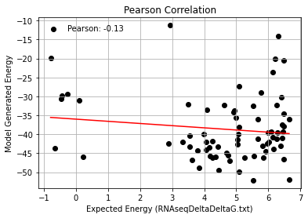
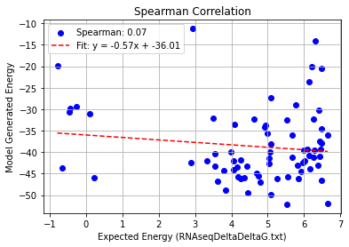
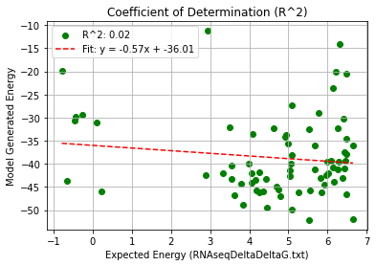
AA_AF_Quadruple Mutation – PHI 9.5
Pearson rank correlation coefficient: -0.129
Spearman rank correlation coefficient: 0.071
Coefficient of Determination (R^2): 0.017

