Slide 1
2c51 – RNA Complex

Slide 2
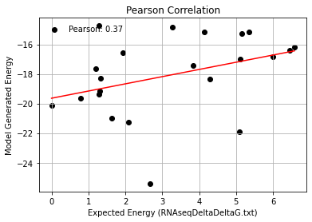
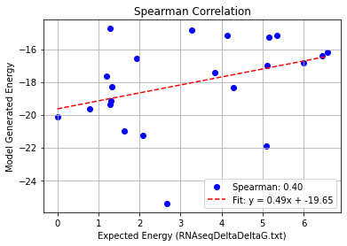
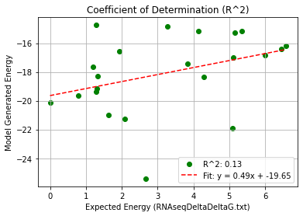
2c51_Single Mutation – PHI 9.5
Pearson rank correlation coefficient: 0.367
Spearman rank correlation coefficient: 0.401
Coefficient of Determination (R^2): 0.134

Slide 3
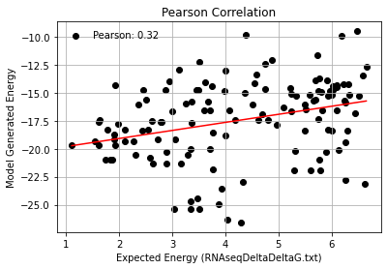
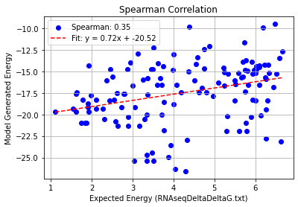
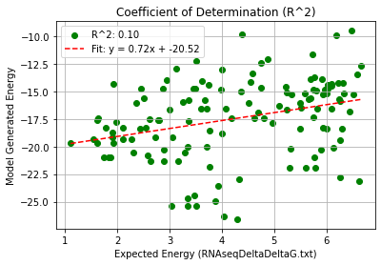
2c51_Double Mutation – PHI 9.5
Pearson rank correlation coefficient: 0.317
Spearman rank correlation coefficient: 0.350
Coefficient of Determination (R^2): 0.101

Slide 4
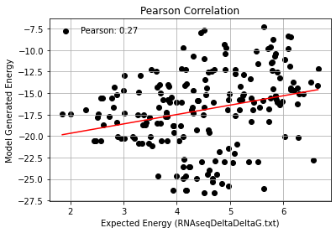
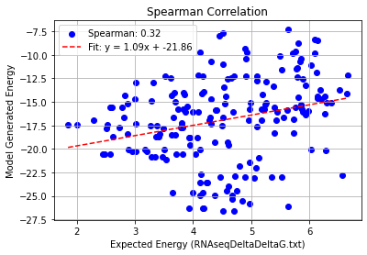
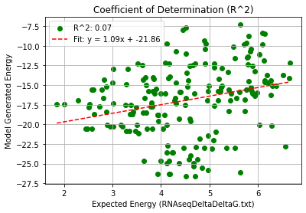
2c51_Triple Mutation – PHI 9.5
Pearson rank correlation coefficient: 0.269
Spearman rank correlation coefficient: 0.320
Coefficient of Determination (R^2): 0.072

