Slide 1
Mutation Graphs

Slide 2
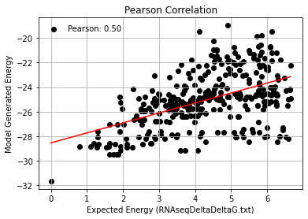
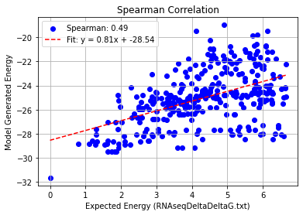
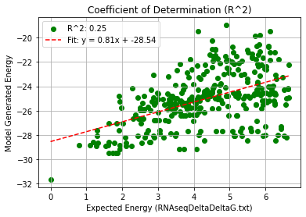
1-3 Mutations – PHI 9.5
Pearson rank correlation coefficient: 0.503
Spearman rank correlation coefficient: 0.489
Coefficient of Determination (R^2): 0.253

Slide 3
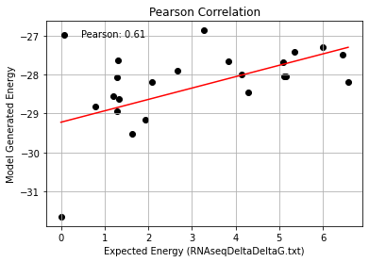
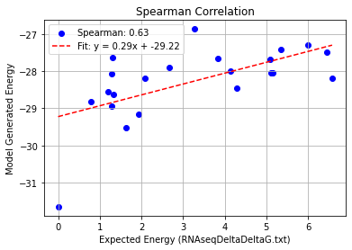
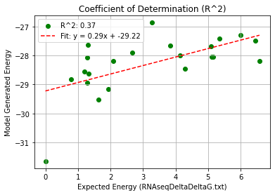
2BU1_Single Mutation – PHI 9.5
Pearson rank correlation coefficient: 0.606
Spearman rank correlation coefficient: 0.626
Coefficient of Determination (R^2): 0.368

Slide 4
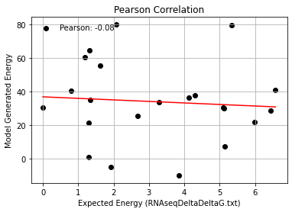
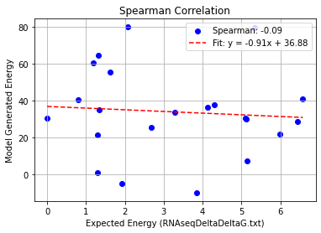
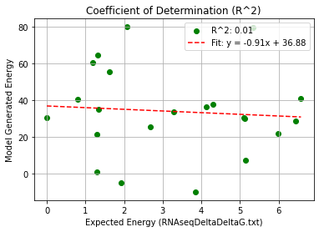
1AQ3_Single Mutation – PHI 9.5
Pearson rank correlation coefficient: -0.078
Spearman rank correlation coefficient: -0.091
Coefficient of Determination (R^2): 0.006

Slide 5
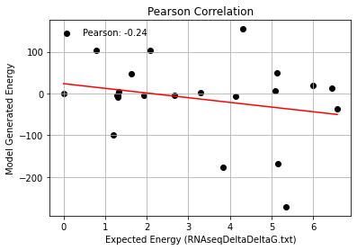
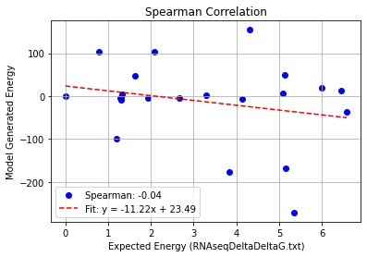
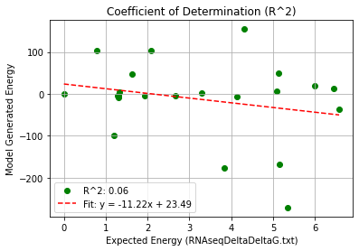
1AQ3(AS)_Single Mutation – PHI 9.5
Pearson rank correlation coefficient: -0.240
Spearman rank correlation coefficient: -0.045
Coefficient of Determination (R^2): 0.058

Slide 6
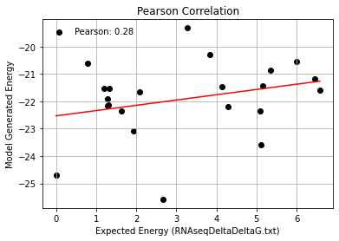
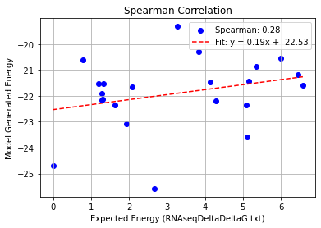
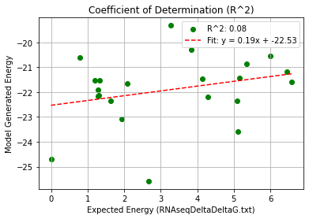
2BU1+1AQ3_Single Mutation – PHI 9.5
Pearson rank correlation coefficient: 0.281
Spearman rank correlation coefficient: 0.281
Coefficient of Determination (R^2): 0.079

Slide 7
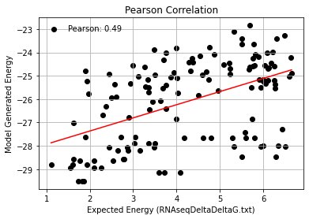
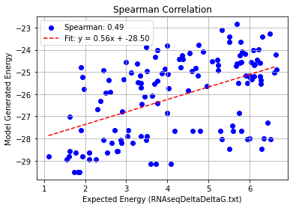
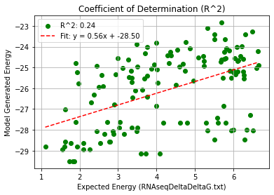
2BU1_Double Mutation – PHI 9.5
Pearson rank correlation coefficient: 0.490
Spearman rank correlation coefficient: 0.488
Coefficient of Determination (R^2): 0.240

Slide 8
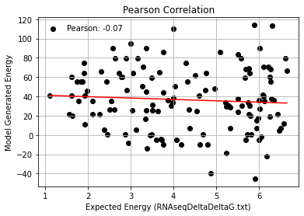
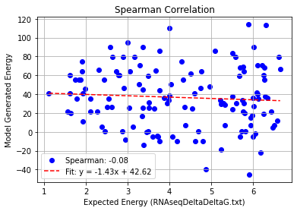
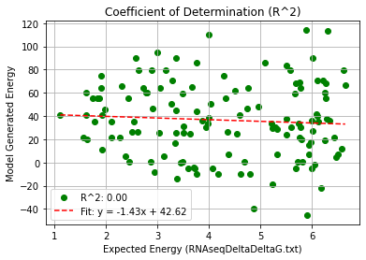
1AQ3_Double Mutation – PHI 9.5
Pearson rank correlation coefficient: -0.069
Spearman rank correlation coefficient: -0.076
Coefficient of Determination (R^2): 0.005

Slide 9
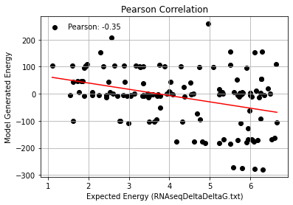
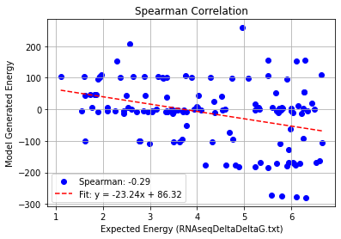
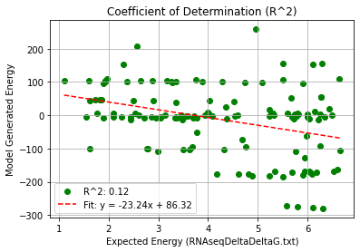
1AQ3(AS)_Double Mutation – PHI 9.5
Pearson rank correlation coefficient: -0.353
Spearman rank correlation coefficient: -0.290
Coefficient of Determination (R^2): 0.125

Slide 10
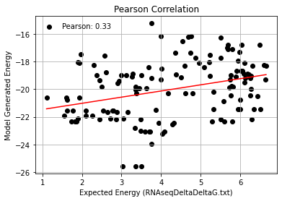
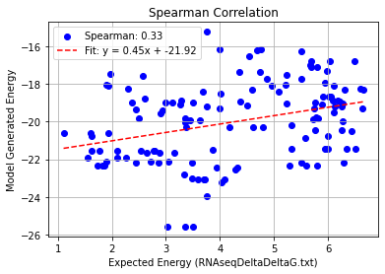
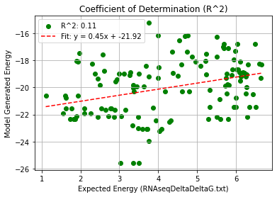
2BU1+1AQ3_Double Mutation – PHI 9.5
Pearson rank correlation coefficient: 0.329
Spearman rank correlation coefficient: 0.331
Coefficient of Determination (R^2): 0.108

Slide 11
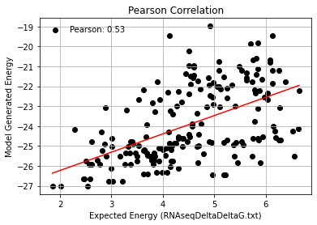
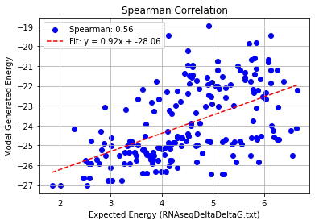
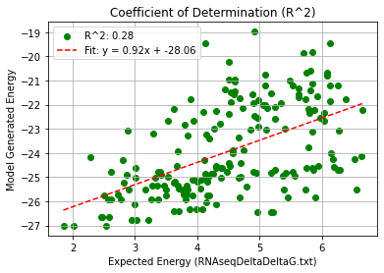
2BU1_Triple Mutation – PHI 9.5
Pearson rank correlation coefficient: 0.534
Spearman rank correlation coefficient: 0.564
Coefficient of Determination (R^2): 0.285

Slide 12
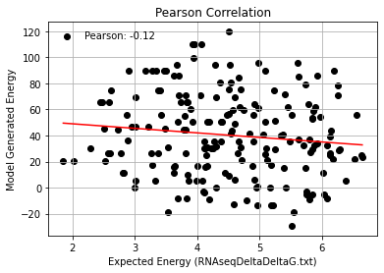
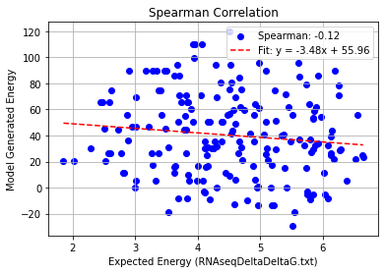
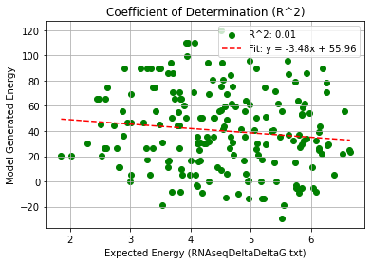
1AQ3_Triple Mutation – PHI 9.5
Pearson rank correlation coefficient: -0.121
Spearman rank correlation coefficient: -0.120
Coefficient of Determination (R^2): 0.015

Slide 13
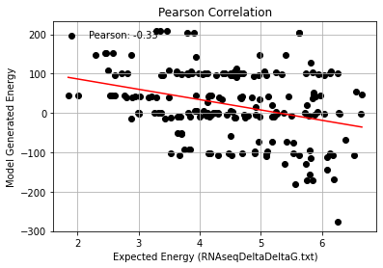
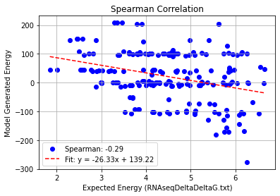
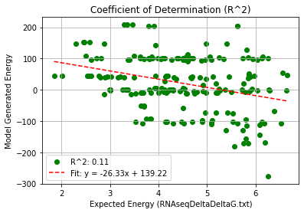
1AQ3(AS)_Triple Mutation – PHI 9.5
Pearson rank correlation coefficient: -0.326
Spearman rank correlation coefficient: -0.285
Coefficient of Determination (R^2): 0.107

Slide 14
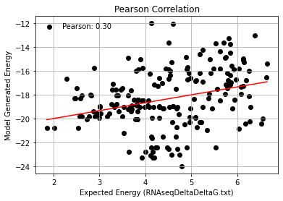
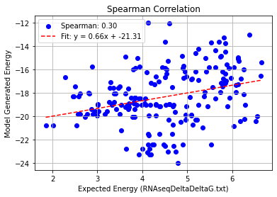
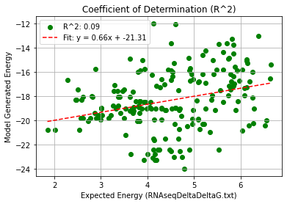
2BU1+1AQ3_Triple Mutation – PHI 9.5
Pearson rank correlation coefficient: 0.299
Spearman rank correlation coefficient: 0.299
Coefficient of Determination (R^2): 0.090

Slide 15
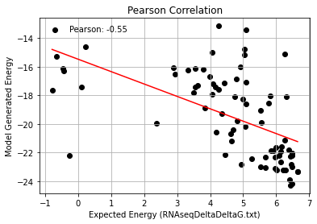
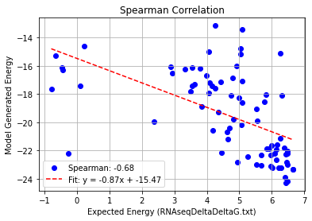
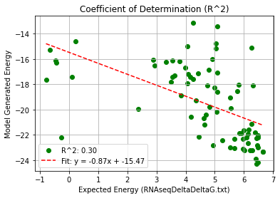
2BU1_Quadruple Mutation – PHI 9.5
Pearson rank correlation coefficient: -0.547
Spearman rank correlation coefficient: -0.683
Coefficient of Determination (R^2): 0.300

Slide 16
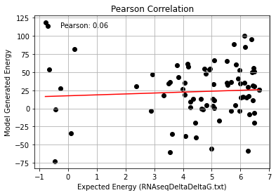
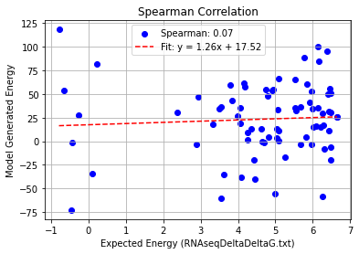
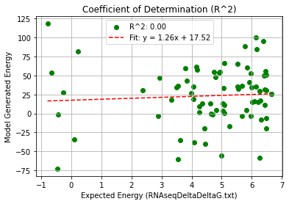
1AQ3_Quadruple Mutation – PHI 9.5
Pearson rank correlation coefficient: 0.063
Spearman rank correlation coefficient: 0.074
Coefficient of Determination (R^2): 0.004

Slide 17
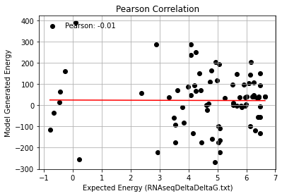
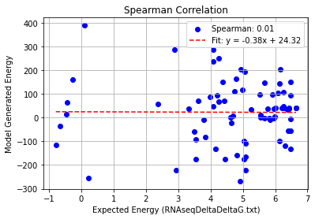
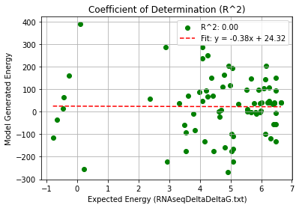
1AQ3(AS)_Quadruple Mutation – PHI 9.5
Pearson rank correlation coefficient: -0.006
Spearman rank correlation coefficient: 0.015
Coefficient of Determination (R^2): 0.000

Slide 18
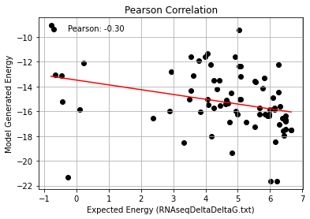
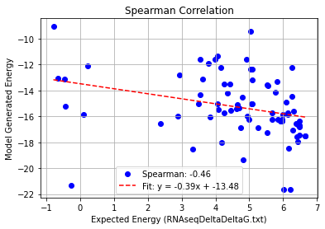

2BU1+1AQ3_Quadruple Mutation – PHI 9.5
Pearson rank correlation coefficient: -0.301
Spearman rank correlation coefficient: -0.463
Coefficient of Determination (R^2): 0.090

Slide 19



2BU1_Quintuple Mutation – PHI 9.5
Pearson rank correlation coefficient: -0.829
Spearman rank correlation coefficient: -0.738
Coefficient of Determination (R^2): 0.687

Slide 20



1AQ3_Quintuple Mutation – PHI 9.5
Pearson rank correlation coefficient: -0.205
Spearman rank correlation coefficient: -0.077
Coefficient of Determination (R^2): 0.042

Slide 21



1AQ3(AS)_Quintuple Mutation – PHI 9.5
Pearson rank correlation coefficient: 0.547
Spearman rank correlation coefficient: 0.513
Coefficient of Determination (R^2): 0.300

Slide 22



2BU1+1AQ3_Quintuple Mutation – PHI 9.5
Pearson rank correlation coefficient: -0.743
Spearman rank correlation coefficient: -0.777
Coefficient of Determination (R^2): 0.552

