Slide 1
2iz8 – RNA Complex

Slide 2
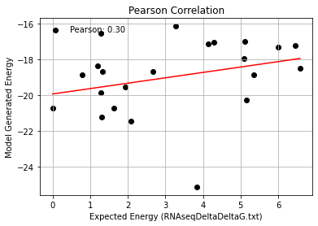
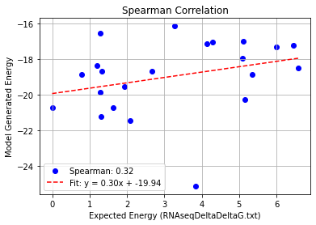
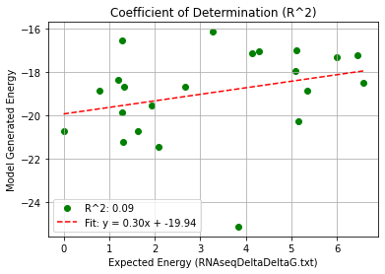
2iz8_Single Mutation (2bu1) – PHI 9.5
Pearson rank correlation coefficient: 0.297
Spearman rank correlation coefficient: 0.317
Coefficient of Determination (R^2): 0.088

Slide 3
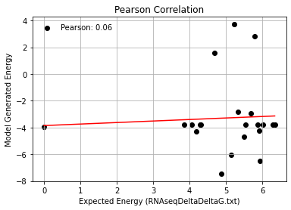
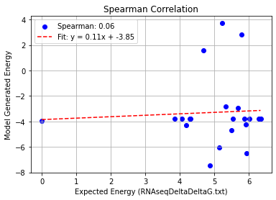
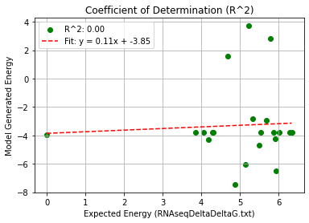
2iz8_Single Mutation (2iz8) – PHI 9.5
Pearson rank correlation coefficient: 0.056
Spearman rank correlation coefficient: 0.062
Coefficient of Determination (R^2): 0.003

Slide 4
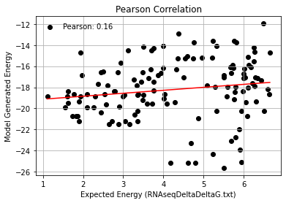
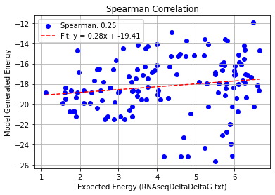
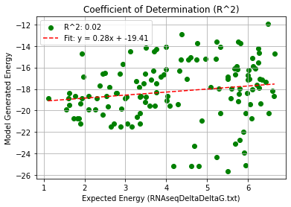
2iz8_Double Mutation (2bu1) – PHI 9.5
Pearson rank correlation coefficient: 0.158
Spearman rank correlation coefficient: 0.245
Coefficient of Determination (R^2): 0.025

Slide 5
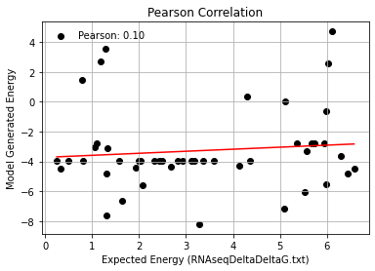
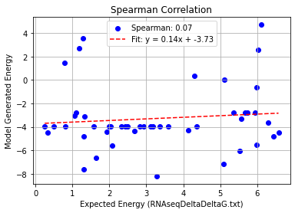
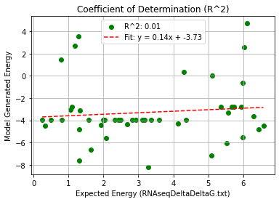
2iz8_Double Mutation (2iz8) – PHI 9.5
Pearson rank correlation coefficient: 0.101
Spearman rank correlation coefficient: 0.070
Coefficient of Determination (R^2): 0.010

Slide 6
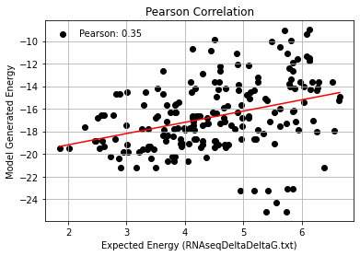
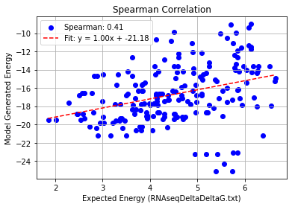
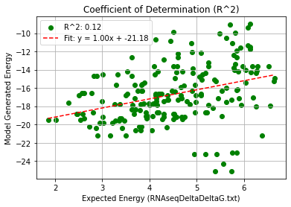
2iz8_Triple Mutation (2bu1) – PHI 9.5
Pearson rank correlation coefficient: 0.348
Spearman rank correlation coefficient: 0.408
Coefficient of Determination (R^2): 0.121

Slide 7
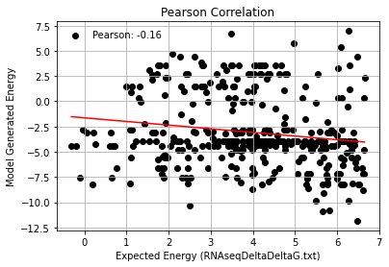
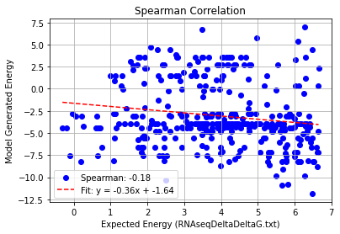
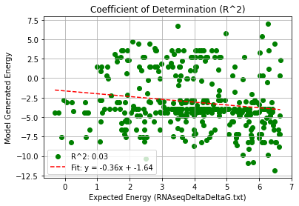
2iz8_Triple Mutation (2iz8) – PHI 9.5
Pearson rank correlation coefficient: -0.162
Spearman rank correlation coefficient: -0.185
Coefficient of Determination (R^2): 0.026

