Slide 1
1u1y - RNA Complex

Slide 2
1u1y Phi & Gamma Graphs
Gamma Randomization
Phis Native
Phis Decoy

Slide 3
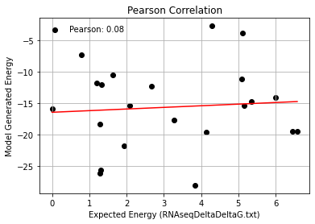
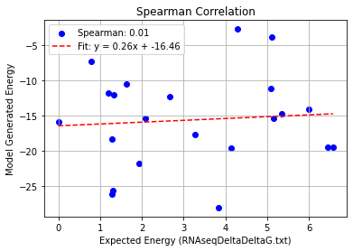
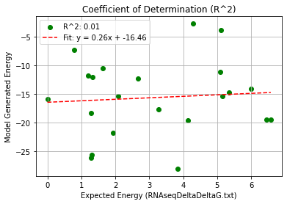
1U1Y(AS)_Single Mutation – PHI 9.5
Pearson rank correlation coefficient: 0.080
Spearman rank correlation coefficient: 0.014
Coefficient of Determination (R^2): 0.006

Slide 4
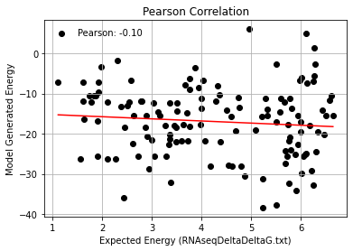
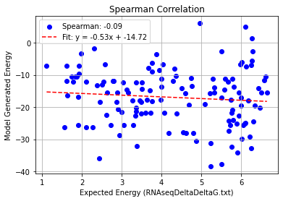
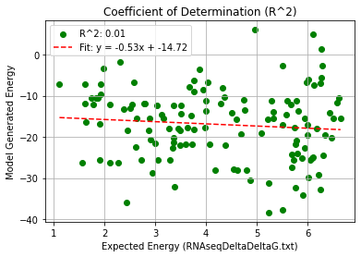
1U1Y(AS)_Double Mutation – PHI 9.5
Pearson rank correlation coefficient: -0.095
Spearman rank correlation coefficient: -0.088
Coefficient of Determination (R^2): 0.009

Slide 5
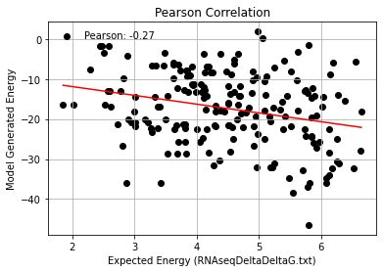
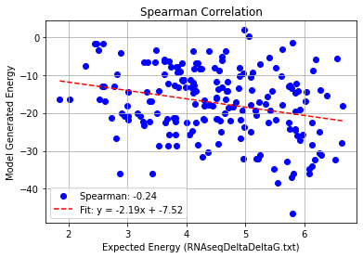
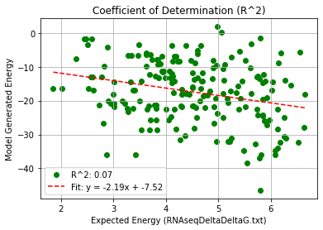
1U1Y(AS)_Triple Mutation – PHI 9.5
Pearson rank correlation coefficient: -0.266
Spearman rank correlation coefficient: -0.240
Coefficient of Determination (R^2): 0.071

Slide 6
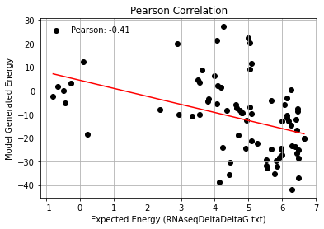
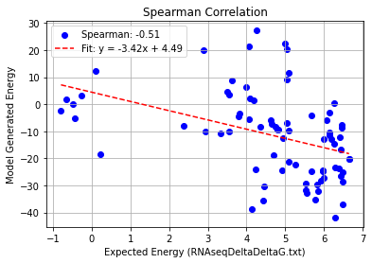
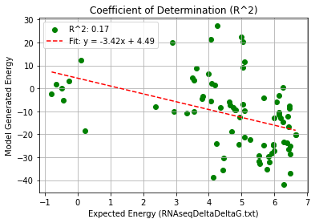
1U1Y(AS)_Quadruble Mutation – PHI 9.5
Pearson rank correlation coefficient: -0.413
Spearman rank correlation coefficient: -0.512
Coefficient of Determination (R^2): 0.171

Slide 7
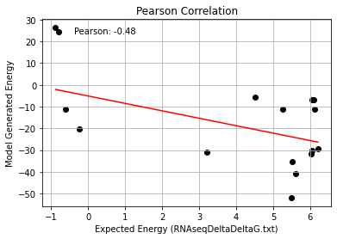
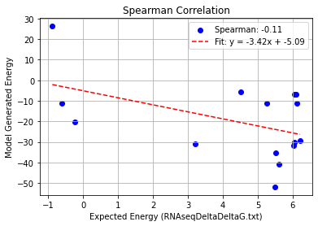
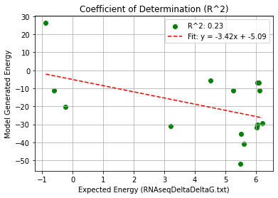
1U1Y(AS)_Quintuple Mutation – PHI 9.5
Pearson rank correlation coefficient: -0.520
Spearman rank correlation coefficient: -0.377
Coefficient of Determination (R^2): 0.271

Slide 8
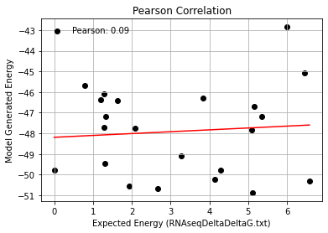
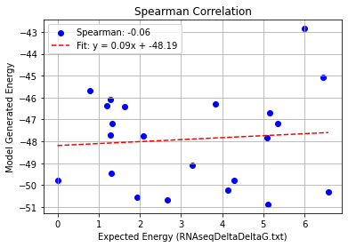
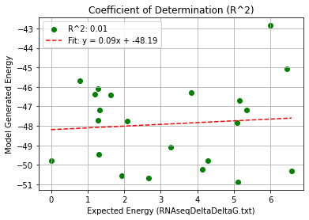
2BU1+1U1Y_Single Mutation – PHI 9.5
Pearson rank correlation coefficient: 0.086
Spearman rank correlation coefficient: -0.058
Coefficient of Determination (R^2): 0.007

Slide 9
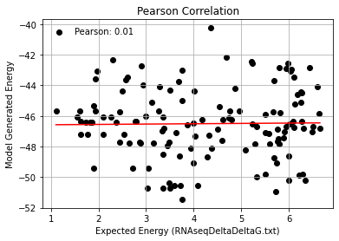
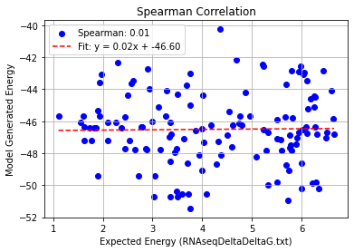
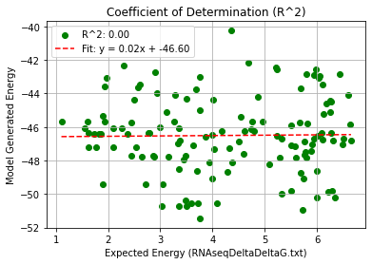
2BU1+1U1Y_Double Mutation – PHI 9.5
Pearson rank correlation coefficient: 0.015
Spearman rank correlation coefficient: 0.007
Coefficient of Determination (R^2): 0.000

Slide 10
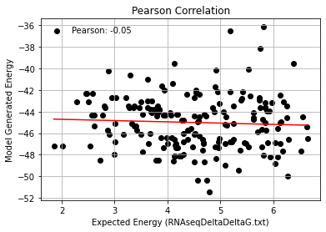
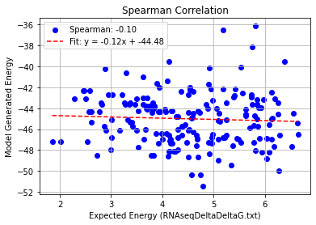
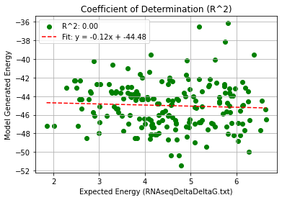
2BU1+1U1Y_Triple Mutation – PHI 9.5
Pearson rank correlation coefficient: -0.053
Spearman rank correlation coefficient: -0.103
Coefficient of Determination (R^2): 0.003

Slide 11
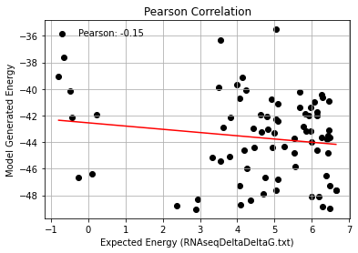
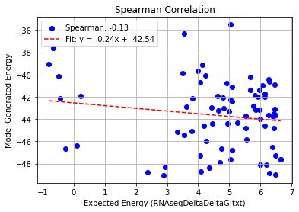
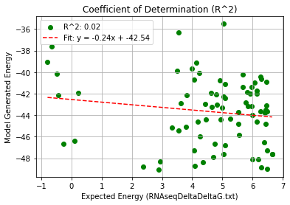
2BU1+1U1Y_Quadruple Mutation – PHI 9.5
Pearson rank correlation coefficient: -0.148
Spearman rank correlation coefficient: -0.133
Coefficient of Determination (R^2): 0.022

Slide 12
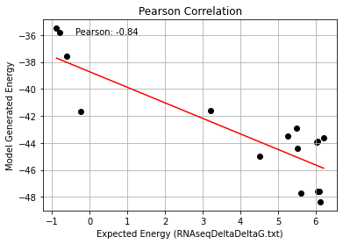
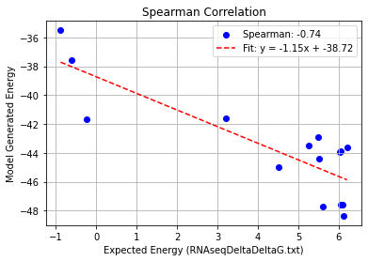
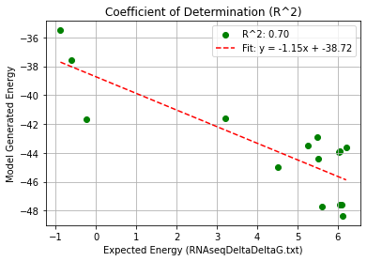
2BU1+1U1Y_Quintuple Mutation – PHI 9.5
Pearson rank correlation coefficient: -0.837
Spearman rank correlation coefficient: -0.738
Coefficient of Determination (R^2): 0.700

