Slide 1
MS2 – RNA Complex
2BU1, 2C4Q, 2IZM, 2C51, 2C50, 2IZ8, 2IZN

Slide 2
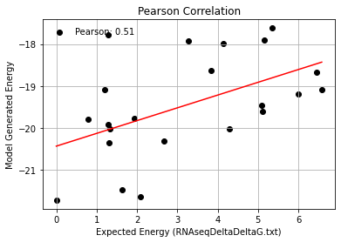
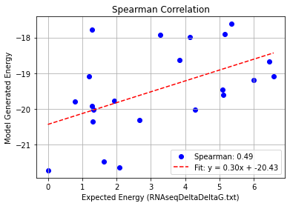
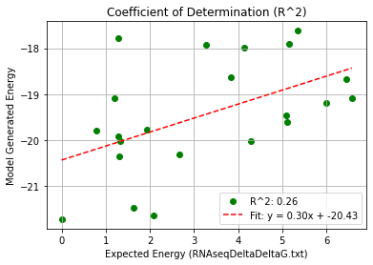
MS2_Single Mutation (2bu1) – PHI 9.5
Pearson rank correlation coefficient: 0.511
Spearman rank correlation coefficient: 0.488
Coefficient of Determination (R^2): 0.261

Slide 3
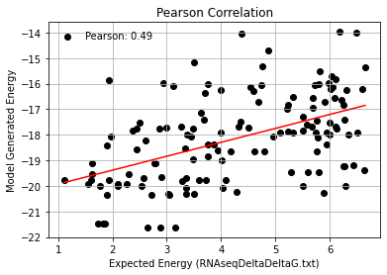
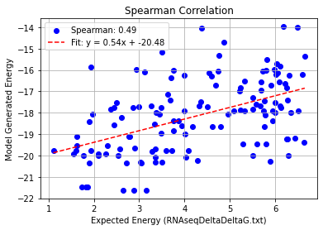
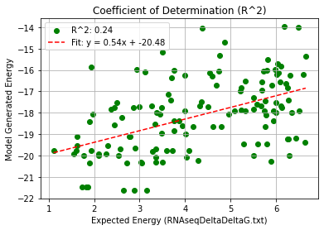
MS2_Double Mutation (2bu1) – PHI 9.5
Pearson rank correlation coefficient: 0.493
Spearman rank correlation coefficient: 0.490
Coefficient of Determination (R^2): 0.243

Slide 4
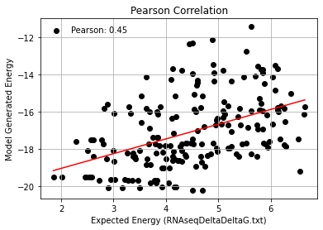
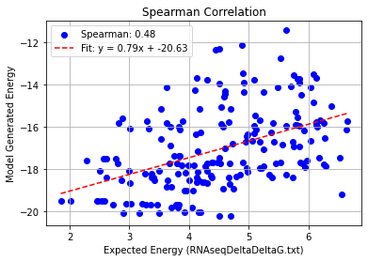
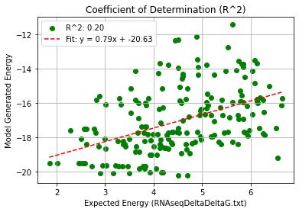
MS2_Triple Mutation (2bu1) – PHI 9.5
Pearson rank correlation coefficient: 0.452
Spearman rank correlation coefficient: 0.476
Coefficient of Determination (R^2): 0.204

Slide 5
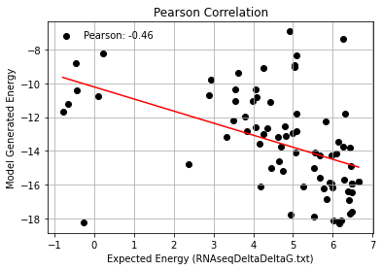
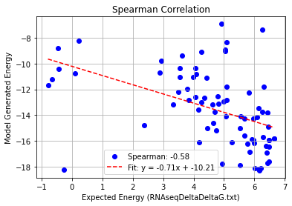
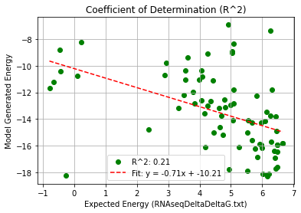
MS2_Quadruple Mutation (2bu1) – PHI 9.5
Pearson rank correlation coefficient: -0.463
Spearman rank correlation coefficient: -0.583
Coefficient of Determination (R^2): 0.215

